Slide 1
AmeriHealth Caritas Pennsylvania Community HealthChoices
Presented by:
Christopher Bruette, Director of Provider Network Long-Term Services and Supports
Steve Orndorff, Director of Provider Network Management
Jill Blessington, Director of Provider Network Management

Slide 2
Rooted.
We began as a mission-driven neighborhood health plan in West Philadelphia and are proud of our passion to serve those most in need.
Multifaceted.
Providing Medicaid, pharmacy benefit, long-term services and supports (LTSS), and administrative services.
Nimble.
Customizing solutions based on our Participants’ and partners’ needs.
Evolving.
An industry thought leader giving its customers the edge with innovative, evidence-based products and services.
AmeriHealth Caritas

Slide 3
AmeriHealth Caritas Pennsylvania (PA) Community HealthChoices (CHC)
AmeriHealth Caritas PA CHC Leadership Team
Pattie Wright – Administrator
Susan McAllister, MD – Chief Medical Officer
Michelle Murphy, PharmD – Pharmacy Director
Danielle Bruette, RN – Director of Quality Management LTSS
Jennifer Rogers – Director of LTSS
Christopher Bruette – Director of Provider Network LTSS
Stephen Orndorff – Director of Provider Network Management
Jill Blessington – Director of Provider Network Management
Together, our team has extensive experience and knowledge in implementation and management of Medicaid, Medicare, LTSS and Waiver services.
Our leadership staff is fully supported by a team of talented individuals in our Philadelphia, Harrisburg and Pittsburgh offices.

Slide 4
Preparing for Readiness Review and Implementation
We are proud to be part of the Phase 3 CHC implementation. We have a dedicated Readiness Review team that meets on a regular basis in preparation for the January 1, 2020 Phase 3 CHC launch.
While we regularly review and update our policies and procedures to demonstrate how we continue to meet and exceed the CHC contractual requirements, we are also working diligently to prepare our staff for CHC in Phase 3.
We continue to attend Managed Long-Term Services and Supports (MLTSS) Subcommittee meetings, 3rd Thursday webinars, meet & greet sessions, Office of Long-Term Living (OLTL) community education and technical assistance sessions. Knowledge gained at these events along with lessons learned during the Southwest and Southeast CHC implementation will be beneficial for the Phase 3 launch.
We have incorporated feedback, comments and suggestions from providers, OLTL, MLTSS Subcommittee, and CHC community stakeholders into our preparations for Phase 3 Readiness Review.

Slide 5
Provider Support and Partnership
Work with participating HealthChoices providers to obtain contracts to help ensure that all Participants continue to receive their services, without interruption, as we implement Phase 3 CHC.
Meet with providers to understand their concerns related to general program and operational requirements, help identify potential service gaps, and brainstorm delivery of service ideas.
Collaborate with providers and associations on how we can provide support and education on topics they identify, to help their staff better serve CHC Participants.
Maintain a dedicated CHC provider mailbox chcproviders@amerihealthcaritas.com for providers to submit questions and requests to join the AmeriHealth Caritas PA CHC network.

Slide 6
Provider Training Topics
Claims and billing.
Change Healthcare.
Provider WebConnect.
HHAeXhange.
Claim testing.
Contracting support.
Critical incident reporting.
Cultural Competency.
Key departments and resources.
Verifying eligibility.
Prior authorization.
Provider disputes and appeals.
In-person and webinar trainings will occur during the 3rd and 4th quarters of 2019.
Ongoing support and training will continue post implementation, January 1, 2020.

Slide 7
Provider Contracting
We recognize that our providers play a vital role to the success of CHC and the health and well-being of our Participants.
All LTSS providers who provide home- and community-based services (HCBS) services must be enrolled in the Pennsylvania Medical Assistance program under provider type 59. Nursing facilities must be enrolled under provider type 03.
Providers must also have a current, active, service location extension for each office and specialty:
Home- and community-based services.
Service coordination entities.
Transportation, meals etc.
Nursing facilities.
Provider contract mailings are ongoing.
Please submit all requests and documents to the dedicated CHC provider mailbox chcproviders@amerihealthcaritas.com.

Slide 8
Provider Network Account Executives
AmeriHealth Caritas PA CHC has a dedicated Provider Services department to answer network provider concerns and offer assistance.
Provider Network Account Executives have experience with both physical health and LTSS services to:
Support, advise and educate our providers.
Provide on-site claims process support to help ensure prompt payment for rendered services.
Account Executives will provide training and education for all providers pre- and post- implementation through:
Face-to-face meetings.
Provider forums.
Webinars.
Association-hosted meetings.

Slide 9
Southwest Zone
Southwest
Total membership 15,291
Dates of service 01/01/18 – 03/01/19
Provider type | Paid $ | Claims | Average turnaround time for claims payment
Home-and community-based | $78,270,944.70 | 624,102 | 9 days
Nursing facility | $183,632,157.02 | 73,416 | 16 days
Physical health | $20,320,386.46 | 1,071,193 | 21 days
Total | $282,223,488.18 | 1,768,711 | 15 days

Slide 10
Southeast Zone
Southeast
Total membership 72,411
Dates of service 01/01/19 – 03/01/19
Provider type | Paid $ | Claims | Average turnaround time for claims payment
Home-and community based | $190,853,713.09 | 1,325,493 | 11 days
Nursing facility | $39,497,545.70 | 10,366 | 12 days
Physical health | $43,345,160.65 | 424,307 | 18 days
Total | $273,696,419.44 | 1,760,166 | 14 days

Slide 11
Medicare and Medicaid Dual Eligible Participants
MEDICARE
MEDICAID

Slide 12
Nursing Facility Ineligible
Nursing Facility Ineligible is defined as having clinical needs that do not require a level of care provided in a nursing facility.
21 years of age and older.
Community Well Duals (CWD).
Medicare/Medicaid.
May be Aligned DSNP, Unaligned DSNP, or Fee-for-Service (FFS).
Have the adult medical benefits in the assigned plan’s CHC package.
Not eligible for the LTSS benefits.
Will be screened on enrollment for unmet needs.
Will receive active care coordination during acute/episodic changes in health.

Slide 13
Dual-Eligible Special Needs Plan (D-SNP)
A Dual Eligible Special Needs Plan (D-SNP) is a Medicare Advantage Plan that primarily or exclusively enrolls individuals who are enrolled in both Medicare and Medical Assistance (Medicaid).
Community Well Dual (CWD) Participants.
Participants who are Nursing Facility Ineligible or Nursing Facility Clinically Eligible who have Medicare and Medicaid can choose a D-SNP.
Participants may choose a D-SNP that is aligned or unaligned with the Plan or remain in Medicare fee-for-service.

Slide 14
D-SNP goal
The goal of AmeriHealth Caritas PA CHC and its companion D-SNP (AmeriHealth Caritas VIP Care) is to provide a coordinated experience from the perspective of full Dual Eligible Participants who enroll in both.
Includes, but is not limited to an integrated assessment and care coordination process that spans all Medical Assistance (Medicaid) and Medicare services.
Administrative integration is expected to evolve over the life of CHC.
AmeriHealth Caritas PA CHC will cooperate fully with Department of Human Services (DHS) and Centers for Medicare and Medicaid Services (CMS) in ongoing efforts to streamline administration of the two programs, which may include, but is not limited to, coordinated readiness reviews, monitoring, enrollment, Participant materials and appeals processes.

Slide 15
Managing Care of our LTSS and Community Well Dual Participants
Managed LTSS (MLTSS)
Service Coordination for NFCE
(Nursing Facility Clinically Eligible)
Service Coordinator’s role is personal with
face-to-face contact to:
Help Participants navigate the system and coordinate their care.
Be the single point of contact for Participants.
Provide information to the Participants, Supports, and Providers.
Facilitate needed access, location, coordination and monitoring services and supports.
Community Well Duals (CWD)
Care Coordination for the CWDs
(Nursing Facility Ineligible)
Care Coordinator’s role with CWD Participants is to:
Screen and identify CWD Participants who may have unmet needs.
Refer CWD Participants for possible LTSS enrollment.
Provide active coordination during acute/episodic changes in health.
Facilitate needed access, location and coordinating care with Medicare and Medicaid providers and benefits.

Slide 16
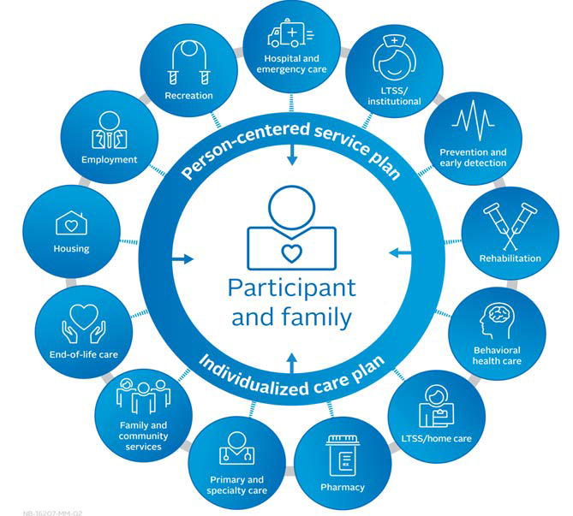
Person-Centered Approach to Participant Care
Our multifaceted approach addresses the needs of Participants, connecting them with health and LTSS services to maximize independence. Our approach includes:
Providing Participants with health care services that are respectful of and responsive to their health beliefs and practices and cultural and linguistic needs.
Engaging, educating, and empowering Participants to actively participate in improving their health outcomes.
Helping ensure services and supports are consumer-directed and family focused.
Involving Participants, caregivers, providers, behavioral health care, and representatives from housing, employment and social service systems in the care planning and management process.
Using community-based services to avoid or delay institutional care, supporting members who desire to remain in a home- and community-based setting.

Slide 17
Thank You!

