Slide 1
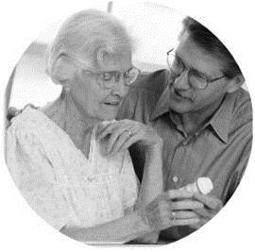
Phase 3 Provider Summits
Transforming the Health of the Community One Person at a Time
May 2019
Confidential and Proprietary Information

Slide 2

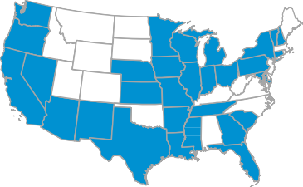



Who is PHW?
WHO WE ARE
WHAT WE DO
Pennsylvania
based company and subsidiary
of Centene Corporation
31 states
with government sponsored healthcare programs & implementations
600 employees between the SW and SE Regions
Medicaid (25 states)
Medicare (20 States)
SNP
(6 States)
Marketplace ( 18 States)
10 States
Over 300,000 LTSS Members
Largest MLTSS plan in country
2 international markets
14.4 million members
includes 2.9 million TRICARE eligibles
Iowa LTSS program starts 7/1/2019
LOCAL
Headquartered in Camp Hill, PA
Offices Statewide
STRONG
Backed by Fortune #66 CENTENE
Notes:
In 1984, when Elizabeth “Betty” Brinn founded a single Medicaid plan in Milwaukee, women owned just 10% of U.S. businesses. That fact didn’t discourage her; she wanted to help people who were falling through the cracks of the healthcare system. For Brinn, the challenge also presented a way to provide employment opportunities for women returning to the workplace.
Today, Centene, the company Brinn founded, is proud to be one of the largest healthcare companies in the world, providing healthcare programs to more than 14 million individuals.
We are a leader in healthcare with a comprehensive portfolio of innovative solutions which includes coverage for Medicaid, Medicare and the Health Insurance Marketplace. We also contract with other healthcare and commercial organizations to provide specialty services to help people attain better health and quality of life.
Candid Communication - We value diversity and trust in all aspects of our business. This is built through appropriate disclosure, honesty and consideration in all forms of communication and at all levels.
Purposeful Innovation - We will always look for, find and implement unique solutions that improve our business and reward our stakeholders.
Growth - We will achieve our Vision through clear and consistent decision making and strategies that produce reliable results for our customers and shareholders.
Entrepreneurial Spirit - We embrace the drive, creativity and open-mindedness of our people. We empower all individuals to take ownership of the business, at all levels.

Slide 3
PA Health & Wellness (PHW)
Transforming the health of the communities
we serve one person at a time
OUR MISSION
Better health outcomes at lower costs
OUR BRAND PILLARS
Focus on individuals + Active Local Involvement + Whole Health
OUR BELIEFS
We believe in treating the whole person, not just the physical body. We believe treating people with kindness, respect and dignity empowers healthy decisions. | We believe we have a responsibility to remove barriers and make it simple to get well, stay well and be well. | We believe local partnerships enables meaningful, accessible healthcare. We believe healthier individuals create more vibrant families and communities.
Notes:
We believe that we must focus on the whole person when transforming healthcare, not just the physical body.
Health care delivery drives only 20 percent of health outcomes, with behavioral and social determinants — including income, living environment, employment status, and access to transportation and healthy food — playing a much bigger role in overall health.
We have initiated the process. Working closely with community partners we have already engaged in:
A pilot to improve access to employment training services and supports;
Developed a program to improve the supports provided by DCWs and hopefully reduce the turn-over rate;
An alternative payment process for brain injury providers;
And, we are exploring affordable and accessible housing options.

Slide 4



PHW Values
LOCAL APPROACH & JOB CREATION
Quality healthcare is best delivered locally and supported by local representatives.
CARE COORDINATION
Our proprietary service coordination ensures members receive the right care, in the right place, at the right time.
HEALTHCARE COMPLIANCE
State and Healthcare Effectiveness Data and Information Set (HEDIS) reporting constitutes the core of the information base that drives our clinical quality performance efforts.
Cultural Sensitivity
Recognize significance of the many different cultures our members represent and form partnerships in communities that bridge social, ethnic and economic gaps.
Notes:
PHW has hired over 600 individuals, all based in PA.
We are committed to a service coordination model that understands PA and its resources. This is critical as we assist some of the state’s most vulnerable older adults and people with disabilities to connect to appropriate supports in order to live in their own community safely and independently.
Compliance is the foundation of our organization. PHW compliance program includes the prevention, detection and resolution of instances of conduct that do not conform to federal and state law, contract requirements and PHW’s ethical business practices.
Cultural Sensitivity - At PHW, we are singularly focused in our purpose - transforming the health of our communities, one person at a time. In order to deliver culturally sensitive healthcare to our members, we depend on the diverse ideas, experiences and cultures that our company's more than 32,000 employees across the U.S. bring to the workplace.

Slide 5

How are We Doing?
Lessons Learned…
Provider Training
Claims Submission Via PHW Portal
Service Coordination Portal & Quality Measures
Person-Centered Service Plans
CHC Service Options
Claims Processing Improvement
Internal Systems
Authorization Turnarounds
Rapid Response Team
Transportation
Who to Call
OHCDS Process
Missed Transportation Resolution

Slide 6

Phase 3 Priorities
CONTINUITY OF CARE
Participants get appropriate and timely services
Providers get accurate
and timely payments
Notes:
In January 2018, there was a single focus – Participants getting services and providers getting paid. – This continues to be our mantra at PHW.

Slide 7
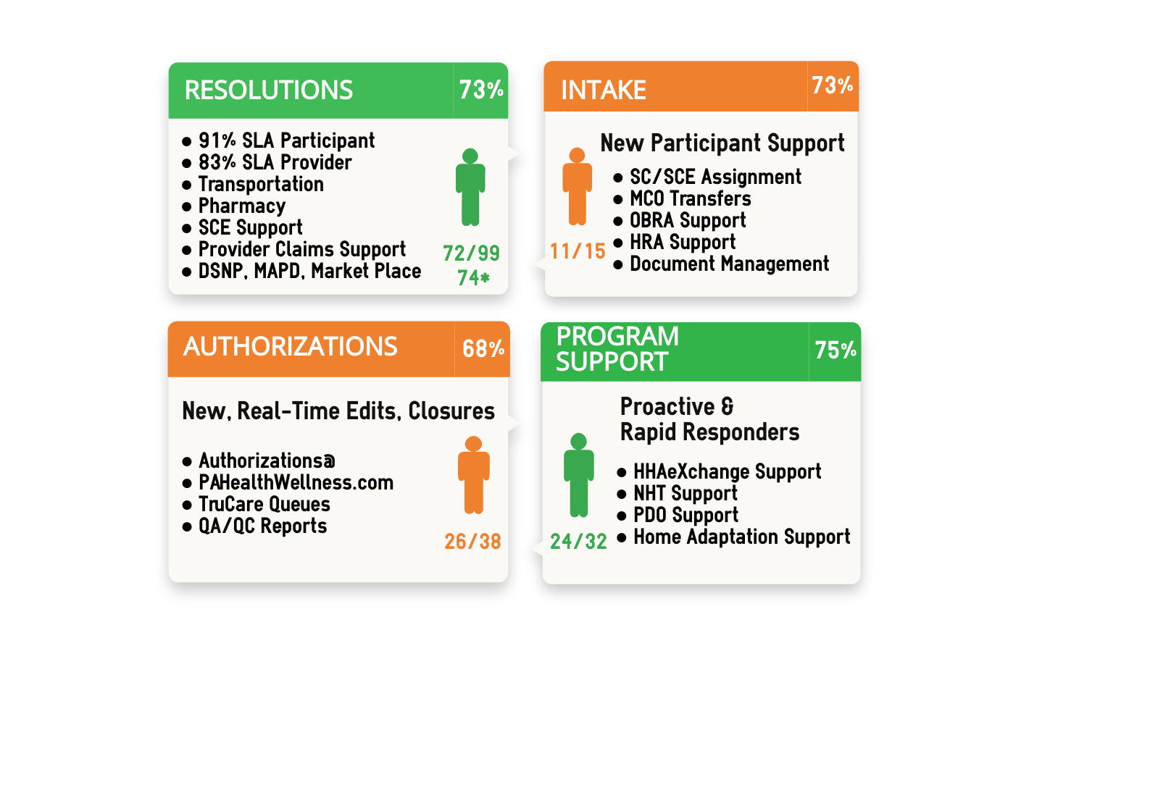
Participants Get Services
SERVICE LEVELS
Year | Line | MTD | YTD | # Calls
2019 | Participant | 87% | 88% | 81K YTD
 | Provider | 88% | 85%
2018 | Participant | 93% |  | 80K Calls
 | Provider | 94%
One Call Resolution
COC Service Authorizations:
100% COC Auths Created Prior to go-live
100% Auths sent to HHAX
SW: 79k Auths (2018 total)
SE: 60k Auths (1/1/2019)
Nursing Home Transitions
Participants transitioned
2018: 137 Total
2019: 56 YTD

Slide 8
Providers Get Paid
2019 Q1
883,000 Claims Received
6.58 Day Adjudication TAT
92% Auto Adjudication Rate
97% Claims processed through EDI
DENIAL REASON | %
DUPLICATE CLAIM SERVICE | 21%
TIMELY FILING LIMIT | 18%
SERVICES NOT ON THE FEE SCHEDULE | 9%
BILL PRIMARY INSURER 1ST (EOB) | 9%
SERVICE NOT REIMBURSABLE IN LOCATION BILLED | 6%
TOP 5 DENIALS TOTAL) | 63%
Summary
Status | Metric
DENIED | 8%
PAID | 89%
PEND | 0.3%
REJECTED | 3%
Notes:
For each SCE, PA Health & Wellness works with their administration to identify several staff that will work as SCE Admins. This short video outlines the process of setting up accounts.
An Admin will have the responsibility of setting up user accounts in the Envolve Client Web Portal staff for the SCE with so the work with your members can get documented and submitted. {CLIP OF ECWP}
Admins will set up accounts and also have the ability to work with member records in Envolve.
This multiple step process has been set-up to ensure the security of information for our members.
SCE admins will experience this exact process while having their accounts set-up, then will replicate it as they work with their staff.
This video provides a refresher for SCE admins, but is also a great tool for any staff being set up in accounts so they become familiar with the process which will lead to greater success.

Slide 9


Customer Service & Claims
Average TIME TO ANSWER
    Participants- 4 seconds
    Providers- 4 seconds
AVERAGE SERVICE LEVEL
    Participant- 98%
    Providers- 98%
CLAIMS PROCESSED SINCE JANUARY 1, 2018
    More than 2,200,000 claims processed
      $545 million paid to providers
      Nearly $33 million paid to PPL for direct care workers
  Average TURN AROUND TIME ON CLEAN CLAIMS
    6.6 days

Slide 10
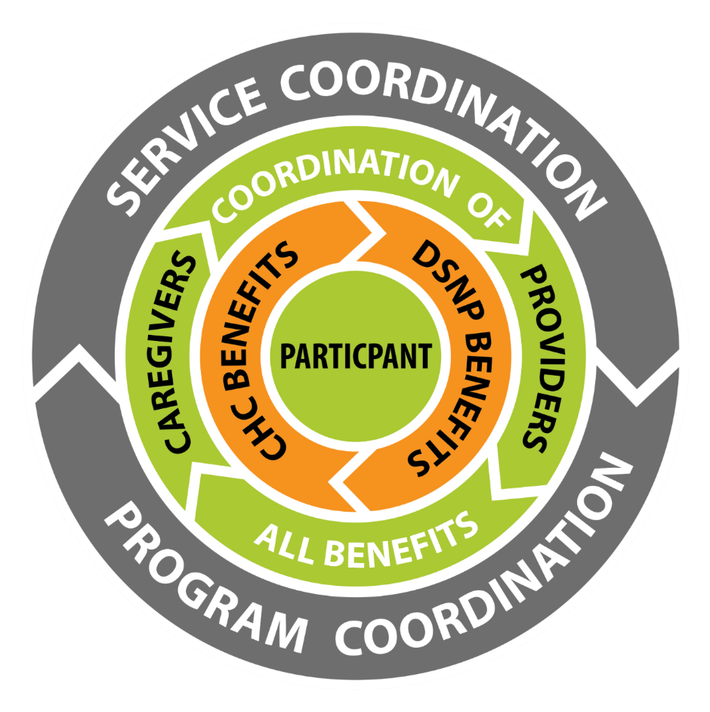

Service Coordination
PHW’s approach:
        Support a Community-Based SC Model
        Assigned SC Account Managers
        Internal NPO Approach
        Drive QUALITY across the marketplace
        Established Service Level Agreements with all participating SCEs
        Introduction of PMPM payment methodology
Notes:
100% of Provider’s Service Coordinators will meet or exceed CHC SC qualification standards.
100% of Provider’s Service Coordinators will complete PHW service coordination initial training requirements.
100% of Provider’s Service Coordinators will complete PHW service coordination annual training requirements.
>90% of participants reviewed in documentation audits will score as meeting >90% of PHW documentation requirements checklist.
>95% of participants served by Provider that received a complete New PCSP within 48-hours or next business day, whichever is later, of new or updated comprehensive needs assessment excluding PHW approved holidays and weekends.
>95% of participants served by Provider will receive an updated Comprehensive Needs Assessment (interRAI) within triggering event turn-around-time (TAT).
>95% of participants served by Provider will complete and receive a signed copy of their PCSP within 48 hours or the next business day, whichever is later, of an updated Comprehensive Needs Assessment (interRAI) excluding PHW approved holidays and weekends.
>95% of participants served by Provider will demonstrate documented evidence of Provider support in maintaining annual clinical and financial CHC eligibility.

Slide 11
Medicare
A goal of Community HealthChoices is to align and coordinate participants’ Medicare and Medicaid benefits
One card, one-stop shop for assistance
More services for no cost
D-SNP participants will have more services covered by Medicare that would not have to be covered by CHC
Continuous service and delivery improvements for the participants
Dental Benefits¹
Vision Benefits¹
Transportation
to and from Approved Locations
Allowance for
Over-The-Counter items
Meal Benefit
Notes:
Allwell is our physical health Medicare Advantage plan. Providing quality healthcare at the local level. Our participants benefit from strategic care coordination and programs through the strong and collaborative relationships built with healthcare providers and community organizations.

Slide 12
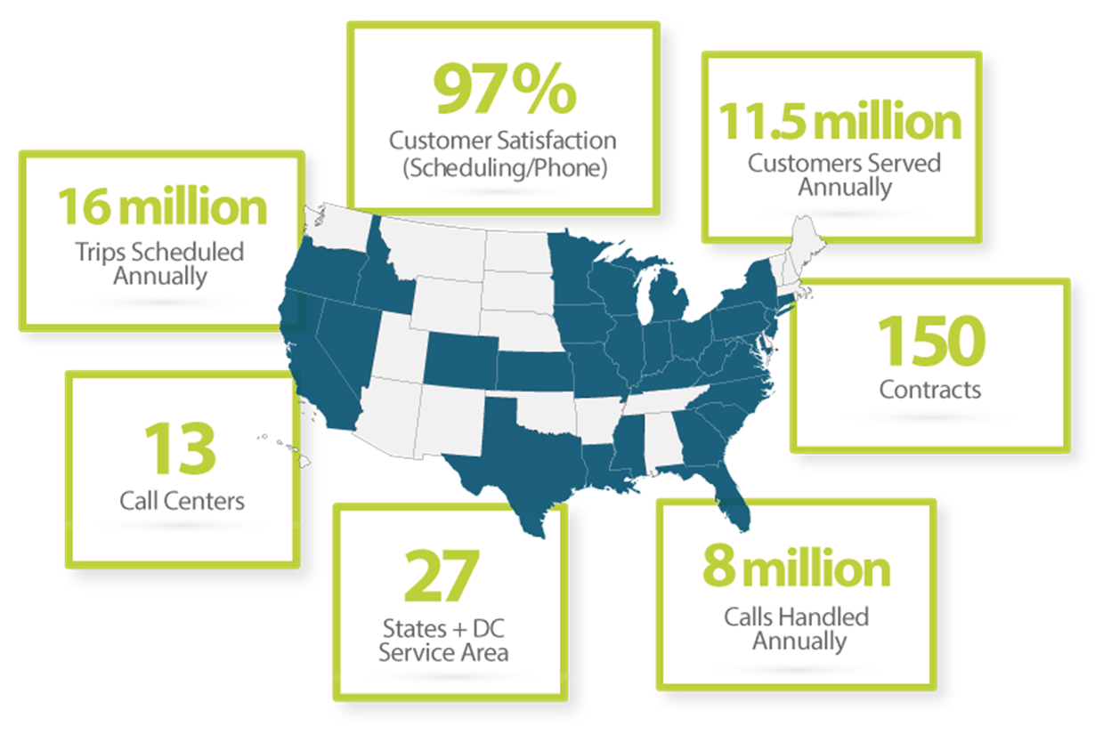
CHC Non-Medical Transport
Notes:
GOALS:
Eliminate barriers to health care
Ensure continuity of care
Assist in member recruitment & retention
Reduce potential for fraud, waste & abuse
WHO IS MTM?:
Established in 1995 Family owned & operated
2nd largest NMT company
Extensive experience managing large transportation programs
Only manages Medicaid & Medicare NMT benefit under contracts with state agencies & health plans

Slide 13

How We Support You…
CALL CENTER
ON-SITE
TRAININGS
WEBINARS
LOCAL REPS
SUPPORT:
Pre go-live
Post go-live
On-going
Participant needs or concerns
Service related matters
Critical Incidents
Admits/Discharges/Changes in Conditions
Authorization Corrections, Updates & Changes, Claim-Auth Related
Notes:
Provider related challenges pertaining to participants
All calls are documented and providers given a tracking number
Conducted in REAL TIME

Slide 14
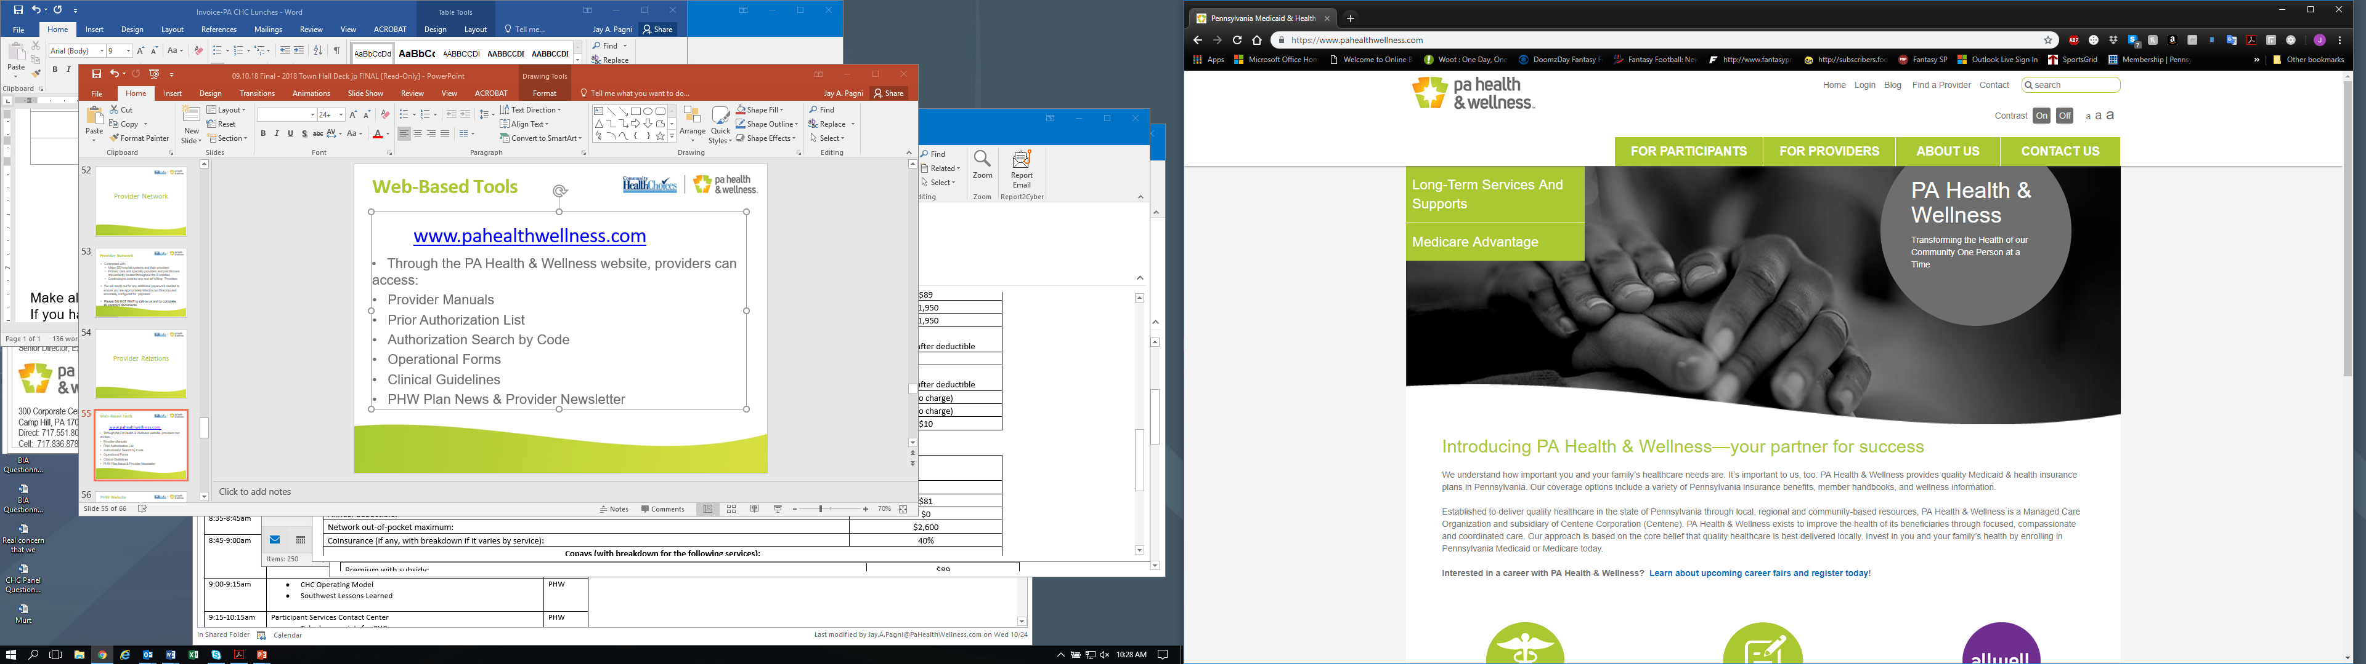
Web-Based Tools
www.pahealthwellness.com
Provider Manuals
Prior Authorization List
Authorization Search by Code
Operational Forms
Clinical Guidelines
PHW Plan News & Provider Newsletter
Training Opportunities

Slide 15
How We Support You…
BEFORE GO-LIVE
NEGOTIATORS - CONTRACTING SUPPORT
PRE AND POST GO LIVE
PROVIDER REPS - BILLING/CLAIMS SUPPORT
ONGOING SUPPORT
SERVICE COORDINATION – ONSITE VISITS
ANY
TIME SUPPORT
PROGRAM COORDINATION TEAM (PCs)
844-626-6813 OPTION 2 or 3

Slide 16
Provider Network
Contracted with:
  Major hospital systems and their providers
  Primary care and specialty providers and practitioners
  LTSS Providers including NF, Adult Day, SCE, etc.
  Continuing to contract any and all Willing Providers
  We will reach out for any additional paperwork needed to ensure you are appropriately listed in our Directory and accurately configured for payment
  Please DO NOT WAIT to talk to us and to complete all contract documents
Notes:
Specifics TBD

Slide 17
ARE YOU
CONTRACTED?
information@PAHealthWellness.com

Slide 18
For More Information
ANNA KEITH
VP, COMMUNITY RELATIONS & MARKETING
(717) 551- 8094
Anna.M.Keith@PAHealthWellness.com
NORRIS BENNS
VP, GOVERNMENT RELATIONS
(717) 551-8005
Norris.E.Benns@PAHealthWellness.com
JAY PAGNI
SR. DIRECTOR, BUSINESS DEVELOPMENT
(717) 551-8041
Jay.A.Pagni@PAHealthWellness.com

