Slide 1
Community HealthChoices Overview
Phase 3 Provider Meetings
Brendan Harris, VP of Government Programs, CE/NE PA

Slide 2
UPMC Community HealthChoices
Brendan Harris, VP/GM Government Programs
Jacquelyn Smith, AVP LTSS Clinical Operation
Andrea Farrell, Director, Ancillary and LTSS Network
Josh Hovanec, Manager, LTSS/HCBS Network
Danielle Rupert, PAE, Nursing Facilities
David Gingerich, Director CHC MCO Integration
Matt Jennings, Director Strategic Planning

Slide 3


Integrated Delivery & Finance System
UPMC HEALTH
SERVICES DIVISION
UPMC
ENTERPRISES
UPMC INSURANCE SERVICES DIVISION
UPMC HEALTH
INTERNATIONAL

Slide 4

Integrated Delivery and Finance System
Integrated system with a world-class academic medical center, affiliated with the University of Pittsburgh
UPMC HEALTH
SERVICES DIVISION
UPMC
ENTERPRISES
UPMC INSURANCE SERVICES DIVISION
UPMC INTERNATIONAL
About UPMC
More than 140 hospitals (including 40+ UPMC-owned hospitals)
and 29,000 providers.
UPMC provides more than $900 million a year in benefits to its communities, including more care to the region’s most vulnerable citizens than any other health care institution.
700 doctors’ offices and outpatient sites, and 60 UPMC Hillman Cancer Center locations.
Region’s largest network of rehabilitation services.
More than 4.7 million outpatient visits.
41 percent medical-surgical market share in western Pennsylvania.
UPMC is the largest non-governmental employer in Pennsylvania, with 87,000 employees.
About UPMC Insurance Services Division
More than 3.5 million members (current state).
CY 2018 operating revenue was $9.0 billion (an increase of 19.7 percent).
Financial strength rating of A- (excellent) from A.M. Best.
More than 13,000 employer groups.
35 percent market share in western Pennsylvania.
The largest behavioral health insurance provider in the nation.
A full product portfolio: HMO, PPO, EPO, HSA, dental, vision, COBRA, workers’ compensation, absence management, EAP, and more.
More than 97 percent of hospitals and other facilities, as well as more than 98 percent of physicians in western Pennsylvania.
More than 65,000 network pharmacies nationwide.

Slide 5
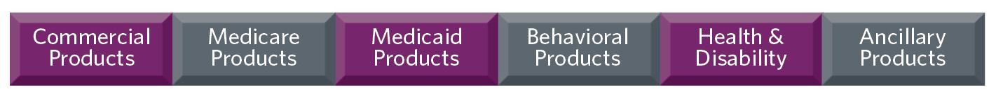
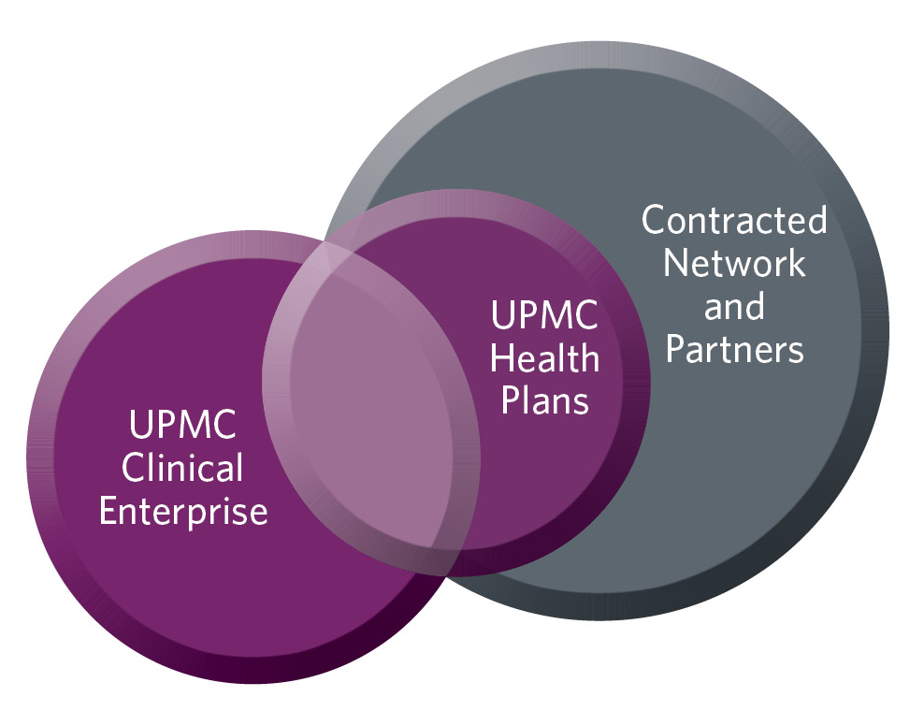
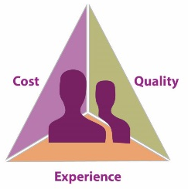
About UPMC Health Plan
Large Network Anchored by UPMC
UPMC Insurance Services
UPMC Health Plan
Community Care Behavioral Health
UPMC for Life
UPMC for Life Special Needs
UPMC for You
UPMC for Kids
UPMC Community HealthChoices
UPMC Dental Advantage
Workers’ Compensation Solutions
UPMC WorkPartners
EAP LifeSolutions
MyFlex Advantage
2nd Largest in Provider Led Plan Nation
3rd Largest Insurer Operating in PA
Over 3.5 M Members
Fastest growing Medicaid and CHIP Plan
Top tier Medicaid plan in PA
4 Star Medicare Dual Special Needs Plan
10th Largest SNP Nationally
Top 10 Nationally in Medicaid Quality
Highest Ranked Provider Satisfaction (PA)
J.D. Power Certified Call Center

Slide 6

UPMC’s Approach to CHC
D-SNP Platform and Experience
  Large D-SNP dating back to 2006
  Quality leadership with CMS 4 Star rating
  Innovative clinical programming
  Provider partnership
Integrated Financing and Delivery System
  Payer-provider relationship propels shift away from volume-based care
  Deep partnership with UPMC Health System and laboratory for innovation
  Value-based partnerships fueled by continuous learning model
Community Partnerships
  Work with behavioral health
  Quality Based Programs for HCBS and Nursing Facility

Slide 7
UPMC is Committed to Achieving the Commonwealth's Goals
Innovative community relationships
Track record of quality, including D-SNP
Experience in value-based care
GOAL 3:
Enhance quality and accountability
GOAL 5:
Increase efficiency and effectiveness
GOAL 1:
Enhance opportunities for community-based living
GOAL 2:
Strengthen coordination of LTSS and other types of health care, including all Medicare and Medicaid services for dual eligibles
GOAL 4:
Advance program innovation
History of integrated physical and behavioral health care and large, innovative D-SNP
Nationally recognized analytics and clinical innovator

Slide 8
Service Model Differentiators
Housing partnerships
Address Social Determinants
Represent diversity of participants
Performance & value
Partners:
Integrated care model & Informatics
Coordinate Service Needs With Partners & UPMC Core Team
Integrated delivery & financing as a payer-provider offers innovation in value-based care
PA has a unique history and strong infrastructure and we are seeking partnerships with the existing service coordination network
Leverage Expertise
Unpaid caregiver support
Connect participants with existing community resources
Our SNP breath and depth of expertise enables integration of long-term supports with Medicare
Lessons learned from CHC SW and SE launch

Slide 9
UPMC’s Approach to CHC
UPMC’s approach embraces the fact that we live in the neighborhoods we serve and have Community Hubs across the state
The Community Hub serves multiple purposes:
  Participants may meet with service coordinators, complete assessments, attend PCPT meetings or meet with community health workers;
  Service coordinators can provide redetermination assistance;
  Participants can access a resource library to help understand benefits & rights; and
  UPMC continues to develop strong relationships with local community resources within the service area.

Slide 10
Contracting - HCBS Providers
Email CHCProviders@upmc.edu to receive a provider application
  We will send you a link to the application.
  Please complete the application in full including all require documentation – incomplete applications will not be considered.
  Contract will be e-mailed for electronic signature.
  Applications and contracts will be processed as they are received.
  The email used on your application is the address we will use for communication.
  NPI are not required for Home and Community Based Services providers; however, HCBS providers are encourage to obtain an NPI as soon as possible if you do not have one (contact us at above e-mail address if assistance is needed).

Slide 11
Contracting- Nursing Facilities
Email nursingfacilityinfo@upmc.edu if you are not currently participating with UPMC Health Plan for an agreement/application as soon as possible.
Provider Account Executive will be in contact to assist with the contracting process.
  UPMC Community HealthChoices Rate sheets will define Custodial Nursing Facility payment methodology.
  Claims testing opportunities will be provided.

Slide 12
Training & Orientation
UPMC Community HealthChoices will conduct education sessions leading up to implementation on 1/1/20 including, but not limited to:
  On-Site Orientation Meetings with a local Network Manager;
    Network Managers will begin contacting providers mid-Summer to offer assistance with the contracting process if needed.
  Group Orientation Meetings beginning late Fall in each of the 3 zones; and
    Provider and Platform Orientations
  Service Coordination training on InterRAI and person centered service plan development.
  Collaboration with various State Associations for HCBS and NF provider orientations/meetings.
  Providers will be informed via mailings, email blasts, or, if appropriate, Association newsletters of upcoming events – please ensure email on applications is your contact email.

Slide 13
Orientation Outline
UPMC – Introduction
UPMC CHC Introduction
Provider Rules/Regulations
Website Review
Provider Roles, Responsibilities, Standards
Provider Communication Methods
EIB/Enrollment
Member Eligibility
Service Coordination
Medical Record Documentation
Provider Status Change
HIPAA
Transportation
Fraud, Waste and Abuse
Provider Disputes
Employee Management
Incident Reporting
Quality Management
Claims Processing
Resources

Slide 14
Orientation Outline (cont’d)
Presentation Methods:
  PowerPoint
  Hard Copy of Presentation
  Process Workflows
  Live Demo:
    UPMCHP/CHC Website
    Provider Manual
    Provider Portal
    HHA Referral/Claims Portal
  Presentation materials posted on secure HCBS Provider Portal

Slide 15
Service Coordination During Continuity
SCs are required to use each MCO’s system but we have developed processes and training for continuity of care.
We are especially cognizant of impacts of extensive training during a period of change and want to work with you throughout this process.
Continuity expectations:
  This is an opportunity for us to build a relationship.
  We lack definitive data and experience working with each of you.
  Communication with UPMC on a regular basis creates success .

Slide 16
Service Coordination in the Long Run
UPMC Community HealthChoices operates a “hybrid” model:
  We have internal and external service coordinators partners.
  Continuity relationship will set the tone for ongoing collaboration.
External service coordination entities:
  Are delegated and become our partners.
  Are a part of the UPMC Community HealthChoices team with consistent:
    Service Coordination model;
    Training;
    IT equipment; and
    Expectations

Slide 17
Physical Health Providers
General benefits of being par-provider:
  No referrals required;
  Ninety-five percent of electronically submitted claims paid in less than 14 days with an accuracy rate of 99 percent or higher;
  Limited prior authorization requirements;
  Physician support tools;
  Provider education and training opportunities; and
  A primary care physician incentive program
Contact ProviderNetworkInquires@upmc.edu to request participation

Slide 18
Claims Payment
We share the Commonwealth’s goals of assuring provider payment and no service disruption during the transition to Community HealthChoices.
Claims payment is one of our top priorities and we will be spending much more time with each provider during our fall onsite meetings and through detailed trainings.
We have an electronic system for HCBS that contains the service authorization to expedite payment and assure we have clean claims.
Physical health claims are processed via EDI or paper.
Custodial nursing facility claims process will be similar to the current DHS claims process today and we will have more information to follow via NF specific trainings and communication.
We work with most major claims clearinghouses, if you have specific questions, email nursingfacilityinfo@upmc.edu or ProviderNetworkInquires@upmc.edu.

Slide 19
HCBS/SC Continuity of Care (COC)
Contract early to ensure your entity is included in the Independent Enrollment Broker Provider File for Participants Open Enrollment Period.
COC Authorizations will remain the same as authorizations effective 12/31/19 for all providers during Continuity of Care.
  Goal of COC is to ensure member services are not disrupted
Communication is key.
  Do not wait too long to identify any type of issue (authorization, payment)
  Communication options will be provided during orientation
Authorization Issue Resolution Process will be provided and explained during Provider Orientation Meetings in Fall 2019.
Changes in authorization should be communicated through the Participants current Service Coordinator who will communicate with UPMC CHC SC team for approval.

Slide 20
UPMC CHC Contacts
HCBS Provider contracting and related inquiries:
HCBS: chcproviders@upmc.edu
Nursing Facility: nursingfacilityinfo@upmc.edu
General questions:
chc@upmc.edu
Physical Health Application/Information:
providernetworkinquires@upmc.edu

