Slide 1
HCBS PROVIDER OVERVIEW
CHC PHASE 3 PROVIDER SUMMIT
Michael Hale Jennifer Hale
Kim Barge
Office of Long-Term Living
Department of Human Services
June 2018

Slide 2
Network Adequacy
ARE THERE NATIONAL MLTSS STANDARDS?
National MLTSS network adequacy standards aren’t available.
The Department has been working with consumers to help develop standards.
The Department is gathering information to establish a baseline of the number of full time equivalents (FTEs) that are potentially needed to continue to provide personal assistance services (PAS) and meet the needs of the participants.
The CHC-MCOs are asking PAS providers for this information during a provider’s initial enrollment with an MCO and on an ongoing basis.
DHS will re-evaluate network adequacy at the end of the 180 day continuity of care period to ensure consumers have access to LTSS.
Lesson Learned: Hold webinar(s) for participants and providers on how to use the IEB provider directory search tool.

Slide 3
Network Adequacy
OLTL MONITORING
The commonwealth will conduct ongoing monitoring to ensure the CHC-MCOs maintain provider networks that enable participants to have a choice of provider for needed services.
MCOs must submit a Provider Network report that contains a comprehensive file of all network providers with a breakdown of each PAS provider’s FTEs.
Network file to be submitted weekly for OLTL provider network analysis (used to update the OLTL Network Analysis tool on a monthly basis) and to the IEB for its Provider Directory.
Provider Network report also to be submitted annually to OLTL.

Slide 4
CONTINUITY OF CARE
MCOs are required to contract with all willing and qualified existing LTSS Medicaid providers for 180 days after CHC implementation. The 180 day continuity of care requirement includes service coordination entities.
Participants may keep their existing LTSS providers for the 180-day continuity of care period after CHC implementation.
Participants may keep their existing physical health providers for the 60-day continuity of care period after CHC implementation.
For nursing facility residents, participants will be able to stay in their nursing facility as long as they need this level of care, unless they choose to move.
The commonwealth will conduct ongoing monitoring to ensure the MCOs maintain provider networks that enable participants choice of provider for needed services.
For all participants, the CHC-MCO must comply with continuity of care requirements for continuation of providers, services, and any ongoing course of treatment outlined in MA Bulletin 99-03-13, Continuity of Care for Recipients Transferring Between and Among Fee-for-Service and Managed Care Organizations.

Slide 5
STANDARDS AND PROTECTIONS FOR CONTINUITY OF CARE
The CHC-MCO must notify OLTL in writing of its intent to terminate a Network Provider and services provided by a Network Provider, 90 days prior to the effective date of the termination.
The CHC-MCO must have procedures to address changes in its Provider Network that impact participant access to services.
The CHC-MCO is required to provide written notice to the participant 45 days prior to the effective date of the Provider’s termination.
The CHC-MCO is required to provide written notice of any change to a participant’s service plan with information on complaints, grievances, and appeals processes.
OLTL will monitor the CHC-MCOs notification requirements.
Notes:
Safeguards are built into the CHC agreement to provide both provider agencies and participants with advance notice when a provider is being terminated, whether it be at the end of the continuity of care period or at any other time. OLTL must be informed in writing 90 days prior to a CHC-MCO termination of a provider; and CHC participants must be informed by the CHC-MCO 45 days prior to a provider’s termination.

Slide 6
PROVIDERS

Slide 7
PREPARING FOR CHC
What Should My Organization Do?
Contact CHC-MCOs to discuss contracting. Each MCO’s contact information is included on slide 14.
Participate in CHC Third Thursday webinars to learn more about CHC.
Participate in stakeholder engagements.
Read and share within your organization any CHC-related information sent to you by the Department.
Participate in upcoming educational sessions hosted by the Department.
Sign up for the CHC LISTSERV by going to www.healthchoices.pa.gov and click “Provider Resources” and “Community HealthChoices”.

Slide 8
Provider Enrollment
How Do Providers Enroll With A CHC-MCO?
A CHC-MCO provider must be enrolled in the Pennsylvania Medical Assistance (MA) Program and must be credentialed by and contracted with a CHC-MCO to receive reimbursement to a CHC participant.
The MA enrollment process verifies a provider meets MA enrollment requirements.
Providers must be enrolled in MA for all types of services they wish to provide under CHC.
To meet necessary accreditation standards, CHC-MCOs must have their own provider credentialing process. This process has additional requirements related to the approval process, time limits for how long information can be used in verifying providers, and requires direct verification of provider information.

Slide 9
MANAGED CARE ORGANIZATIONS
The selected offerors were announced on August 30, 2016.
www.AmerihealthCaritasCHC.com
www.PAHealthWellness.com
www.upmchealthplan.com/chc

Slide 10
Provider Enrollment
How Do Providers Enroll With A CHC-MCO?
Provider must agree to contractual terms and meet CHC-MCO participation requirements.
The CHC-MCOs will determine best practices and quality standards to support their programs.
CHC-MCOs are currently actively contracting with providers in the Southeast region.
Providers are encouraged to engage with the CHC-MCOs now to assure continuity of care for participants.
After the continuity of care period, service coordination entities must contact CHC-MCOs to discuss subcontract arrangements.
All three CHC-MCOs are using HHA Exchange for providers to bill for home health and personal assistance services.

Slide 11
Provider Enrollment
do subcontractors to service coordination entities need to take any special actions?
All CHC-MCO providers must be enrolled in Medicaid and must be credentialed by and contracted with a CHC-MCO to receive reimbursement for a CHC participant.
All providers currently subcontracted through an Organized Health Care Delivery System (OHCDS) to provide home delivered meals, community transition, non-medical transportation, home adaptations, personal emergency response systems, vehicle modifications, and/or assistive technology must be enrolled directly as MA providers with OLTL.
Subcontracted providers should enroll as an MA provider before January 1, 2020 to be eligible to contract with CHC-MCOs in the Lehigh/Capital, Northwest, and Northeast zones.
Special exceptions may be considered in areas where there are not an adequate number of providers for specific services. Providers must work with OLTL to determine if exceptions will be granted on a case-by-case basis.

Slide 12
How the Provider Relationship with DHS will change under CHC
What Do Providers Do If They Disagree With A CHC-MCO Decision?
The CHC-MCO must develop, implement, and maintain a provider dispute resolution process, which provides for informal resolution of provider disputes at the lowest level and a formal process for provider appeals.
Each CHC-MCO must establish a Provider Appeal Committee, which providers can use to appeal the decision of a provider dispute. At least 25% of the membership of the committee must be composed of providers/peers.

Slide 13
How the Provider Relationship with DHS will change under CHC
What Role Does DHS Play IF Providers Disagree With A CHC-MCO Decision?
DHS must review and approve the CHC-MCOs policies and procedures for resolution of provider disputes and provider appeals.
DHS will review reports from the CHC-MCOs on provider appeal decisions.
The CHC-MCO and the provider must handle the resolution of all issues regarding the interpretation of provider agreements. This process does not involve DHS, and provider appeals are not within the jurisdiction of the Department’s Bureau of Hearings and Appeals.
Notes:
(FYI Bullet 2 -- Report doesn’t currently exist)

Slide 14
Eligibility Verification System
How Can A Provider Identify A Participant’s CHC Plan?
The current Eligibility Verification System or EVS will identify CHC participants and their CHC-MCO.
The EVS methods, inquiry and response formats will not change with CHC implementation.
EVS will display the CHC-MCO plan code information, along with the participant’s PCP if available.
CHC-MCO plan information will not be available until January 1, 2020 for participants in the Lehigh/Capital, Northeast, or Northwest zones who are transitioning to CHC on January 1, 2020.
Please reference Provider Quick Tip #11 for more information related to EVS. http://www.dhs.pa.gov/publications/forproviders/QuickTips/

Slide 15
Third Party Liability
How is Third Party Liability Handled With CHC?
Providers are required to check the EVS to ensure a participant is eligible for services prior to rendering services.
EVS will include information of the participant’s CHC-MCO along with any Third Party Liability (TPL) information.
When the financial responsibility for all or part of a participant's health care expense rests with an individual entity or program other than the CHC-MCO, such as Medicare or commercial insurance, providers must bill the other insurer first for payment of eligible services.
Providers should obtain an Explanation of Benefits (EOB) from the primary insurer. Once the TPL has paid or denied the claim, CHC-MCOs (Medicaid) should be billed by the provider for the remainder of the claim.

Slide 16
Third Party Liability
How is Third Party Liability Handled With CHC?
When a recipient is eligible for both Medicare and Medicaid benefits, the Medicare program must be billed first if the service is covered by Medicare.
Some Medicare Advantage plans and Special Needs Plans may cover personal assistance services. The service coordinator and PAS agency are responsible for verifying coverage of services with other payors.
For more information, the PAS agency should check with the MCO to ensure that they are following the MCO’s billing procedures correctly.
Lessons Learned: Training and materials have been developed on how CHC interfaces with Medicare (for MCOs, providers and participants).
Notes:
Even though traditional Medicare does not cover personal assistance services, some Medicare Advantage or Special Needs plans have decided to cover personal assistance services. In this case, the Medicare Advantage plan or Special Needs plan should cover the service before CHC. The CHC Service Coordinator and Personal Assistance Agency should check with Medicare Advantage or SNP plans to determine coverage.

Slide 17
Critical Incident Reporting
How Is Critical Incident Reporting Handled?
Providers must report in accordance with applicable requirements.
CHC-MCOs and their network providers and subcontractors must report critical events or incidents via the Department’s Enterprise Incident Management (EIM) System.
CHC-MCOs must ensure that providers are trained on the use of EIM.
Using the Department’s Enterprise Incident Management System, the CHC-MCOs must investigate critical events or incidents reported by network providers and subcontractors and report the outcomes of these investigations.

Slide 18
Care and Service Coordination in CHC
What Are The Objectives of Service Coordination For CHC?
The primary objective of service coordination is to oversee the person-centered service planning process and to provide support for CHC program participants, specifically those individuals in need of long-term supports and services (LTSS) and those with unmet needs, in the following ways:
The identification of needed services through the Comprehensive Needs Assessment process.
The assurance of appropriate service delivery that supports both a participant’s needs and their preferences through the management of the person-centered planning process and the development and implementation of the participant’s person-centered service plan.
The coordination of the participant’s long-term care services with all of their other services including those provided by Medicare, behavioral health, and Medicaid physical health.

Slide 19
COORDINATION WITH MEDICARE
Promoting improved coordination between Medicare and Medicaid is a key goal of CHC. Better coordination between these two payers can improve participant experience and outcomes.
Dually eligible participants will continue to have all of the Medicare options they have today, including Original Medicare and Medicare Advantage managed care plans. The implementation of CHC will not change the services that are covered by Medicare.
All CHC-MCOs are required to offer a companion Dual Eligible Special Needs Plans, also known as D-SNPs to its dually eligible participants. D-SNPs are a type of Medicare Advantage plan that coordinates Medicare and Medicaid services.

Slide 20
COORDINATION WITH MEDICARE
Medicare will continue to be the primary payor for any service covered by Medicare. Providers will continue to bill Medicare for eligible services prior to billing Medicaid. All Medicaid bills for participants will be submitted to the participant’s CHC-MCO, including bills that are submitted after Medicare has denied or paid part of a claim.
Participants must have access to Medicare services from the Medicare provider of his or her choice. Participants will be able to keep their Medicare PCP even if they are not enrolled with the CHC-MCO. The CHC-MCO is responsible to pay any Medicare co-insurance and deductible amount, whether or not the Medicare provider is included in the CHC-MCO’s provider network.
Providers cannot bill dually eligible participants for Medicare cost- sharing when Medicare or Medicaid do not cover the entire amount billed for a service delivered.
Providers should still check EVS to confirm participant eligibility, their CHC MCO, and any other coverage a participant might have

Slide 21
Service plan information
Will service plan information be transferred when A PARTICIPANT SWITCHES MCOs?
A CHC-MCO must provide an electronic or hard paper copy of a participant’s existing Comprehensive Medical and Service Record, including PCSPs, to the participant’s new CHC-MCO within 5 business days of the participant’s notification of the transfer.
How is the service plan impacted by continuity of care?
The CHC-MCO must continue services provided under all existing HCBS waiver service plans through all existing service providers, including service coordination entities, for 180 days or until a comprehensive needs assessment has been completed and a PCSP has been developed and implemented, whichever date is later.

Slide 22
Specific CHC Services
How Will CHC-MCOs handle Personal Emergency Response Systems?
The CHC-MCOs are required to cover personal emergency response systems.
Personal Emergency Response Systems (PERS) are subject to continuity of care provision.
After continuity of care time period, CHC-MCOs can determine their provider network.
Providers must agree to contractual terms and meet CHC-MCO participation requirements.
PERS providers who are currently enrolled as a subcontractor to a service coordination entity must enroll as a Medicaid provider with OLTL and contract with CHC-MCOs to provide services to CHC participants.

Slide 23
Specific CHC Services
How Will CHC-MCOs Handle Home Modifications?
The CHC-MCOs are required to cover home modifications.
Home modification services are subject to the continuity of care provision.
After continuity of care time period, CHC-MCOs can determine their provider network.
Providers must agree to contractual terms and meet CHC-MCO participation requirements.
Home modification providers who are currently enrolled as a subcontractor to a service coordination entity must enroll as a Medicaid provider with OLTL and contract with CHC-MCOs to provide services to CHC participants.
OLTL tracks home modification projects that are already approved on the FFS-Waiver service plan in either HCSIS or SAMS, but the projects are not installed and finalized before the participant transitions over to CHC Waiver.
OLTL works with the FFS-Waiver SCE to have the SC make a specific date of service plan update in the HCSIS/SAMS plan for these instances. The date of service plan data update allows for the project that was already approved onto the FFS-Waiver service plan to also be paid under the FFS-Waiver.

Slide 24
Specific chc services How Will CHC-MCOs Handle transportation?
CHC participants have access to non-emergency medical transportation to medical appointments.
MATP is to be used for non-emergency medical transportation.
Participants in nursing facilities are the exception – nursing facilities will continue to coordinate transportation for their residents.
NFCE participants also have access to Non-Medical Transportation services through the CHC waiver.
Non-Medical Transportation services are services offered in order to enable individuals served through the waiver to gain access to waiver and other community activities and resources, specified by the service plan.
Notes:
See following chart for breakdown.

Slide 25
Specific chc services How Will CHC-MCOs Handle transportation?
POPULATION | TRANSPORTATION TYPE IN CHC
 | EMERGENCY MEDICAL |  | NON-EMERGENCY MEDICAL |  | NON-MEDICAL
 | PAYMENT | COORDINATION | PAYMENT | COORDINATION | PAYMENT | COORDINATION
Participants in a Nursing Facility | CHC-MCO | Nursing facility should discuss with MCO | Costs and amounts paid between nursing facilities and CHC-MCOs is part of the contracting process | Nursing facility should discuss with MCO | CHC-MCO | Nursing facility should discuss with MCO
Participants Receiving Home and CommunityBased Waivers | CHC-MCO | CHC-MCO/ Participant | MATP — Non-ambulance & Unexceptional | CHC-MCO/ Participant | CHC-MCO | CHC-MCO/ Participant
 |  |  | CHC-MCO — Ambulance, Stretcher
 |  |  | County Assistance Offi ce — Exceptional transportation
Nursing Facility Ineligible, Dual-Eligible Participants | CHC-MCO | CHC-MCO/ Participant | MATP — Non-ambulance & Unexceptional | CHC-MCO/ Participant | NOT ELIGIBLE
 |  |  | CHC-MCO — Ambulance, Stretcher
 |  |  | County Assistance Offi ce — Exceptional transportation
Notes:
This chart shows who is responsible for both the payment and coordination of different types of transportation under CHC.

Slide 26
Specific chc services
How will personal assistance service agencies coordinate with Medicare-certified home health agencies?
This will not be any different than under a current HCBS waiver. The service coordinator will work with the PAS agencies, home health agencies, and other providers to coordinate providing services for the participant.
Each CHC-MCO has an internal authorization system and providers will need to work with the MCOs to obtain access and training for the relevant systems.

Slide 27
Specific chc services
What is the impact of chc on participant-directed services ?
Participant directed services, including Services My Way, will continue, and CHC-MCOs will offer the option to all participants receiving HCBS.
Just like today, the CHC-MCO’s SCs will work with the participant to create an individualized service plan regarding type, scope, amount, duration and frequency of services needed. The SC will monitor the provision and utilization of services to ensure the participant’s health and welfare.
The CHC-MCOs are required to comply with state and federal regulations including the Department of Labor Fair Labor Standards Act regulations at 29 CFR Part 552 requirements related to minimum wage, overtime pay, and travel time.
Just like today, the SC will work with the individual if overtime pay requires a modification to the individual’s budget.
All participants who are transitioning to the CHC waiver and who are utilizing a PDS model will transition to monthly authorizations.

Slide 28
Specific chc services
How will participant-directed services be paid?
Financial Management Services (FMS) will continue.
The CHC-MCOs are required to establish agreements and cooperate with the Commonwealth-procured Fiscal/Employer Agent (F/EA) in order that necessary FMS services are provided to participants.
The F/EA will continue to perform the same functions as today:
Prepare and distribute payroll and address federal, state, and local employment tax; labor, and workers compensation insurance rules; and other requirements that apply when the participant functions as the employer of his or her workers
Make financial transactions on behalf of the participant
Generate reports for participants, CHC-MCOs and OLTL

Slide 29
Specific CHC Services
How Will CHC-MCOs Handle Nursing Home Transitions?
NHT is an administrative role for the CHC-MCOs.
CHC-MCOs must provide NHT activities to participants residing in nursing facilities who express a desire to move back to their homes or other community-based settings.
The CHC-MCO must provide NHT activities using appropriately qualified staff, whether employed by or under contract with the CHC-MCO.
Services coordinators will participate in these activities, although the CHC-MCOs may have dedicated staff focused on the responsibilities of this role.

Slide 30
Specific CHC Services How Will CHC-MCOs handle nursing home transitions?
An applicant in a nursing facility who is not enrolled with a CHC-MCO who has applied for long-term care MA coverage – but has not yet been approved by the CAO – may request NHT services. For an applicant who is not yet enrolled in CHC:
The nursing facility staff will follow referral procedures established for fee-for-service NHT.
The NHT Coordination Agency chosen by the Applicant will carry out NHT activities and follow procedures established for fee-for-service NHT.
The CHC-MCO is not required to interact with the Applicant until he/she is found eligible for CHC and a CHC plan is selected.

Slide 31
ELECTRONIC VISIT VERIFICATION (EVV)
WHY IS EVV beING IMPLEMENTED?
The 21st Century Cures Act requires electronic visit verification (EVV) for Medicaid covered personal care services by January 1, 2020 and home health care services by January 1, 2023 (Sec. 207).
The EVV system must verify and record electronically (for example, through a telephone or computer-based system): the type of service performed; the individual receiving the service; the date of the service; the location of the service; and the time the service begins and ends.
OLTL waiver services included in the initial implementation of EVV include:
Personal Assistance Services (Agency and Participant-Directed Model)
Participant-Directed Community Supports
Respite (unlicensed settings only)

Slide 32
ELECTRONIC VISIT VERIFICATION (EVV)
How is the department developing the EVV approach?
The Department solicited input from participants, family caregivers, provider agencies, and individuals who furnish personal care services or home health care services, managed care organizations, and other stakeholders on the current use of EVV in the commonwealth and the impact of EVV implementation.
The Department intends to implement the EVV requirements so that the system is minimally burdensome and will take into account the input from stakeholders.
DHS is working with vendors to develop an EVV system and aggregator that will integrate with PROMISe, our existing Medicaid Management Information System.
CHC-MCOs are required to have EVV systems that comply with this requirement.
Providers may use other EVV vendors/systems (Alternate EVV).
Alternate EVV systems will need to capture the six required items under the Cures Act and will need to meet DHS system data requirements.

Slide 33
ELECTRONIC VISIT VERIFICATION (EVV)
WHEN WILL THE DEPARTMENT IMPLEMENT EVV?
May 2019 – FAQ document, Alternative EVV Technical Specifications, and DHS Addendum to be distributed to providers.
August-October 2019 – Provider training to be offered to providers choosing to use the DHS EVV system with phased in system use. Training will continue to be offered through full implementation. At this time, providers using Alternative EVV systems must work with the DHS EVV vendor, Sandata, to ensure their system can integrate with the EVV Aggregator.
September-October 2019 – Go live and soft launch of DHS EVV system.
January 2020 – Full implementation of the system as required by the 21st Century Cures Act.
Additional EVV implementation information will be posted to the DHS website as it becomes available: http://www.dhs.pa.gov/provider/billinginformation/electronicvisitverification/index.htm
Additional EVV questions can be sent to RA-PWEVVNotice@pa.gov

Slide 34
CHC PROVIDERS & EVV
Providers Serving Participants in an Active CHC Zone (Southwest or Southeast)
Providers in CHC will have the option to use the MCO’s internal EVV system.
A CHC-participating provider with their own internal EVV system must work with each contracted MCO to ensure the provider’s system is able to send information to the MCO’s system.
Providers should begin discussing training and system options with their contracted MCO(s) in order to implement EVV by October 2019.
Providers Serving Participants in the Phase 3 Region of CHC (Lehigh/Capital, Northeast, and Northwest)
Includes providers currently serving participants in Aging, Attendant Care, and Independence waivers
Providers who will be participating in CHC will have the option to use the MCO’s internal EVV system.
A CHC-participating provider with their own internal EVV system must work with each contracted MCO to ensure the provider’s system is able to send information to the MCO’s system.
Providers currently serving participants in the Phase 3 region of CHC should begin discussing training and system options with the three MCOs to ensure that they will be able to use EVV when they transition to CHC on January 1, 2020.

Slide 35
OLTL FFS PROVIDERS & EVV
Providers Serving Participants in the OBRA Waiver or Act 150 Program
Providers participating in the OBRA waiver or Act 150 program will have the option to use the DHS system or use their own internal system.
Providers who choose to use the DHS system must participate in training in order to gain access to the system when it is implemented.
Providers who choose to use their own internal system must allow at least 60 days before soft launch to complete certification and testing with the DHS EVV vendor, Sandata.

Slide 36
Information Technology Related impacts
What systems will be used for service coordination?
The CHC-MCOs will have an integrated technology system that supports service coordination and other operational aspects of CHC such as claims processing, participant information, and provider enrollment data.
The CHC-MCOs will provide training to providers on the systems.
Lesson Learned: Systems training by the MCOs should be provided earlier to service coordinators and providers.
Notes:
Defer to MCOs for additional details.

Slide 37
CHC AND LIFE
How Does chc impact the LIFE Program?
The Living Independence for the Elderly (LIFE) program will be the enrollment alternative to CHC for individuals residing in an area that offers the LIFE program.
Individuals who already participate the LIFE program may remain in their LIFE program and will not be moved into CHC unless they specifically ask to change.
CHC participants who would prefer to participate in a LIFE program and qualify to participate in LIFE will be free to do so.

Slide 38
CHC and Act 150
How does chc impact individuals In act 150?
The Act 150 program will continue as it does today.
Individuals who are enrolled in Act 150 and are enrolled in both Medicaid and Medicare will be enrolled in CHC for physical health coverage. In addition to receiving services through CHC, these individuals will continue to be eligible to receive services through Act 150.
CHC-MCOs must coordinate with the Act 150 program.
The Quality Management Efficiency Teams (QMETs) will continue to monitor Act 150 providers.

Slide 39
OLTL MONITORING HOW WILL OLTL MONITOR MISSED SERVICES AND CHANGES TO PERSON-CENTERED SERVICE PLANS?
OLTL has developed monitoring reports to capture LTSS service plan changes, missed services, service denial notices, and complaints and grievances through the continuity of care period and ongoing after the continuity of care period ends. These reports include:
OPS 3 & 4 – Complaints and Grievances
OPS 8 – Services Not Delivered
OPS 21 – Person-Centered Service Plan Changes
QMUM 7 – Denial Log
These reports help OLTL to assure participants are receiving services and to help ensure participant health and safety.
HCBS providers are required to provide information on missed services to the CHC-MCOs to assist in monitoring efforts.
OLTL staff monitors the reports and addresses concerns with the CHC-MCOs. The MCOs may request additional information from SCEs and HCBS providers to assist in responding to OLTL requests.

Slide 40
QUALITY

Slide 41
Key Components of Quality Assurances & Improvements
Continuous Program
Improvement
Readiness Review
Ongoing Monitoring of Quality and Performance
Independent Program Evaluation
Early Implementation Monitoring

Slide 42
Pre-Launch
Launch
(Begins at “Go Live”)
Launch
(“Go Live”- 6 Months)
Steady State (9-12 Mos. & Beyond)
Readiness
Continuity
Program Improvement
Continuity
Primary Aim
Readiness Reviews
System Testing
Baseline Analyses
Frequent Meetings with MCOs
Monitor Launch Indicators & Reports
Conduct Implementation Study
Regular Meetings with MCOs
Quarterly Quality Reviews
Conduct Evaluation Analyses
Monitor Reports
Key Activities
Readiness Review Tool
Report Templates
Quality Strategy
Launch Indicators
Process Measures
Hot-lines (Consumer & Provider)
Program and Financial Reports
Outcome Measures
Program and Financial Reports
Program Imp. Projects (PIPs)
Pay for Performance (P4Ps)
-Launch indicators
-Assurance & other process measures
-Hot lines (consumer & provider)
-Critical incident reports
-Grievances & appeals
-Program and financial reports
Tools
Consumer Communications
Provider Communications
Local Advisory group
SubMAAC, 3rd Thurs.
CHC Website
MCO Participant Advisory Coms.
Local Advisory Group
SubMAAC, 3rd Thurs.
CHC Website
MCO Participant Advisory Coms.
Ad Hoc Public Engagements
SubMAAC, CHC Website
-MCO Participant Advisory Committees
-Local advisory group
-SubMAAC, 3rd Thurs., CHC web pages
Stake-
holders

Slide 43
COMMUNICATIONS

Slide 44
www.HealthChoices.pa.gov

Slide 46
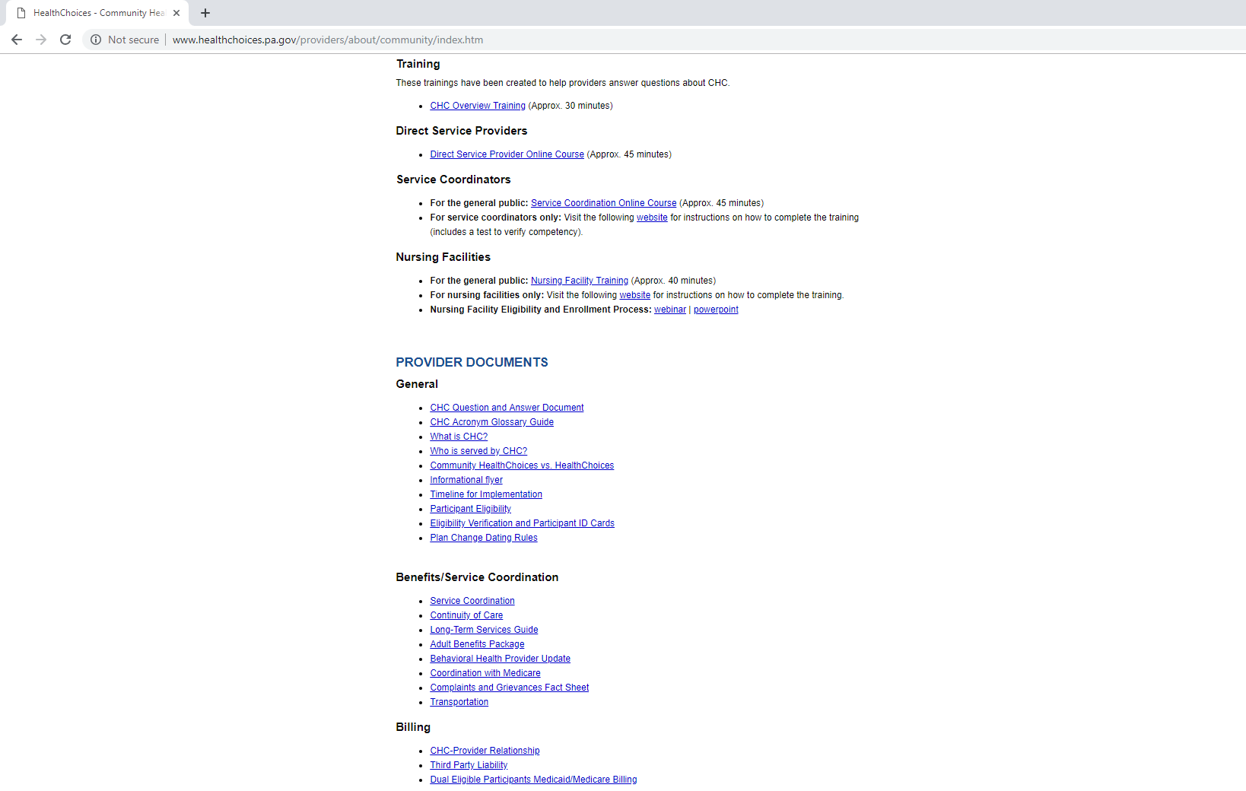

Slide 47
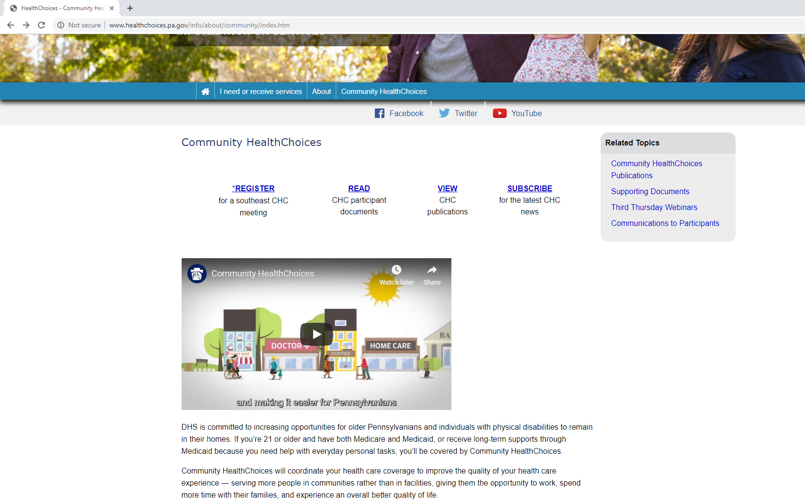

Slide 48
WHAT IS NECESSARY FOR PROVIDERS?
Contact MCOs to discuss contracting.
All providers will need to contract with the MCOs to provide services through the continuity of care period.
Educate yourself.
Participate in CHC Third Thursday webinars to learn more about CHC.
Participate in stakeholder engagements.
Read and share within your organization any CHC-related information sent to you by the Department.
Participate in upcoming educational sessions hosted by the Department.

Slide 49
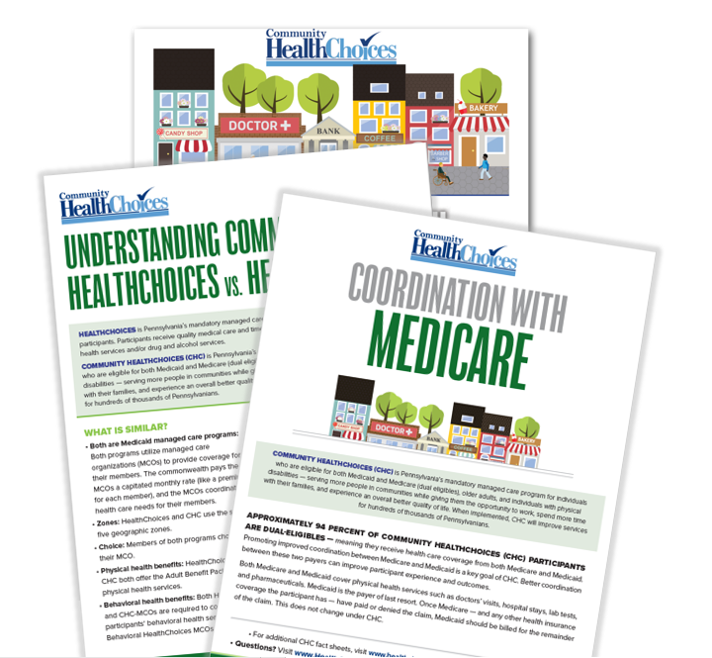
PROVIDERS
Bi-weekly email blasts on specific topics
Examples: Billing, Service Coordination, Medicare, HealthChoices vs. CHC, Continuity of Care
Provider narrated training segments
Provider events in local areas to meet with MCOs and gain information about CHC

Slide 50
WHAT IS NECESSARY FOR PARTICIPANTS?
Select an MCO by the date indicated by the Department.
Get information on the different plans by going to www.enrollCHC.com.
Educate yourself.
Participate in CHC Third Thursday webinars to learn more about CHC.
Participate in stakeholder engagements.
Read CHC-related information sent to you by the Department.
Participate in upcoming educational sessions hosted by Aging Well.

Slide 51
PARTICIPANTS
AWARENESS FLYER
Mailed five months prior to implementation. Phase Three: July 2019
AGING WELL EVENTS
Participants will receive invitations for events in their area. Phase Three: August 2019
PRE-TRANSITION NOTICES AND ENROLLMENT PACKET
Mailed four months prior to implementation. Phase Three: August 2019
SERVICE COORDINATORS
Will reach out to their participants to inform them about CHC. Phase Three: August 2019
NURSING FACILITIES
Discussions about CHC will occur with their residents. Phase Three: August 2019

Slide 52
RESOURCE INFORMATION
CHC LISTSERV // STAY INFORMED: http://listserv.dpw.state.pa.us/oltl-community-healthchoices.html
COMMUNITY HEALTHCHOICES WEBSITE: www.healthchoices.pa.gov
MLTSS SUBMAAC WEBSITE: www.dhs.pa.gov/communitypartners/informationforadvocatesandstakeholders/mltss
EMAIL COMMENTS TO: RA-PWCHC@pa.gov
OLTL PROVIDER LINE: 1-800-932-0939
OLTL PARTICIPANT LINE: 1-800-757-5042
INDEPENDENT ENROLLMENT BROKER: 1-844-824-3655 or (TTY 1-833-254-0690)
or visit www.enrollchc.com

Slide 53
QUESTIONS

