Slide 1



O V E R V I E W

Slide 2

WHAT IS COMMUNITY HEALTHCHOICES (CHC)?
A Medicaid managed care program that will include physical health benefits and long-term services and supports (LTSS). The program is referenced to nationally as a managed long-term services and supports program (MLTSS).
WHO IS PART OF CHC?
Individuals who are 21 years of age or older and dually eligible for Medicare and Medicaid.
Individuals who are 21 years of age or older and eligible for Medicaid (LTSS) because they need the level of care provided by a nursing facility.
  This care may be provided in the home, community, or nursing facility.
  Individuals currently enrolled in the LIFE Program will not be enrolled in CHC unless they expressly select to transition from LIFE to a CHC managed care organization (MCO).

Slide 3
WHO IS NOT PART OF CHC?
People receiving long-term services & supports in the OBRA waiver & are not nursing facility clinically eligible (NFCE)
A person with an intellectual or developmental disability receiving services beyond supports coordination through the Department of Human Services’ Office of Developmental Programs
A resident in a state-operated nursing facility, including the state veterans’ homes

Slide 4
CHC STATEWIDE POPULATION
15%
66,561
Duals in Waivers
15%
69,036
Duals in Nursing Facilities
63%
285,018
NFI Duals
454,045
CHC POPULATION
6%
26,293
Non-duals in Waivers
20%
IN WAIVERS
17%
IN NURSING FACILITIES
93%
DUAL-ELIGIBLE
2%
7,137
Non-duals in Nursing Facilities

Slide 5
CHC STATEWIDE POPULATION (2015-2018)
Population | 2015 | 2018 | Change
NFCE Dual Waiver | 49,759 | 66,561 | +16,802 | +134%
NFCE Dual NF | 77,610 | 69,036 | -8,574 | -11%
NFCE Non-Dual Waiver | 15,821 | 26,293 | +10,472 | +166%
NFCE Non-Dual NF | 7,314 | 7,137 | -177 | -2%
NFI Dual | 270,114 | 285,018 | +14,904 | +106%
Total CHC Population | 420,618 | 454,045 | +33,931 | +108%
Total HCBS | 65,580 | 92,854 | +27,274 | +142%
Total NF | 84,924 | 76,173 | -8,751 | -10%

Slide 6
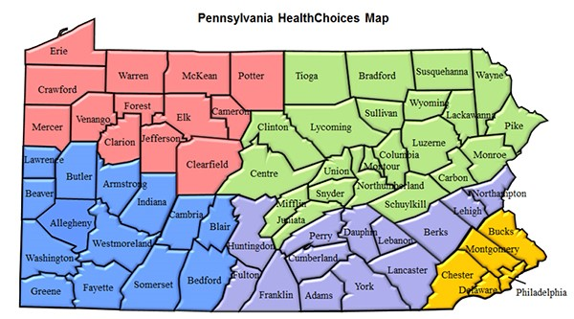

Slide 7
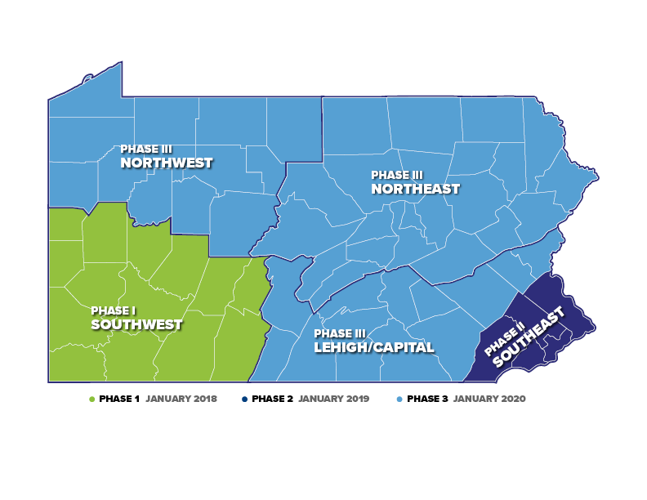

Slide 8
CHC PHASE 3 POPULATION
10%
14,609
Duals in Waivers
16%
23,323
Duals in Nursing Facilities
70%
99,887
NFI Duals
143,004
CHC POPULATION
3%
4,089
Non-duals in Waivers
13%
IN WAIVERS
17%
IN NURSING FACILITIES
96%
DUAL-ELIGIBLE
1%
1,096
Non-duals in Nursing Facilities

Slide 9
PHASE 3 ZONES: LEHIGH/CAPITAL
16%
10,861
Duals in Nursing Facilities
10%
6,269
Duals in Waivers
70%
46,411
NFI Duals
3%
1,996
Non-duals in Waivers
66,044
CHC POPULATION
LEHIGH/CAPITAL COUNTIES:
Adams, Berks, Cumberland,
Dauphin, Franklin, Fulton,
Huntingdon, Lancaster, Lebanon, Lehigh, Northampton, Perry, York
1%
507
Non-Duals in Nursing Facilities

Slide 10
PHASE 3 ZONES: NORTHWEST
15%
4,053
Duals in Nursing Facilities
13%
3,671
Duals in Waivers
68%
18,737
NFI Duals
4%
1,080
Non-duals in Waivers
27,730
CHC POPULATION
NORTHWEST COUNTIES:
Cameron, Clarion, Clearfield, Crawford, Elk, Erie, Forest, Jefferson, McKean, Mercer, Potter, Venango, Warren
<1%
189
Non-Duals in Nursing Facilities

Slide 11
PHASE 3 ZONES: NORTHEAST
17%
8,397
Duals in Nursing Facilities
9%
4,664
Duals in Waivers
71%
34,727
NFI Duals
2%
1,007
Non-duals in Waivers
49,195
CHC POPULATION
NORTHEAST COUNTIES:
Bradford, Carbon, Centre, Clinton, Columbia, Juniata, Lackawanna,
Luzerne, Lycoming, Mifflin, Monroe, Montour, Northumberland, Pike, Schuylkill, Snyder, Sullivan, Susquehanna, Tioga, Union, Wayne, Wyoming
1%
400
Non-Duals in Nursing Facilities

Slide 12
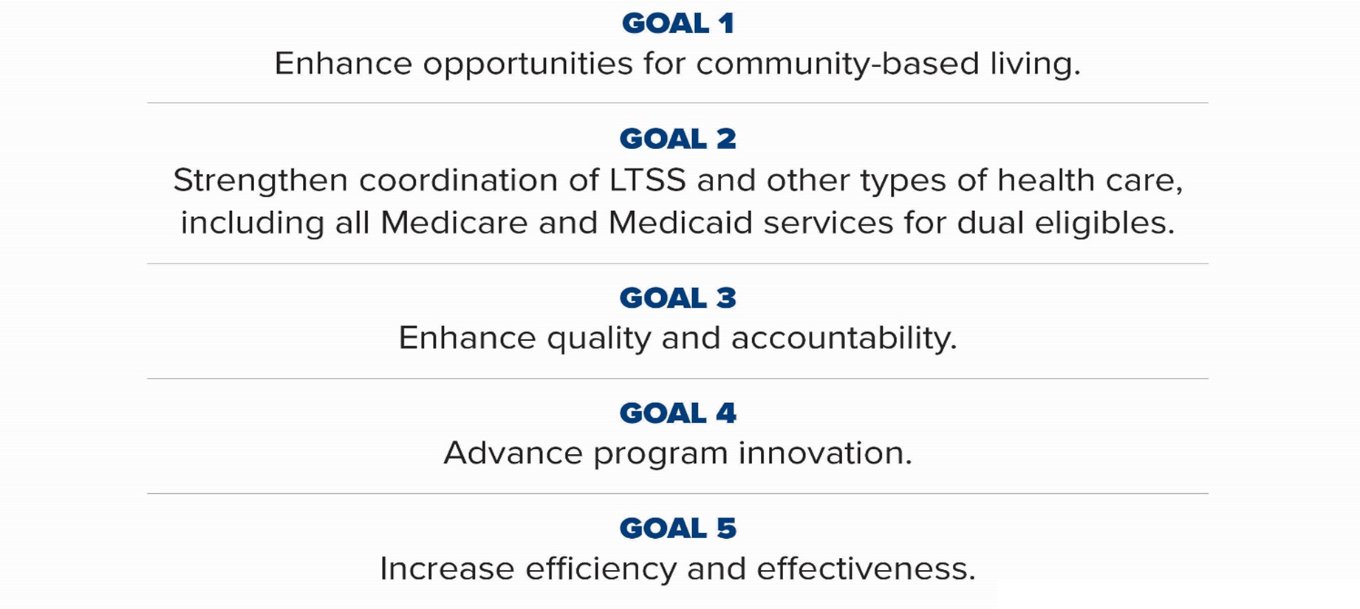
WHAT ARE THE GOALS OF CHC?

Slide 13
COMPARISON OF FFS VS. MANAGED CARE
FEE-FOR-SERVICE
Providers enroll as Medicaid providers
Providers contract with
the Commonwealth
Providers bill PROMISe
MANAGED CARE
  Providers enroll as Medicaid providers
  Providers contract with MCOs
  Providers bill MCOs
  MCOs paid by Commonwealth capitation rate

Slide 14
COVERED SERVICES
FOR ALL PARTICIPANTS:
Physical health services
All participants will receive the Adult Benefit Package, which is the same package they receive today.
This includes services such as:
  Primary care physician
  Specialist services
  Please note: Medicare coverage will not change.

Slide 15
COVERED SERVICES
FOR ALL PARTICIPANTS:
Behavioral health services
All participants will receive behavioral health services through the Behavioral Health HealthChoices MCOs.
This is new for Aging Waiver participants and nursing facility residents, who receive behavioral health services through fee-for-service.
Services available to participants include but are not limited to:
  Inpatient Psychiatric Hospital
  Inpatient Drug and Alcohol Detox and Rehabilitation
  Psychiatric Partial Hospitalization
  Outpatient Psychiatric Clinic
  Drug and Alcohol Outpatient Clinic

Slide 16
COVERED SERVICES
FOR PARTICIPANTS WHO QUALIFY FOR LTSS:
Home and community-based long-term services and supports including:
Long-term services and supports in a nursing facility
Participant-directed services will continue as they exist today.
  Adult Daily Living
  Assistive Technology
  Behavior Therapy
  Benefits Counseling
  Career Assessment
  Cognitive Rehabilitation Therapy
  Community Integration
  Community Transition Services
  Counseling Services
  Employment Skills Development
  Financial Management Services
  Home Adaptations
  Home Health Aid Services
  Home Delivered Meals
  Non-Medical Transportation
  Nursing
  Nutritional Consultation
  Occupational Therapy
  Personal Assistance Services
  Personal Emergency Response System (PERS)
  Pest Eradication
  Physical Therapy
  Job Coaching
  Job Finding
  Residential Habilitation
  Respite
  Specialized Medical Equipment
  and Supplies
  Speech and Language Therapy
  Telecare
  Vehicle Modifications

Slide 17
COVERED SERVICES
Transportation Services:
All CHC participants have access to emergency and non-emergency medical transportation.
Participants will continue to use the Medical Assistance Transportation Program (MATP) for non-emergency medical transportation to and from medical appointments.
  Participants residing in nursing facilities are the exception.
  Nursing facilities will continue to coordinate transportation for their residents.
Nursing facility clinically eligible (NFCE) participants also have access to non-medical transportation. Non-medical transportation can include:
  Transportation to community activities, religious services, employment and volunteering, and other activities or LTSS services as specified in the Participant’s Person-Centered Service Plan (PCSP).
  This service is offered in addition to medical transportation services and shall not replace them.
  These services may include the purchase of tickets or tokens to secure transportation for a participant.
CHC Transportation Provider Workshops will be held on May 16th in Kutztown, May 23rd in Bradford, and June 7th in Bloomsburg.

Slide 18
CONTINUITY OF CARE
MCOs are required to contract with all willing and qualified existing LTSS Medicaid providers for 180 days after CHC implementation. The 180 day continuity of care requirement includes service coordination entities.
Participants may keep their existing LTSS providers for the 180-day continuity of care period after CHC implementation.
Participants may keep their existing physical health providers for the 60-day continuity of care period after CHC implementation.
For nursing facility residents, participants will be able to stay in their nursing facility as
long as they need this level of care, unless they choose to move.
The commonwealth will conduct ongoing monitoring to ensure the MCOs maintain provider networks that enable participants choice of provider for needed services.
For all participants, the CHC-MCO must comply with continuity of care requirements for continuation of providers, services, and any ongoing course of treatment outlined in MA Bulletin 99-03-13, Continuity of Care for Recipients Transferring Between and Among Fee-for-Service and Managed Care Organizations.

Slide 19
IDENTIFYING NEEDS
SCREENING, COMPREHENSIVE NEEDS ASSESSMENT AND REASSESSMENT
CHC-MCOs must:
  screen each new participant who are community well duals within 90 days of the start date
  conduct a comprehensive needs assessment of every participant who is determined NFCE
  conduct a comprehensive assessment when the participant makes a request, self-identifies as needing LTSS, or if either the CHC-MCO or the Independent Enrollment Broker (IEB) identifies that the participant has unmet needs, service gaps or a need for service coordination
  conduct a reassessment at least every 12 months unless a trigger event occurs

Slide 20
SERVICE COORDINATION
    Every participant receiving LTSS will choose a service coordinator.
    The service coordinator will coordinate Medicare, LTSS, physical health services, and behavioral health services.
    They will also assist in accessing, locating and coordinating needed covered services and non-covered services such as social, housing, educational and other services and supports.
    The service coordinator will also facilitate the person-centered planning team.
    Each participant will have a person-centered planning team that includes their doctors, service providers, and natural supports.
    Service coordination is an administrative function of the CHC-MCO.

Slide 21
SERVICE PLANNING
CARE MANAGEMENT PLANS
A care management plan is used to identify and address how the participant’s physical, cognitive, and behavioral health care needs will be managed.
PERSON-CENTERED SERVICE PLANS (PCSP)
All LTSS participants will have a PCSP. The PSCP includes both the care management plan and the LTSS services plan.
PCSPs are developed through the person-centered planning team process, which includes the participant, service coordinator, participant’s supports, and participant’s providers.

Slide 22
COORDINATION WITH MEDICARE
Promoting improved coordination between Medicare and Medicaid is a key goal of CHC. Better coordination between these two payers can improve participant experience and outcomes.
  Dually eligible participants will continue to have all of the Medicare options they have today, including Original Medicare and Medicare Advantage managed care plans. The implementation of CHC will not change the services that are covered by Medicare.
  All CHC-MCOs are required to offer a companion Dual Eligible Special Needs Plans, also known as D-SNPs to its dually eligible participants. D-SNPs are a type of Medicare Advantage plan that coordinates Medicare and Medicaid services.

Slide 23
COORDINATION WITH MEDICARE
Medicare will continue to be the primary payor for any service covered by Medicare. Providers will continue to bill Medicare for eligible services prior to billing Medicaid. All Medicaid bills for participants will be submitted to the participant’s CHC-MCO, including bills that are submitted after Medicare has denied or paid part of a claim.
Participants must have access to Medicare services from the Medicare provider of his or her choice. Participants will be able to keep their Medicare PCP even if they are not enrolled with the CHC-MCO. The CHC-MCO is responsible to pay any Medicare co-insurance and deductible amount, whether or not the Medicare provider is included in the CHC-MCO’s provider network.
Providers cannot bill dually eligible participants for Medicare cost- sharing when Medicare or Medicaid do not cover the entire amount billed for a service delivered.
Providers should still check EVS to confirm participant eligibility, their CHC MCO, and any other coverage a participant might have

Slide 24
WHERE
IS IT NOW?

Slide 25
SOUTHWEST AND SOUTHEAST IMPLEMENTATION
  Successfully implemented CHC in the Southwest on January 1, 2018 and the Southeast on January 1, 2019
  Approximately 79,000 Participants in the Southwest and 131,000 Participants in the Southeast have been transitioned to the CHC program
  Lessons Learned
  Enhanced communication materials and training regarding Medicare vs. CHC
  More education and communication on continuity-of-care
  MCO Provider Training and outreach to occur earlier and more often
  Earlier pre-transition notices
  Increased focus on transportation
  Schedule additional provider workshops in the fall of 2019
  Identify additional locations for participant information sessions

Slide 26
PHASE THREE IMPLEMENTATION
  OBJECTIVES
  Comprehensive participant communication
  Robust readiness review
  Provider communication and training
  Pre-transition and plan selection for phase three participants
  Incorporation of southwest, southeast implementation and launch lessons learned
  CHALLENGES
  Transportation
  Geography
  Participant Outreach
  Electronic Visit Verification (EVV) Implementation

Slide 27
PRIORITIES THROUGH IMPLEMENTATION
ESSENTIAL PRIORITIES
  No interruption in participant services
  No interruption in provider payment
HOW WILL WE ENSURE NO INTERRUPTIONS?
  The Department of Human Services (Department) is engaged with the MCOs in a rigorous readiness review process that looks at provider network adequacy and IT systems.
  The Department of Health must also review and approve the MCOs to ensure they have adequate networks.

Slide 28
PRIORITIES THROUGH IMPLEMENTATION
READINESS
REVIEW
STAKEHOLDER
COMMUNICATION
Participants
and caregivers
DHS PREPAREDNESS
Quality Oversight
Network Development
Network adequacy
Provider Outreach
Providers
Public
MCO Operational Readiness
Launch Monitoring
Address Emergent Issues

Slide 29
NETWORK ADEQUACY
PHYSICAL HEALTH
  CHC-MCOs will be required to meet the existing HealthChoices network adequacy requirements.
  LTSS
  The Department has developed network standards based on best practices and participant input.
  The Department gathered information to establish a baseline of the number of full time equivalents (FTEs) that are potentially needed to continue to provide services and meet the needs of the participants.
  The CHC-MCOs are asking providers for this information during a provider’s initial enrollment with an MCO and on an ongoing basis.
  DHS will re-evaluate network adequacy at the end of the 180-day continuity of care period to ensure consumers have access to LTSS.
  The commonwealth will conduct ongoing monitoring to ensure the MCOs maintain provider networks that enable participants choice of provider for needed services.

Slide 30


MANAGED CARE ORGANIZATIONS
The selected offerors were announced on August 30, 2016.
www.AmerihealthCaritasCHC.com
www.PAHealthWellness.com
www.upmchealthplan.com/chc

Slide 31
PROVIDERS

Slide 32
WHAT IS NECESSARY?
Contact MCOs to discuss contracting.
All providers will need to contract with the MCOs to provide services through the continuity of care period.
Educate yourself.
Participate in CHC Third Thursday webinars to learn more about CHC.
Participate in stakeholder engagements.
Read and share within your organization any CHC-related information sent to you by the Department.
Participate in upcoming educational sessions hosted by the Department.

Slide 33
COMMUNICATIONS

Slide 34

www.HealthChoices.pa.gov

Slide 35
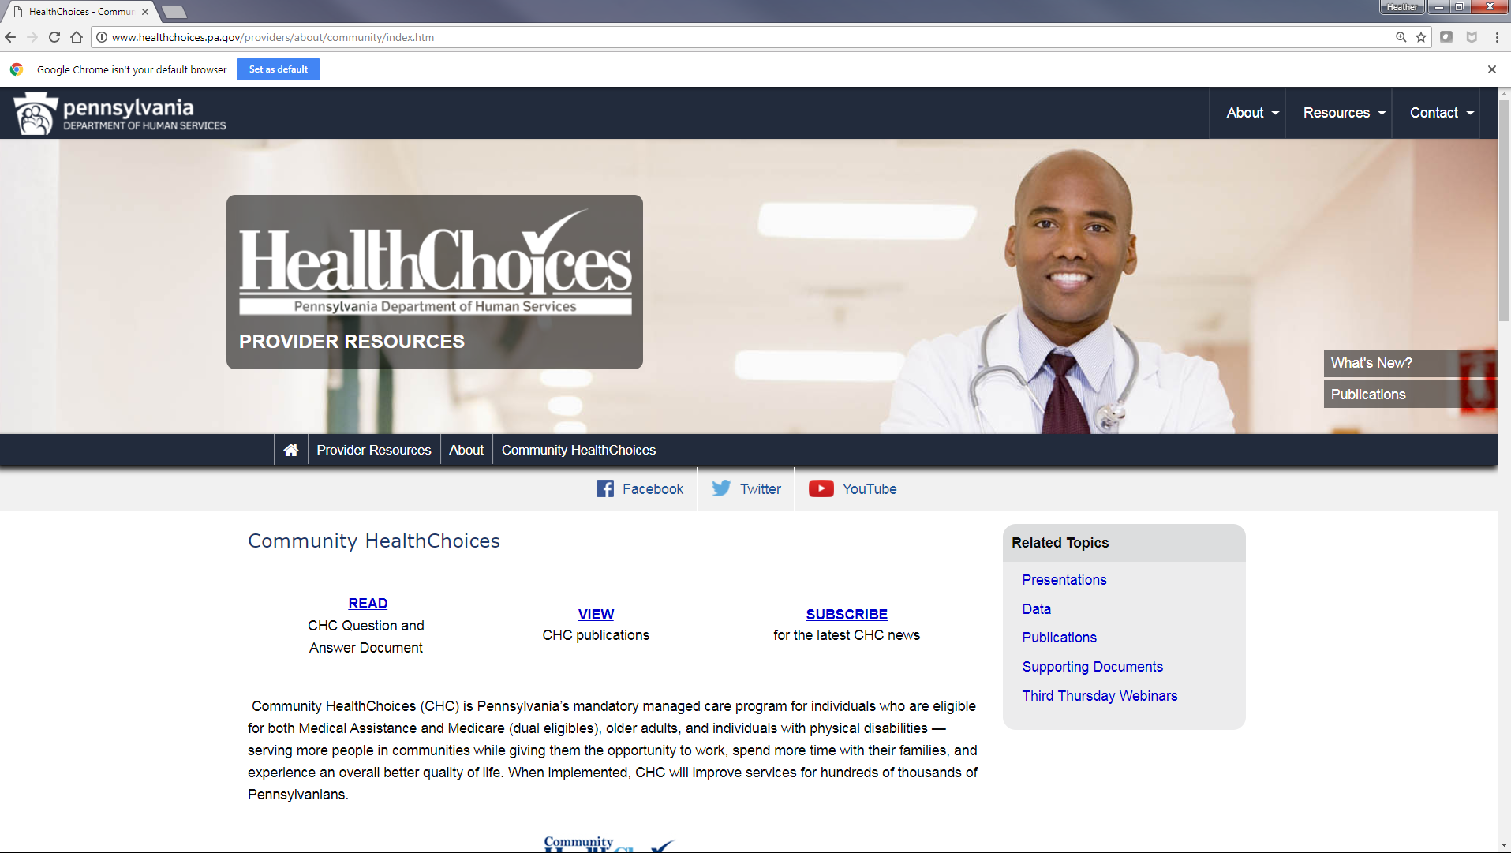

Slide 36
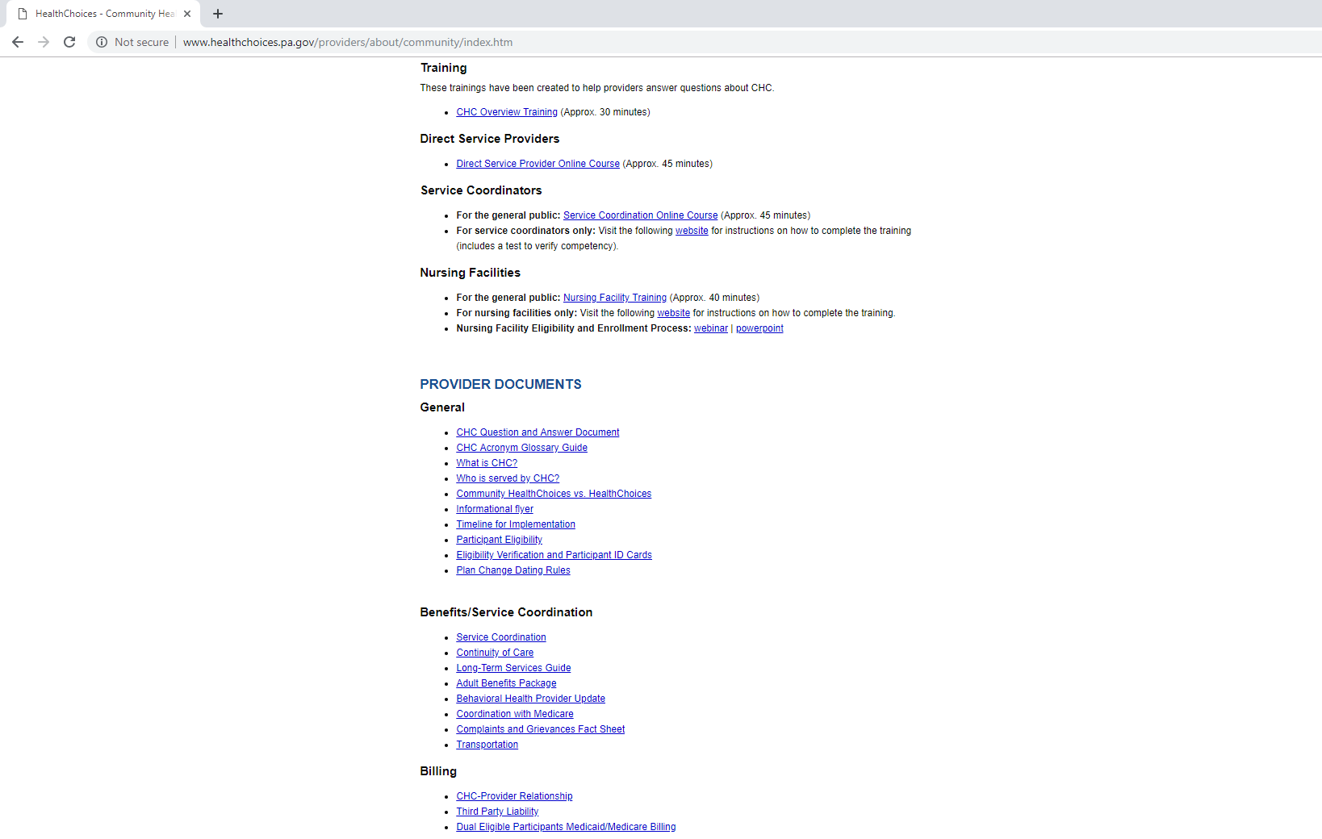

Slide 37
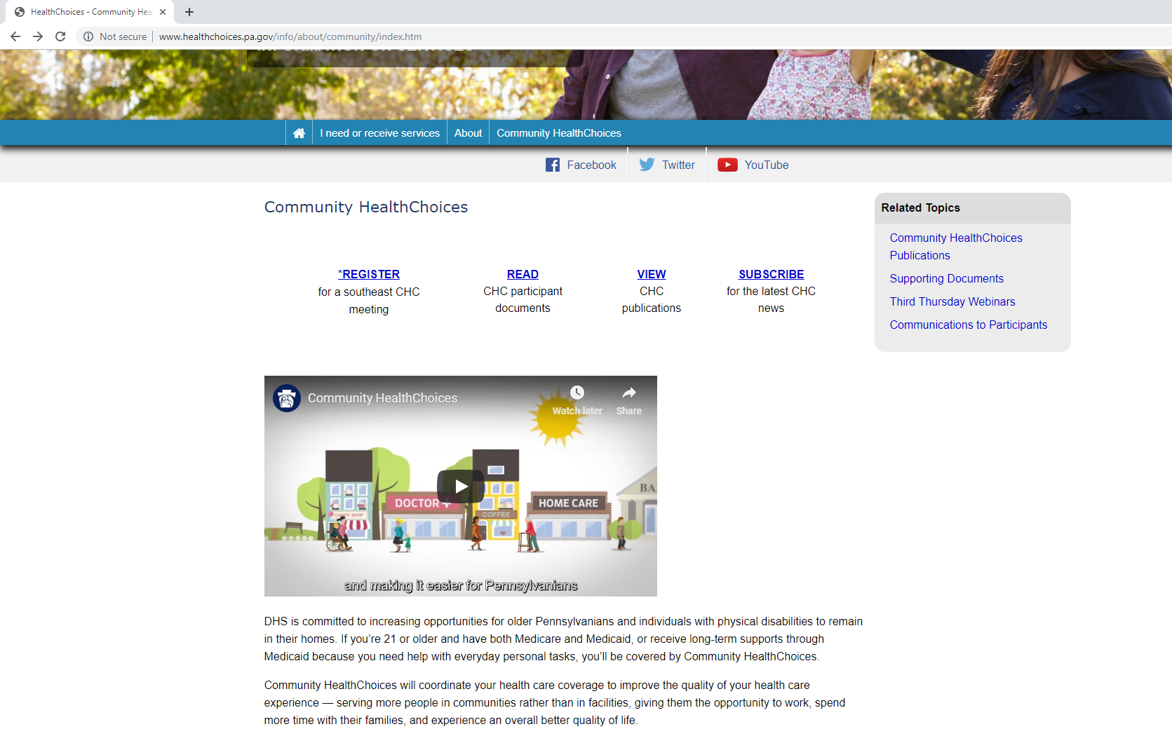

Slide 38

PROVIDERS
Bi-weekly email blasts on specific topics
  Examples: Billing, Service Coordination,
  Medicare, HealthChoices vs. CHC,
  Continuity of Care
Provider narrated training segments
Provider events in local areas to meet with
MCOs and gain information about CHC

Slide 39
PARTICIPANTS
AWARENESS FLYER
  Mailed five months prior to implementation. Phase Three: July 2019
AGING WELL EVENTS
  Participants will receive invitations for events in their area. Phase Three: August 2019
PRE-TRANSITION NOTICES AND ENROLLMENT PACKET
  Mailed four months prior to implementation. Phase Three: August 2019
SERVICE COORDINATORS
  Will reach out to their participants to inform them about CHC. Phase Three: August 2019
NURSING FACILITIES
  Discussions about CHC will occur with their residents. Phase Three: August 2019

Slide 40
WHAT IS NECESSARY FOR PARTICIPANTS?
Select an MCO by the date indicated by the Department.
Get information on the different plans by going to www.enrollCHC.com.
Educate yourself.
Participate in CHC Third Thursday webinars to learn more about CHC.
Participate in stakeholder engagements.
Read CHC-related information sent to you by the Department.
Participate in upcoming educational sessions hosted by Aging Well.

Slide 41
RESOURCE INFORMATION
CHC LISTSERV // STAY INFORMED: http://listserv.dpw.state.pa.us/oltl-community-healthchoices.html
COMMUNITY HEALTHCHOICES WEBSITE: www.healthchoices.pa.gov
MLTSS SUBMAAC WEBSITE: www.dhs.pa.gov/communitypartners/informationforadvocatesandstakeholders/mltss
EMAIL COMMENTS TO: RA-PWCHC@pa.gov
  OLTL PROVIDER LINE: 1-800-932-0939
  OLTL PARTICIPANT LINE: 1-800-757-5042
  INDEPENDENT ENROLLMENT BROKER: 1-844-824-3655 or (TTY 1-833-254-0690)
  or visit www.enrollchc.com

Slide 42
QUALITY

Slide 43

Key Components of Quality Assurances & Improvements
Continuous Program
Improvement
Readiness Review
Ongoing Monitoring of Quality and Performance
Independent Program Evaluation
Early Implementation Monitoring

Slide 44
CHC Quality Components
CHC Quality Components
CHC Quality Components
Exist in
current FFS
CHC Quality
Readiness Review
Monitoring & Compliance
Network Standards
Independent Evaluation
Complaints & Appeals
Performance Measures
Consumer
Surveys
Value-based Payment (future)
External Quality Review (EQR)
Performance Improvement Projects (PIP)
Critical Incidents
NEW in
CHC

Slide 45
Pre-Launch
Launch
(Begins at “Go Live”)
Launch
(“Go Live”- 6 Months)
Steady State (9-12 Mos. & Beyond)
Readiness
Continuity
Program Improvement
Continuity
Primary Aim
Readiness Reviews
System Testing
Baseline Analyses
Frequent Meetings with MCOs
Monitor Launch Indicators & Reports
Conduct Implementation Study
Regular Meetings with MCOs
Quarterly Quality Reviews
Conduct Evaluation Analyses
Monitor Reports
Key Activities
Readiness Review Tool
Report Templates
Quality Strategy
Launch Indicators
Process Measures
Hot-lines (Consumer & Provider)
Program and Financial Reports
Outcome Measures
Program and Financial Reports
Program Imp. Projects (PIPs)
Pay for Performance (P4Ps)
-Launch indicators
-Assurance & other process measures
-Hot lines (consumer & provider)
-Critical incident reports
-Grievances & appeals
-Program and financial reports
Tools
Consumer Communications
Provider Communications
Local Advisory group
SubMAAC, 3rd Thurs.
CHC Website
MCO Participant Advisory Coms.
Local Advisory Group
SubMAAC, 3rd Thurs.
CHC Website
MCO Participant Advisory Coms.
Ad Hoc Public Engagements
SubMAAC, CHC Website
-MCO Participant Advisory Committees
-Local advisory group
-SubMAAC, 3rd Thurs., CHC web pages
Stake-
holders

Slide 47
2018 HCBS CAHPS Scores:
Service Coordinator and Service Choice
Source: OLTL analysis of HCBS CAHPS measure scores reported by CHC-MCOs from 2018 survey administration in Southwest region of Pennsylvania
Notes:
This graph shows all five component items for the two composites addressing experiences with service coordination and service choice.
Results are reported as “Scores”
Percentage of respondents selecting the most positive category(s) of responses for a specific question
Definition of the most positive response category(s) follows CMS instruction for analyzing the HCBS CAHPS Survey, i.e., the core survey and the employment supplement
HCBS CAHPS response categories that are counted as “Most Positive”
“Yes” for Yes/No items
“Always” for Always/Usually/Sometimes/Never items
“Mostly Yes” for Mostly Yes/Mostly No items (alternate response)
“9” and “10” for ratings from 0 to 10
“Excellent” for Excellent/Very good/Good/Fair/Poor items (alternate response)
“Definitely Yes” for Definitely Yes/Probably Yes/Probably No/Definitely No items

Slide 48
CHC-Evaluation—Upcoming Nursing Facility Surveys
Medicaid Research Center will focus on:
Does CHC result in greater access to HCBS and shift the balance of care away from institutionalized settings for people who prefer to live in the community?
Does CHC improve coordination of LTSS, PH care and BH care?
Does CHC improve the quality of care and quality of life of participants and family caregivers?
Does CHC lead to innovation in the delivery of PH care and LTSS?
Timeline
Providers: On-Line Survey (May 1—31, 2019)
Residents: Interviews (May 1—August 31, 2019)
Providers and Participants will be randomly selected.
All information gathered is confidential.

Slide 49

QUESTIONS

