Slide 1



OCTOBER 2019 PROVIDER WORKSHOPS
TRANSPORTATION SESSION

Slide 2

AGENDA
Background Information
Types of Transportation Available
Entities Involved
Payment and Coordination
Questions
Panel Presentations
Coordinated Transportation Solutions (CTS)
MTM
Medical Assistance Transportation Program (MATP)
Office of Income Maintenance (OIM)
Pennsylvania Department of Transportation (PennDOT)

Slide 3
TYPES OF TRANSPORTATION AVAILABLE
Community HealthChoices (CHC) Participants will have access to one or both of the following types of transportation through CHC:
Medical Transportation
  All CHC Participants have access to emergency and non-emergency medical transportation. Emergency medical transportation is transportation provided by an ambulance for emergency medical conditions. Non-emergency medical transportation is used when traveling to and/or from a medical facility, physician’s office, dentist’s office, hospital, clinic, pharmacy, or medical equipment vendor. Participants living in the community will continue to use the Medical Assistance Transportation Program (MATP) for these services. Nursing facilities will continue to be responsible for providing non-emergency transportation for their residents.
Non-Medical Transportation
  All CHC Participants receiving long-term services and supports (LTSS) in their homes or in nursing facilities also
  have access to non-medical transportation. This type of transportation can be used to access community activities,
  grocery shopping, religious services, and other community-based activities and must be included in the Participant’s
  person-centered service plan. The CHC managed care organizations (CHC-MCO) will use transportation brokers to
  help Participants, service coordinators, and nursing facilities coordinate this service.

Slide 4
ENTITIES INVOLVED
There are several entities involved in ensuring CHC Participants receive non-emergency medical and non-medical transportation:
Medicare
  Medicare provides certain transportation services to dually eligible individuals. CHC, MATP and County Assistance Offices (CAO) provide coverage and payment after Medicare.
CHC-MCOs
  CHC-MCOs are responsible for non-emergency medical transportation by ambulance or stretcher for CHC Participants.
MATP
  MATP has the same responsibilities under CHC as they do under other Medical Assistance programs.
CAO
  The CAO is the payor of last resort. MATP or the CHC-MCO will make a referral to the CAO when appropriate.
PennDOT
  The CHC-MCO must coordinate access to transportation through all available programs such as the Shared Ride Program prior to using MATP.

Slide 5
PAYMENT AND COORDINATION
The chart below illustrates the roles of several entities in the payment for and coordination of transportation for Nursing Facility Participants.
Population | Transportation Type in CHC
 | Emergency Medical |  | Non-Emergency Medical |  | Non-Medical
 | Payment | Coordination | Payment | Coordination | Payment | Coordination
Participants in a Nursing Facility | CHC-MCO | Nursing Facility should discuss with MCO | Costs and amounts paid between Nursing Facilities and CHC-MCOs is part of the contracting process | Nursing Facility should discuss with MCO | CHC-MCO | Nursing Facility should discuss with MCO

Slide 6
PAYMENT AND COORDINATION
The chart below illustrates the roles of several entities in the payment for and coordination of transportation for Home and Community-Based Services Participants.
Population | Transportation Type in CHC
 | Emergency Medical |  | Non-Emergency Medical |  | Non-Medical
 | Payment | Coordination | Payment | Coordination | Payment | Coordination
Participants Receiving Home and Community-Based Waivers | CHC-MCO | CHC-MCO/Participant | MATP: Non-ambulance and unexceptional | CHC-MCO/Participant | CHC-MCO | CHC-MCO/Participant
 |  |  | CHC-MCO: Ambulance, stretcher
 |  |  | County Assistance Office: Exceptional transportation

Slide 7
PAYMENT AND COORDINATION
The chart below illustrates the roles of several entities in the payment for and coordination of transportation for Nursing Facility Ineligible Dual-Eligible Participants.
Population | Transportation Type in CHC
 | Emergency Medical |  | Non-Emergency Medical |  | Non-Medical
 | Payment | Coordination | Payment | Coordination | Payment | Coordination
Nursing Facility Ineligible, Dual-Eligible Participants | CHC-MCO | CHC-MCO/Participant | MATP: Non-ambulance and Unexceptional | CHC-MCO/Participant | Not eligible
 |  |  | CHC-MCO: Ambulance, Stretcher
 |  |  | County Assistance Office: Exceptional Transportation

Slide 8

QUESTIONS

Slide 9
LET’S HEAR FROM THE PANEL

Slide 10
Coordinated Transportation Solutions (CTS)

Slide 11

TRANSPORTATION SUMMIT
Since 2009

Slide 12
COORDINATED TRANSPORTATION SOLUTIONS INC.
Since 1997, Coordinated Transportation Solutions (CTS) has provided Non Emergency Transportation (NET) and Mobility Management services for government agencies, not-for-profits, managed care organizations and businesses throughout the country.
Founded as a not-for-profit 501(c)3 organization, CTS provides services to the most fragile individuals in our communities. Our continuum of integrated services is designed to address the unique transportation challenges posed by both Medicaid and other programs serving at risk populations in rural, urban and suburban environments.
2 Million Trips
311,000 Covered Lives
5 States
CTS EXECUTIVE LEADERSHIP TEAM
David L. White, President & Founder
Steven Mackinnon, Vice President of Administration
Jana Hunkler, Vice President of Business Development
Jeff Mathena, Senior Director of IT & Operations
Mary Pat Elwood, Director of Compliance, Quality & Client Relations
Celebrating 20+ Years in Business!
Notes:
CTS is a non-profit and has been in business for 22 years
Founded by David White who has been a leader in public transportation and NEMT space for over two decades

Slide 13



MISSION
It is the mission of CTS to increase the availability of cost-effective and efficient transportation services to transportation disadvantaged individuals and communities.
VALUES
CUSTOMER FOCUS
INTEGRITY
RESPECT
VISION
With an empowered team of professionals, CTS adds value to the services provided to our customers and improves the lives of the people we serve.
Notes:
You can see our Mission, Values and Vision are member focused by ensuring a high quality network of providers.
We support our providers with a dynamic provider relations team, not only at our Connecticut headquarters, but with local staff, on the ground, everywhere we operate..

Slide 14
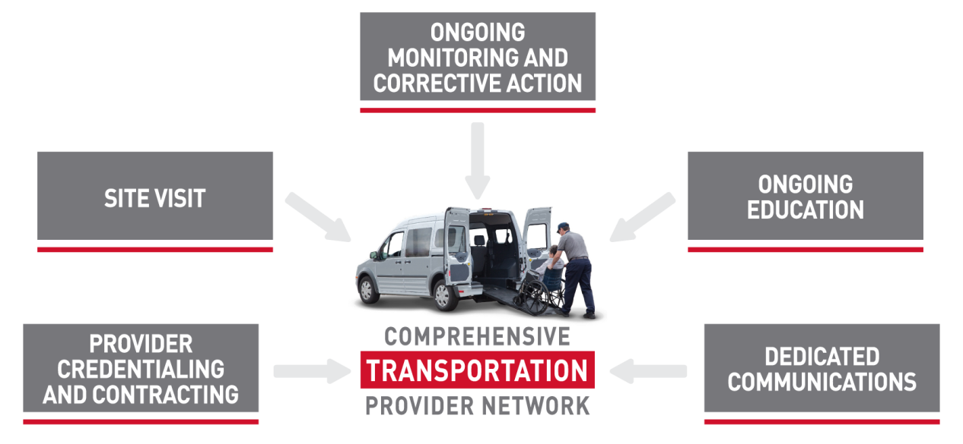
CTS TRANSPORTATION NETWORK
Outreach
Notes:
As part of the Provider Relation’s team we are in the field to support our providers with whatever is needed.
We pay our providers directly with a wire transfer within 10 days of billing.

Slide 15
Network Statistics
Notes:
CTS is a non-profit and has been in business for 22 years
Founded by David White who has been a leader in public transportation and NEMT space for over two decades

Slide 16
Mode Distribution for Entire Population
Completed Trips – Q1 & Q2 2019
Data as of 9/18/19
CTS, Inc © 2019 Proprietary and Confidential. All Rights Reserved.

Slide 17
Phase III Demographics
Notes:
CTS is a non-profit and has been in business for 22 years
Founded by David White who has been a leader in public transportation and NEMT space for over two decades

Slide 18
Phase 3
Notes:
You can see the 3 phases of implementation and as you can see phase III comprises the majority of counties.

Slide 19
PA Total Population in CHC Zones
Zones | # Counties | Total population
Southwestern | 14 | 2,973,231
Southeastern | 5 | 4,008,994
Lehigh/Capital, Northeast & Northwest | 48 | 5,721,558
 |  | 12,703,783
Notes:
Here is a better representation of the zones by total population

Slide 20
CTS Transportation Provider Network
Notes:
CTS is a non-profit and has been in business for 22 years
Founded by David White who has been a leader in public transportation and NEMT space for over two decades

Slide 21
PROVIDER NETWORK
Transportation Providers Used by CTS
• CTS uses only fully credentialed transportation providers that meet all state and federal requirements for the mode of transportation offered.
• Taxis must meet all PUC requirements in addition to the CTS credentialing criteria.
• Any one who has interest in becoming a provider in our network should reach out to a CTS representative or go to our web site and fill out an inquiry form at:
https://www.ctstransit.com/transportation-providers/
PA East Network Development PA West Network Development
Christopher Knaff James Petro
484.345.1897 203.308.0339
cknaff@ctstransit.com jpetro@ctstransit.com

Slide 22
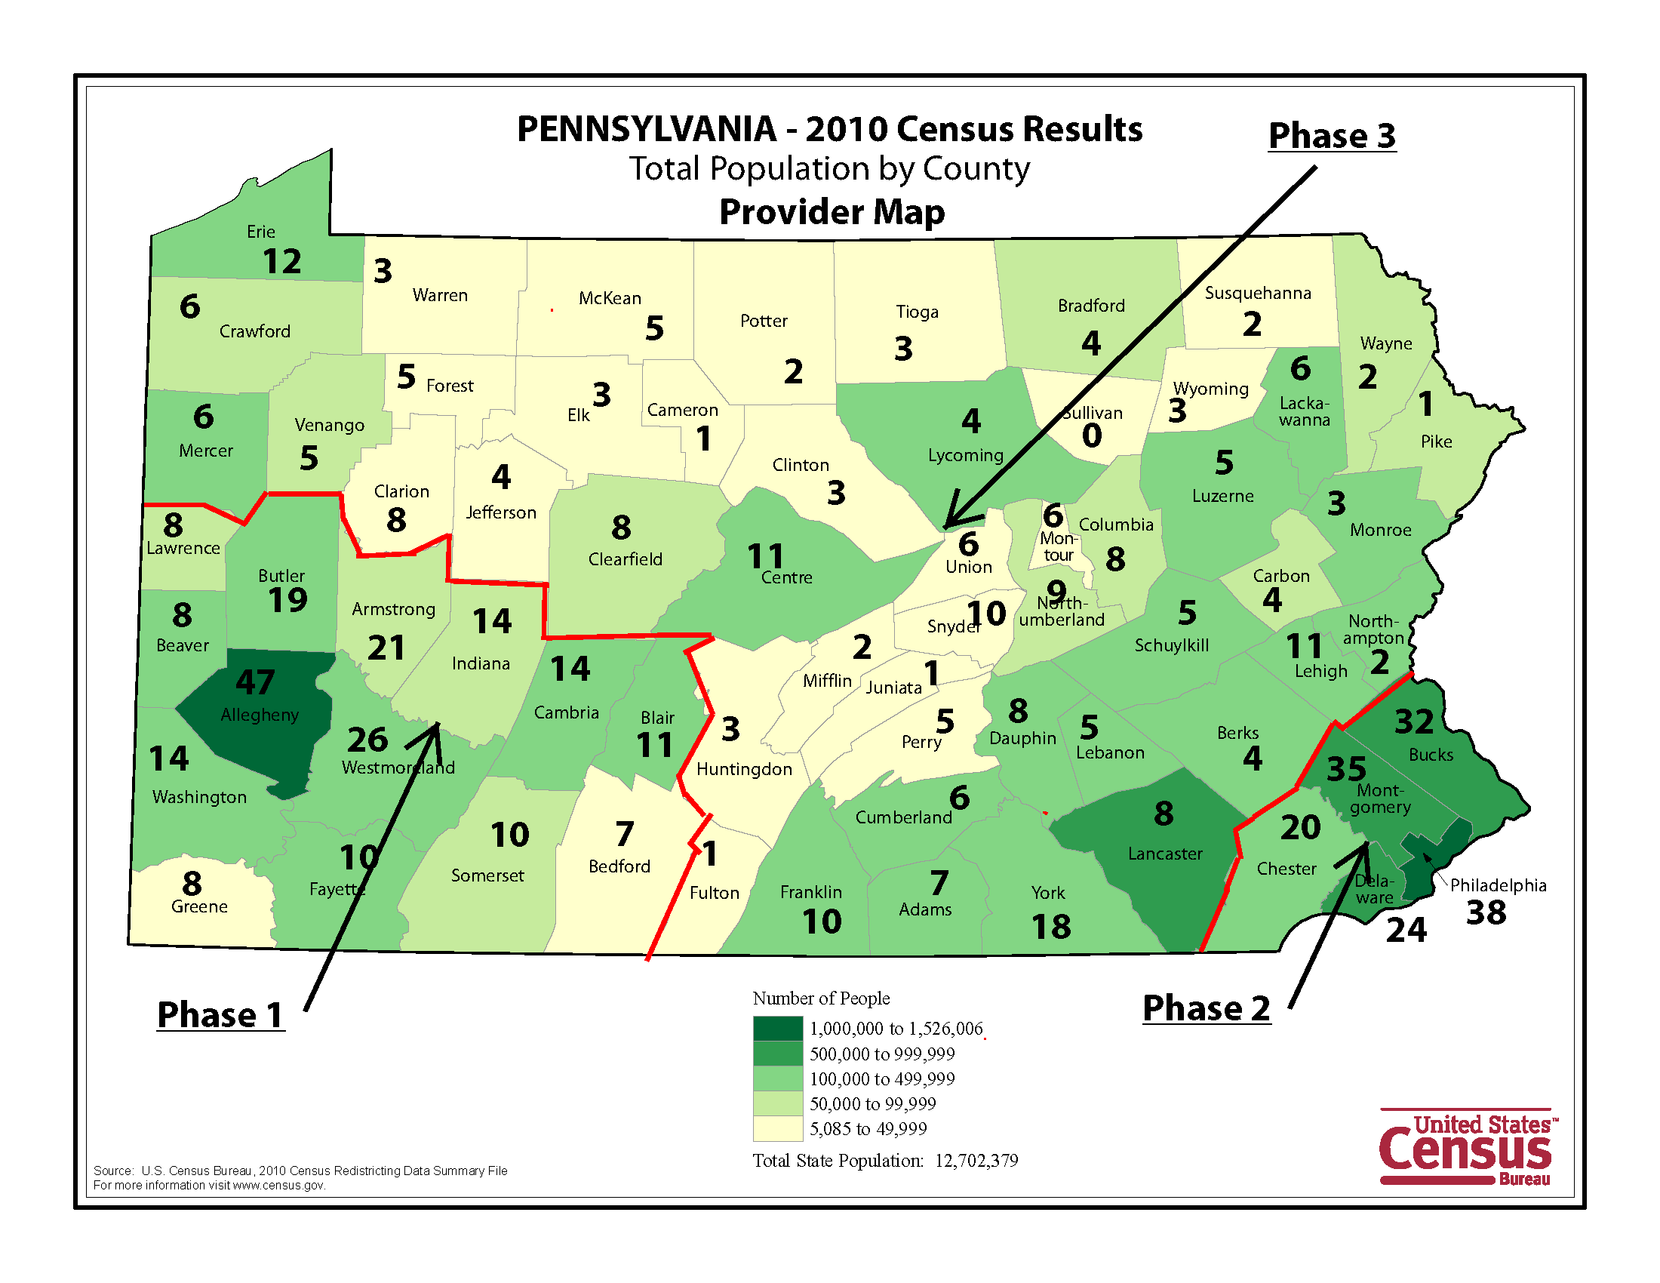
Coverage Map

Slide 23


SOUTHWESTERN PENNSYLVANIA TRANSPORTATION NETWORK
66 CONTRACTED PROVIDERS:
Taxi/Livery
Wheelchair Accessible
Non-emergency Ambulance
Phase 1
Notes:
289 - Ambulance 22 - Stretcher Van 733 – WCV 631 - Taxi Total - 1675

Slide 24


SOUTHEASTERN PENNSYLVANIA TRANSPORTATION NETWORK
36 CONTRACTED PROVIDERS:
Taxi/Livery
Wheelchair Accessible
Non-emergency Ambulance
Phase 2
Notes:
181 - Ambulance 6 - Stretcher Van 231 – WCV 171 - Taxi Total - 589

Slide 25

LEHIGH/CAPITAL, NORTHWEST & NORTHEAST TRANSPORTATION NETWORK
124 PROVIDERS CONTACTED:
  41 Contracted
  46 Perspective and Pending
  37 Not interested
Taxi/Livery
Wheelchair Accessible
Non-emergency Ambulance
Phase 3
Notes:
164 - Ambulance 30 - Stretcher Van 407 – WCV 310 - Taxi Total - 911

Slide 26


SUPPLEMENTING THE TRANSPORTATION NETWORK
PUBLIC TRANSIT:
  Bus Pass Program Management
    Online Tracking & Monitoring of Member Use
CTS AND AGREEMENT
  On-Demand / Same Day / Urgent Requests
  Availability Statewide
FRIENDS & FAMILY MILEAGE REIMBURSEMENT

Slide 27
Transportation Decision Process
Notes:
CTS is a non-profit and has been in business for 22 years
Founded by David White who has been a leader in public transportation and NEMT space for over two decades

Slide 28
NFCE - Living in Nursing Facility
Nursing Facility Clinically Eligible - Non-emergency Medical and Non-Medical trips
Can Nursing Facility provide the trip?
Nursing Facility
Participant receives trip from Nursing Facility’s provider
YES
NO
Provider invoices Nursing Facility
Nursing Facility contacts UPMC SC to arrange transportation
CTS aranges
transport – Provider invoices Nursing Facility
UPMC Service Coordinator requests assistance from CTS
Trip requested

Slide 29
NFCE - HCBS Waiver Living in Community
Nursing Facility Clinically Eligible - Non-emergency Medical and Non-Medical trips
Can MATP perform the trip?
Participant calls their county specific MATP provider
YES
MATP provides the medical trip
Medical Trip
NO
UPMC Service Coordinator
Non-Medical Trip
Trip requested
CTS arranges trip for member
Public Transportation
Friends & Family
CTS Network

Slide 30
NFI* - UPMC for Life Dual Aligned
Nursing Facility Ineligible – Aligned with both UPMC Medicare D-SNP & Medicaid CHC
Member calls to Arrange Trip
50 one-way trip limit reached?
UPMC Medicare Transportation Provider
UPMC Medicare Transportation Provider does the trip
NO
YES
UPMC Medicare transportation provider asks member to arrange Non-emergent transport through MATP
Member calls their county specific MATP provider
MATP Provides the medical trip

Slide 31
NFI - UPMC for Life Dual Non-Aligned
Nursing Facility Ineligible – Member has Non-UPMC Medicare D-SNP plan with UPMC Medicaid CHC
Does member’s Medicare plan offer transportation?
YES
Member calls D-SNP Medicare plan’s provider
Medical Trip
If trip can’t be provided
NO
Member calls MATP to provide the medical trip
Non-Medical Trip
If CHC is coordinating member care and member can’t get transportation to their medical trip through D-SNP or MATP
NO due to exceptional nature i.e. ambulance, bariatric, etc.
Can MATP provide the trip?
UPMC Service Coordinator
CTS arranges Non-Medical trip for Member
CTS may arrange Medical trip for Member
CTS
Public Transportation
Friends & Family
CTS Network

Slide 32
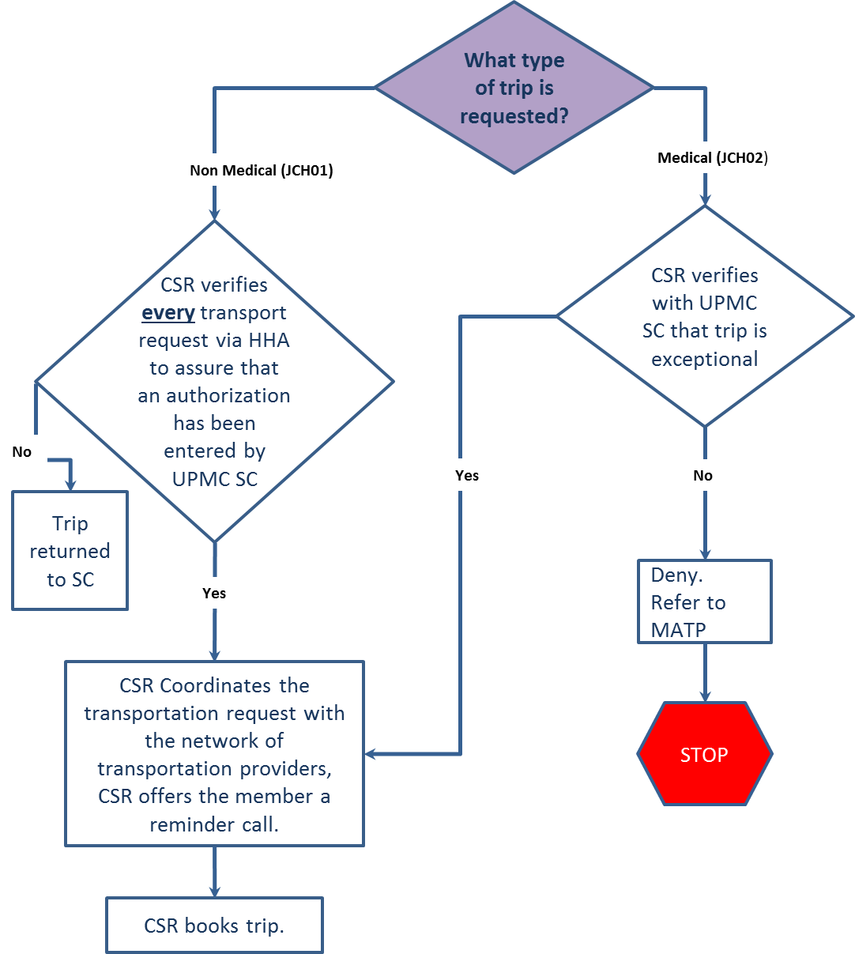
UPMC CHC Call Intake Workflow

Slide 33
Additional Passengers
Members are allowed one additional passenger (escort)
Escort (parent, legal guardian, care giver or case worker) is allowed for a member who is blind, deaf, handicapped, developmentally disabled, or otherwise medically necessary
Participants must provide their own car seats; wheelchairs; DME supplies; O2 or the Member will need to reschedule their appointment

Slide 34

Questions?
35 Nutmeg Drive, Suite 120 Trumbull, CT 06611 203-736-8810
www.ctstransit.com

Slide 35
MTM

Slide 36

v
Phase 3 Logistics
October 28, 2019

Slide 37
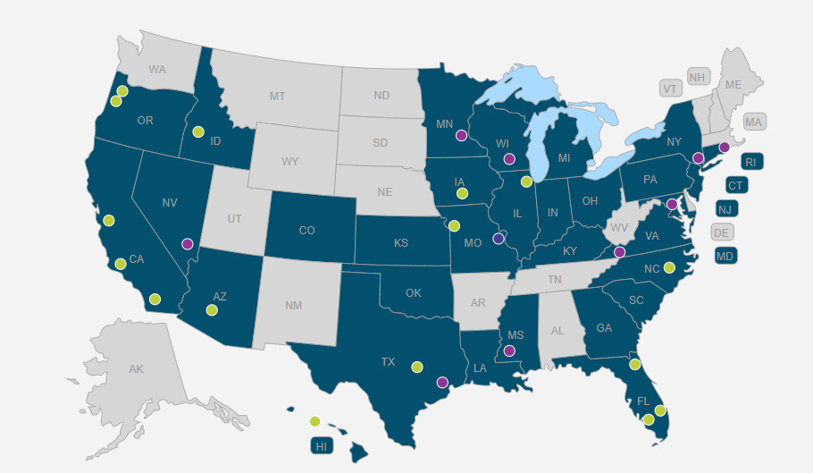
Who We Are
Transportation broker since 1995
Servicing 32 states and over 8,000,000 members
Current broker for both Amerihealth & PA Health and Wellness

Slide 38

Continued Success
99.84% of trips requested are successful transports
  Vendor No Show is 0.09% of total trip requests
  Failure to schedule a vendor for a transportation request is 0.06% of total trip requests
99.98% complaint free percentage for all Pennsylvania transports

Slide 39
Transportation Recruitment
Utilization Rate
Mode Mix
Classification of Service Area
Total Population per county

Slide 40

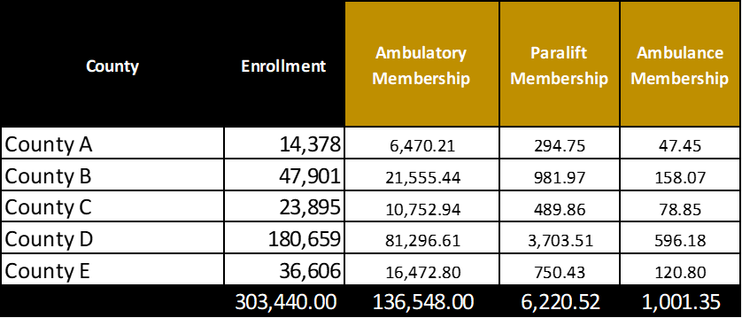
Fleet Build = Recruiting Goal
  Step 1, membership enrollment
  by mode mix
  Example Data

Slide 41

Utilization Rate
Utilization rate is factored into membership mode mix
  57% in example below
Example Data

Slide 42

Capacity per day
County classification capacity
  Cab 5 legs per day
  Paralift 3 legs per day
  Ambulance 2 legs
  Example Data

Slide 43
Transportation Recruitment
Pennsylvania Community Health Choices
Mode |  | Cab, Para lift, Stretcher/Ambulance
Legs Projected Daily |  | Ambulatory | Wheelchair |  | Ambulance / Stretcher
 |  | 354 | 193 |  | 97
Vehicles Required: |  | Ambulatory | Wheelchair |  | Ambulance / Stretcher
 |  | 85 | 77 |  | 59
Vehicles Contracted: |  | Ambulatory | Wheelchair |  | Ambulance / Stretcher
 |  | 170 | 72 |  | 17
Transportation Provider Recruitment Pool
 | Ambulatory Car Count | Wheelchair Count |  | Ambulance / Stretcher Count
147 Transportation Providers | 310 | 313 |  | 74

Slide 44
County by County Recruitment
Goal is to have contracted provider(s) in all 48 counties
  All 48 counties currently have providers, with confirmed interest, that are in the recruitment process
  38 counties currently have contracted providers within them
  Deadline to complete recruitment by November 15th
  4 Full Time Recruiters in place for Phase 3 recruitment
  Weekly goal to add 5 providers
  Hired a new Vendor Account Manager that has transportation experience for centers for independent living
    Recruitment for these facilities will be taken over by her

Slide 45
Counties of focus
Columbia
Crawford
Elk
Forrest
Fulton
Pike
Sullivan
Union
Warren
Wayne

Slide 46
Challenges
Lack of urgency by some transportation providers
  Reminding of the training and credentialing time required during each call
  Identified providers in all 48 counties to start recruiting to ensure coverage in place
  We cannot continue to wait on providers to return paperwork at this point
Ambulance Stretcher coverage
  700 letters mailed to prospective Ambulance Stretcher Providers from MTM to introduce company for contracting

Slide 47


Contact Information
Brian Arnold
Director Logistics – East Division
barnold@mtm-inc.net
540-994-2121

Slide 48
Medical Assistance Transportation Program (MATP)

Slide 49
Medical Assistance Transportation Program (MATP)
MATP BASICS

Slide 50
MATP Basics
The MATP in Pennsylvania is governed by:
State Plan under Title XIX of the Social Security Act
Public Welfare Code (62 P.S. §§ 202 & 403)
55 Pa. Code § 2070, Eligibility for Services Funded Through the Public Assistance Transportation Block Grant
MATP Standards and Guidelines (S & G)

Slide 51
What is MATP?
The MATP is designed to provide:
  Access to MA compensable medical and pharmacy services
  Access to ongoing treatment of chronic diseases and care management
  Access to care with individual medical practices excluding the Emergency Room or Urgent Care facilities
  Access to preventative care (equates to fewer and shorter hospital stays)

Slide 52
Transportation Providers
County Government
Sub-Contracted Entities of County Government
Transportation Brokerage Agencies
Local Transit Agencies

Slide 53
Available Modes of Transportation
Mass transit (buses, trains, subways etc..)
Mileage Reimbursement
Paratransit (includes multi-modal and taxi)
Volunteers

Slide 54
Accessing MATP Services
To begin the registration process, the consumer should contact the MATP agency in their county in order to determine and complete the following:
  Eligibility
    75% of all Category/Code combinations are eligible for the MATP
    Consumers 65 years of age, are referred to the Shared Ride 65+ Program
    Shared Ride pays 85% of the fare
    MATP pays 15% of the fare
  Application
  Needs Assessment
  Determination of Mode

Slide 55
Covered Services
Grantee is required to provide transportation to all MA covered services.
Examples of covered services:
  Physician’s Office Dialysis
  Pharmacy Behavioral Health
  Methadone Clinic PT, OT, Rehab
  Urgent Care Trip (Although not to an Urgent Care Center)
Grantee must ensure transportation is only to and from qualified MA-enrolled providers of their choice.

Slide 56
Non-Covered Services
Examples of non-covered services:
  Transportation to any service not MA compensable
  Transportation to non-medical services
  Transportation for those requiring a stretcher or those who are technologically dependent (Ventilators)
  Transportation to adult day programs
  Transportation to urgent care centers

Slide 57
The Provision of Services
If necessary, the Grantee must allow one (1) escort to accompany a consumer depending on verifiable medical support, supervision, or translation needs.
Depending on the circumstances and known factors, the Grantee may provide an attendant on the trip.
In order to ensure that services are cost efficient and appropriate, the Grantee may sometimes request a waiver of a MATP requirement.

Slide 58
The Provision of Services Continued
Any issue brought to the attention of the Grantee by a consumer, guardian, advocate or agency for the purpose of assistance or resolution is considered a “complaint.”
There are times when the Grantee may, deny, reduce or terminate a consumer’s request for transportation.

Slide 59
CHC and MATP
MATP will continue to provide NEMT services to eligible consumers and the application and access procedures will continue as always according to individual county policy.
Community HealthChoices (CHC) MCOs will provide some transportation services, which are not within the scope of MATP.
All exceptional transportation needs will be referred to the County Assistance Office (CAO) or to the CHC MCO as appropriate.

Slide 60
Consumer Initial Contact at County MATP Provider

Slide 61
Consumer Initial Contact at CHC/MCO

Slide 62
MATP Updates
June 22, 2018: Legislature enacted changes to the Human Services Code that required DHS to issue a solicitation for a regional or statewide full risk broker to administer the MATP.
December 21, 2018: DHS released a Request for Application (RFA) to comply with legislative requirement.
June 28, 2019: Act 19 of 2019 was signed into law, which, required DHS to coordinate with the Departments of Transportation and Aging to commission an analysis of the impact of a brokered MATP model prior to entering into a contract for a full risk brokered model.
Any further information will be shared by the Department when it is available.

Slide 63
MATP Updates Continued
The MATP Broker procurement is currently on hold as DHS works to fulfill its statutory obligation to complete an analysis. DHS cannot move forward with the procurement until the analysis is completed.
The act gave the agencies 180 days in which to have the analysis completed. A preliminary report is due to the legislature on October 28, 2019, and the final analysis is due on December 28, 2019.

Slide 64
Program Staff Assignments
Erie
Warren
McKean
Potter
Tioga
Bradford
Susquehanna
Crawford
Wayne
Forest
Wyoming
Venango
Elk
Cameron
Sullivan
Lackawanna
Mercer
Lycoming
Pike
Clarion
Clinton
Luzerne
Jefferson
Columbia
Monroe
Lawrence
Clearfield
Montour
Butler
Union
Armstrong
Centre
Northumberland
Carbon
Beaver
Indiana
Snyder
Schuylkill
Northampton
Cambria
Mifflin
Lehigh
Allegheny
Blair
Juniata
Berks
Perry
Dauphin
Bucks
Washington
Westmoreland
Huntingdon
Lebanon
Montgomery
Cumberland
Lancaster
Bedford
Fulton
Chester
Somerset
Greene
Fayette
Somerset
Franklin
York
Delaware
Philadelphia
Adams
Jeffrey Stinson-Primary
Ronald Minnich-Primary
Daphne Simeonoff
Eira Andrade-Hall-Primary
Maribel Torres-Primary

Slide 65
MATP Staff Directory
Tamara Carter, Director
717-346-3937
tacarter@pa.gov
Daphne Simeonoff Program Manager
717-265-7829 Bucks, Chester, Delaware, Montgomery, Philadelphia
daphsimeon@pa.gov
Program Advisor
Eira Andrade-Hall Adams, Bedford, Centre, Columbia, Cumberland, Franklin, Fulton, Huntingdon, Juniata, Mifflin, Montour,
717-214-1351 Northumberland, Perry, Snyder, Union, York
eandradeha@pa.gov
Ronald Minnich Berks, Carbon, Dauphin, Lackawanna, Luzerne, Lancaster, Lebanon, Lehigh, Monroe, Northampton, Pike,
717-705-8259 Schuylkill, Susquehanna, Wayne, Wyoming
rominnich@pa.gov
Jeffrey Stinson Bradford, Cameron, Clarion, Clinton, Crawford, Elk, Erie, Forest, Lycoming, Potter, McKean, Mercer,
717-783-3042 Sullivan, Tioga, Venango, Warren
jstinson@pa.gov
Maribel Torres Allegheny, Armstrong, Beaver, Blair, Butler, Cambria, Clearfield, Fayette, Greene, Jefferson, Indiana,
717-772-6288 Lawrence, Somerset, Washington, Westmoreland
martorres@pa.gov
Program Analyst
Cecilia Watkins Data and Systems Contact
717-214-1352
ccwatkins@pa.gov

Slide 66
Thank you!
For more information, please visit www.matp.pa.gov

Slide 67
Office Of Income Maintenance (OIM)

Slide 68

Office of Income Maintenance Medical Transportation Allowance
The Office of Income Maintenance (OIM) will assist with payment for transportation to non-emergency medical appointments and to obtain prescriptions if all the conditions listed below are met:
The client is active in a Medical Assistance (MA) category eligible for transportation
The medical service or prescription is covered under MA
The transportation is not covered by MA
The transportation is not provided or covered through the Medical Assistance Transportation Program (MATP) AND MATP provides the client or County Assistance Office (CAO) with an MATP referral (i.e. a letter, email, or denial of services)
The transportation is not provided or covered through a Community Heath Choices Managed Care Organization (CHC-MCO) and the CHC-MCO provides the client and/or CAO with a CHC-MCO formal referral.
There is no other means of transportation available AND
The CAO receives all required documentation

Slide 69
CHC-MCO, Skilled Nursing Facility, and Client Responsibilities
The CHC-MCO is responsible to send a referral to the client and or the client’s local CAO when a non-emergency medical transportation request is not covered under the MCO.
The Skilled Nursing Facility (SNF) is responsible to provide non-emergency medical transportation for MA clients receiving Long-Term Care benefits.
The client is responsible to provide their local CAO with:
Physician verification
MATP and CHC-MCO referrals
Verification of travel expenses such as but not limited to invoices from transportation agencies, lodging invoices, toll and parking receipts, and formal requests for mileage
References: 55 Pa Code § 175.23, 55 Pa Code § 2070.4, 55 Pa Code § 2070.5, CAH 138.41, OPS 14-07-01, & PA Medicaid State Plan

Slide 70
Pennsylvania Department of Transportation (PennDOT)

Slide 71
PennDOT-Funded Public Transportation Overview for
Community Health Choices
Provider Sessions
PA Department of Transportation
Bureau of Public Transportation

Slide 72
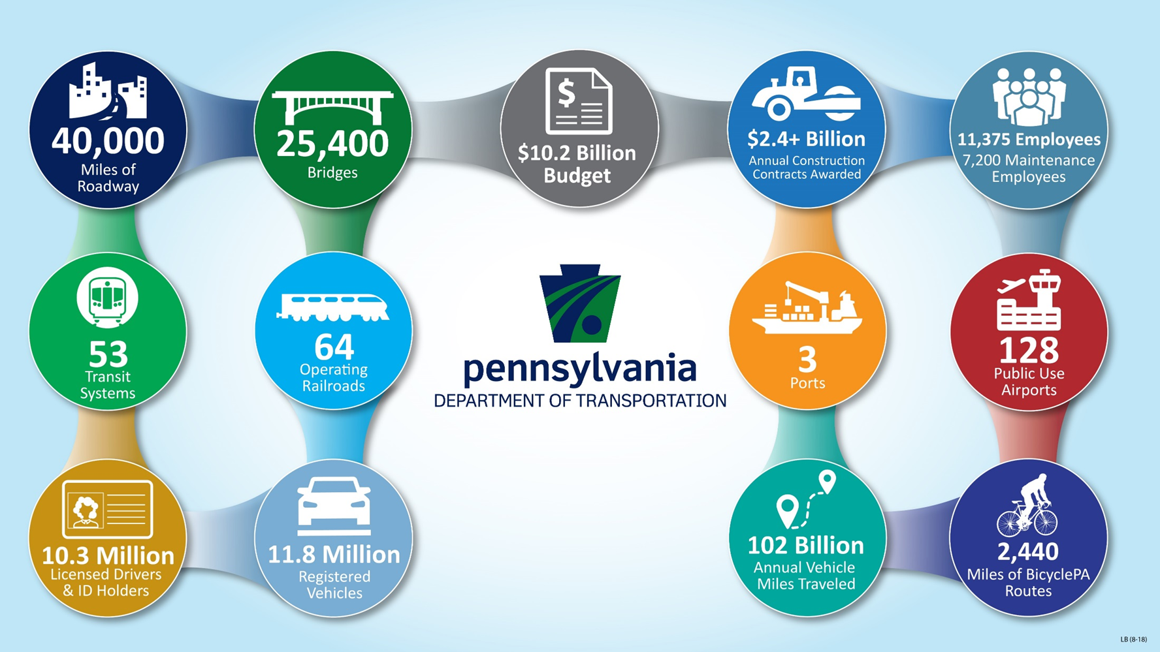

Slide 73
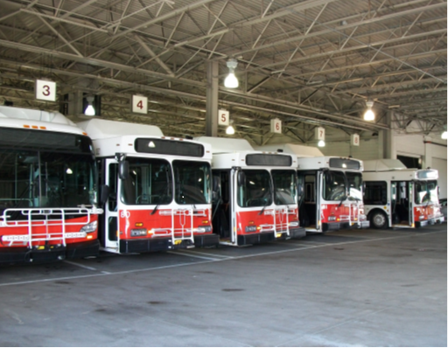
Presentation Outline
Fixed Route Service
PennDOT’s Role in Fixed Route Service
Shared-Ride service
PennDOT’s Role in Shared-Ride

Slide 74
Characteristics of Fixed Route Service
Operates along a specific route.
Stops at scheduled times at set locations.
Includes both bus and rail service.
Passengers are charged a relatively low fare
Cost of service is heavily subsidized with federal, state, and local funding.

Slide 75
PennDOT’s Role in Fixed Route Service
PennDOT:
Provides a majority of the operating funding for public fixed route providers in Pennsylvania;
Provides a significant portion of the capital funding local match for federal capital funding;
Funds and oversees the Free Transit Program for senior citizens.

Slide 76
Shared-Ride Service in Pennsylvania
Service is demand responsive.
Service must be reserved in advance – generally the day prior at the latest.
The service is open to the public.
The public fare for each trip reflects the fully-allocated cost of the service.
Various human service programs or agencies can purchase service at the public fare – these arrangements provide most of the funding for the service.

Slide 77
PennDOT’s Role in Shared-Ride Service
PennDOT provides funding for and oversees the Senior Shared-Ride (SSRP) and Persons with Disabilities (PwD) Programs.
PennDOT distributes most of the funding (both state and federal) used to purchase vehicles.
PennDOT oversees compliance of the ADA complementary paratransit service offered by rural fixed route providers.

Slide 78
Third-Party Sponsorship for Shared-Ride
Only permitted for the Senior Shared-Ride Program – not for the Persons with Disabilities Program
A sponsor may not require a higher level of service for its riders than would be provided to public shared-ride riders
PennDOT must approve all Senior Shared-Ride Program third-party sponsors

Slide 79
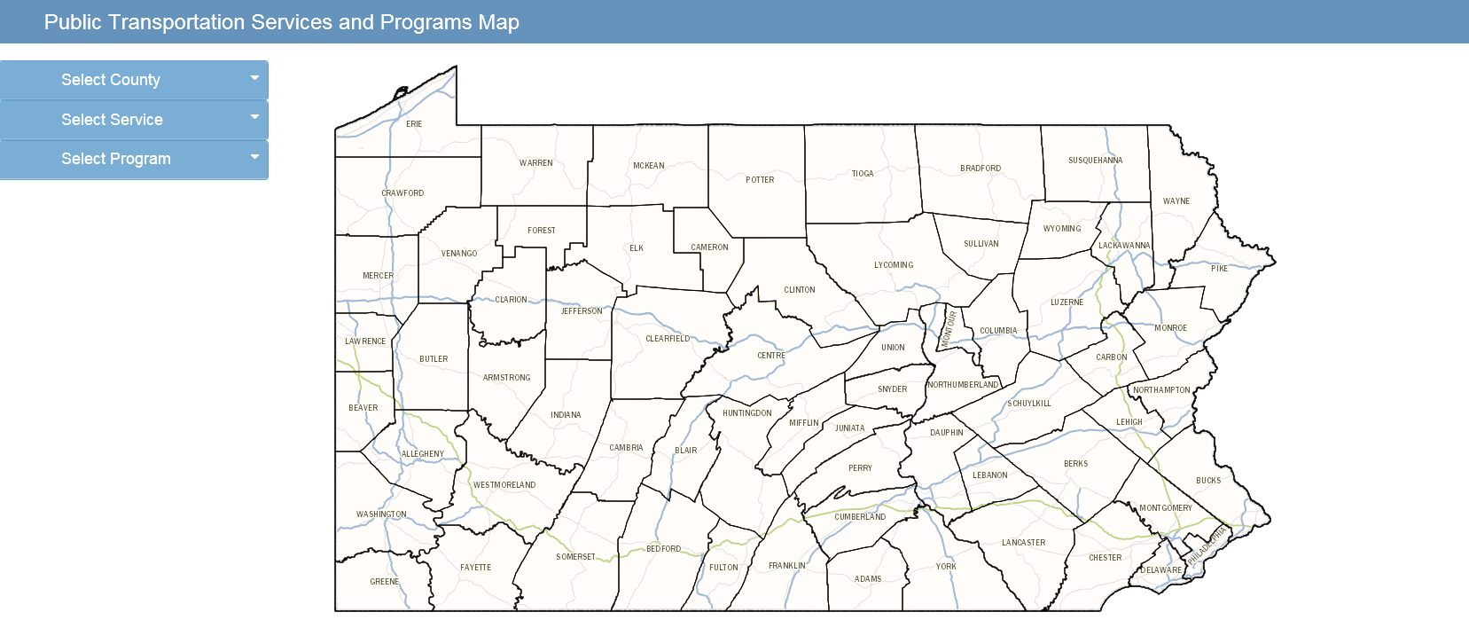
Locating Local Public Transit Providers
Please visit our interactive map at:
http://www.dot7.state.pa.us/TransitMap/

Slide 80
Thank you

Slide 81
QUESTIONS

Slide 82
RESOURCE INFORMATION
CHC LISTSERV // STAY INFORMED: http://listserv.dpw.state.pa.us/oltl-community-healthchoices.html
COMMUNITY HEALTHCHOICES WEBSITE: www.healthchoices.pa.gov
MLTSS SUBMAAC WEBSITE: www.dhs.pa.gov/communitypartners/informationforadvocatesandstakeholders/mltss
EMAIL COMMENTS TO: RA-PWCHC@pa.gov
  OLTL PROVIDER LINE: 1-800-932-0939
  OLTL PARTICIPANT LINE: 1-800-757-5042
  INDEPENDENT ENROLLMENT BROKER: 1-844-824-3655 or (TTY 1-833-254-0690)
  or visit www.enrollchc.com

