Slide 1
CHC Third Thursday Webinar
December 19, 2019

Slide 2
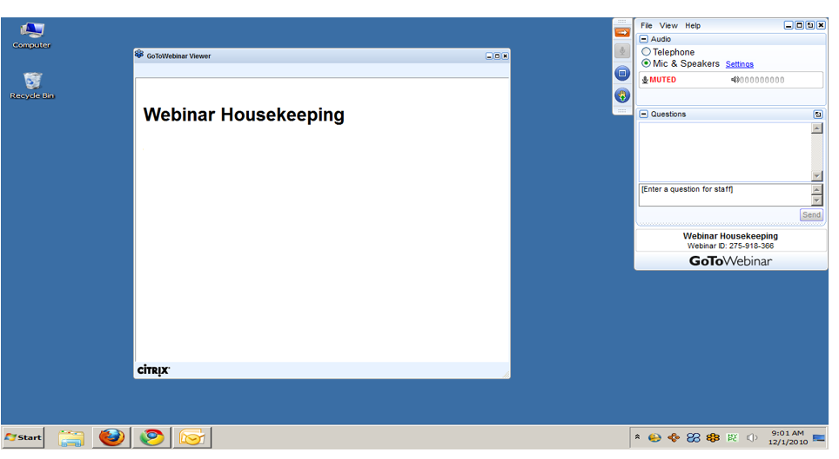
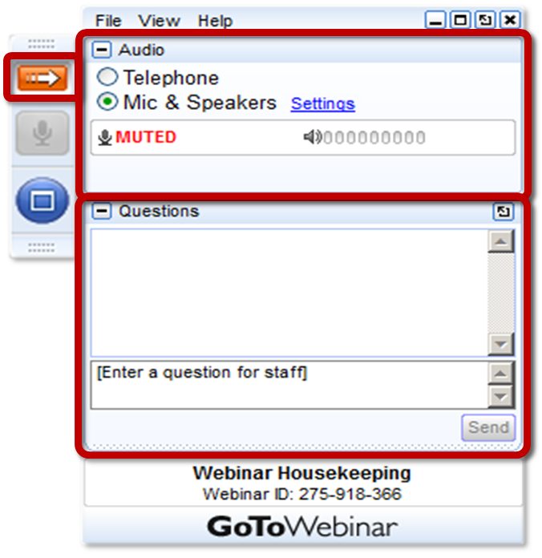
GoToWEBINAR HOUSEKEEPING: What Attendees See
Notes:
Before we get started, I’d like to go over a few items so you know how to participate in today’s event:
Here is a screen shot of the Attendee interface. This is what you should see on your desktop.
In the center of the screen is the GoToWebinar Viewer where you will see the presentation.
In the upper right hand corner is the GoToWebinar control panel where you can ask questions and select audio mode.
If the Control Panel is closed you will see a slim red rectangle. Click on the red arrow to expand the Control Panel.
5. You will be listening to the presentation via your computer's speaker system by default. If you prefer to join by phone, select the “Telephone” button in the audio pane and the dial-in information will be displayed. This will place you in the “listen only” mode to hear the presentation.
You may submit questions (via text) by typing your questions into the “Questions” pane of the control panel. You may send in your questions at any time during the presentation.
Note: The attendee control panel will collapse automatically when not in use. To keep it open, click the “View”, menu, and uncheck “Auto-hide Control Panel”.

Slide 3
AGENDA
Community HealthChoices (CHC) Phase 3 Updates
CHC Implementation

Slide 4
PHASE 3 UPDATES

Slide 5
PRIORITIES THROUGH IMPLEMENTATION
ESSENTIAL PRIORITIES
No interruption in participant services
No interruption in provider payment
HOW WILL WE ENSURE NO INTERRUPTIONS?
Launch Indicators
Daily Managed Care Organization (MCO) Huddles
Ongoing Monitoring Reports

Slide 6
PHASE THREE PROVIDER NETWORKS
Nursing Facilities (318 Total)
Amerihealth Caritas – 269
PA Health & Wellness – 270
UPMC – 296
Hospitals (93 Total)
Amerihealth Caritas – 86
PA Health & Wellness – 66
UPMC – 69
All other Nursing Facility and Hospital contracts are in process.
All MCOs continue to submit weekly provider network reports for network adequacy monitoring.

Slide 7
PHASE THREE PLAN SELECTION
December 20th is the last day for plan changes to take affect on January 1, 2020.
As of November 16th, 39% of participants transitioning to CHC have made an advanced plan selection.

Slide 8
PHASE THREE PLAN SELECTION
Region | Population | Recipients who Selected a Plan | Total Recipients Transitioning to CHC | % of Recipients Selecting a Plan
Northeast | NFI Dual | 12,035 | 34,526 | 34.9%
 | HCBS Dual | 2,968 | 4,954 | 59.9%
 | HCBS Non Dual | 662 | 1,100 | 60.2%
 | LTC Dual | 2,979 | 8,309 | 35.9%
 | LTC Non Dual | 100 | 390 | 25.6%
 | Total | 18,744 | 49,279 | 38.0%
Advanced plan selections as of November 16th

Slide 9
PHASE THREE PLAN SELECTION
Region | Population | Recipients who Selected a Plan | Total Recipients Transitioning to CHC | % of Recipients Selecting a Plan
Northwest | NFI Dual | 8,100 | 18,518 | 43.7%
 | HCBS Dual | 2,378 | 3,774 | 63.0%
 | HCBS Non Dual | 666 | 1,205 | 55.3%
 | LTC Dual | 1,556 | 3,960 | 39.3%
 | LTC Non Dual | 46 | 171 | 26.9%
 | Total | 12,746 | 27,628 | 46.1%
Advanced plan selections as of November 16th

Slide 10
PHASE THREE PLAN SELECTION
Region | Population | Recipients who Selected a Plan | Total Recipients Transitioning to CHC | % of Recipients Selecting a Plan
Lehigh/ Capital | NFI Dual | 15,113 | 45,816 | 33.0%
 | HCBS Dual | 4,138 | 7,213 | 57.4%
 | HCBS Non Dual | 1,549 | 2,604 | 59.5%
 | LTC Dual | 3,519 | 10,786 | 32.6%
 | LTC Non Dual | 156 | 532 | 29.3%
 | Total | 24,475 | 66,951 | 36.6%
Advanced plan selections as of November 16th

Slide 11
CHC IMPLEMENTATION

Slide 12
CHC STATEWIDE IMPLEMENTATION
Accomplishments
Stakeholder Engagement and Support
Transparency
Quality Initiatives
Future Goals and Opportunities

Slide 13
CHC RESOURCE INFORMATION
CHC LISTSERV // STAY INFORMED: http://listserv.dpw.state.pa.us/oltl-community-healthchoices.html
COMMUNITY HEALTHCHOICES WEBSITE: www.healthchoices.pa.gov
MLTSS SUBMAAC WEBSITE: www.dhs.pa.gov/communitypartners/informationforadvocatesandstakeholders/mltss
EMAIL COMMENTS TO: RA-PWCHC@pa.gov
OLTL PROVIDER LINE: 1-800-932-0939
OLTL PARTICIPANT LINE: 1-800-757-5042
INDEPENDENT ENROLLMENT BROKER: 1-844-824-3655 or (TTY 1-833-254-0690)
or visit www.enrollchc.com

Slide 14
QUESTIONS

