Slide 1
Third Thursday Webinar
Kevin Hancock
Acting Deputy Secretary
OFFICE OF LONG-TERM LIVING
DEPARTMENT OF HUMAN SERVICES
March 15, 2018

Slide 2
Agenda
CHC Launch Update
CHC Areas of Current Focus
CHC Southeast Implementation
Resources

Slide 3
CHC LAUNCH UPDATE

Slide 4
2018 Community HealthChoices SW GOALS
ASSURING NO PARTICIPANT SERVICE INTERRUPTIONS
ASSURING NO INTERRUPTION IN PROVIDER PAYMENT
SUCCESSFUL LAUNCH FIRST PHASE

Slide 5
CHC SOUTHWEST JANUARY (Population Distribution)

Slide 6
CHC SOUTHWEST JANUARY (Age Distribution)
Population | Over 60 | Under 60
NFI Duals | 51.2% | 48.8%
HCBS Duals | 69.4% | 30.6%
HCBS Non Duals | 33.3% | 66.7%
NF Duals | 94.7% | 5.3%
NF Non-Duals | 45.0% | 55.0%
Total Population | 57.9% | 42.1%

Slide 7
CHC SOUTHWEST JANUARY (Plan Distribution)
Distribution | Amerihealth Caritas | Pennsylvania Health and Wellness | UPMC COMMUNITY HEALTHCHOICES
Percentage | 20% | 28% | 52%

Slide 8
CHC SOUTHWEST JANUARY: Plan Selection Method
D-SNP ALIGNMENT | PARTICIPANT PLAN SELECTION |  |  | AUTO ASSIGNED
 | PLAN SELECTION FORM | PHONE | WEB
11% | 19% | 20% | 2% | 48%

Slide 9
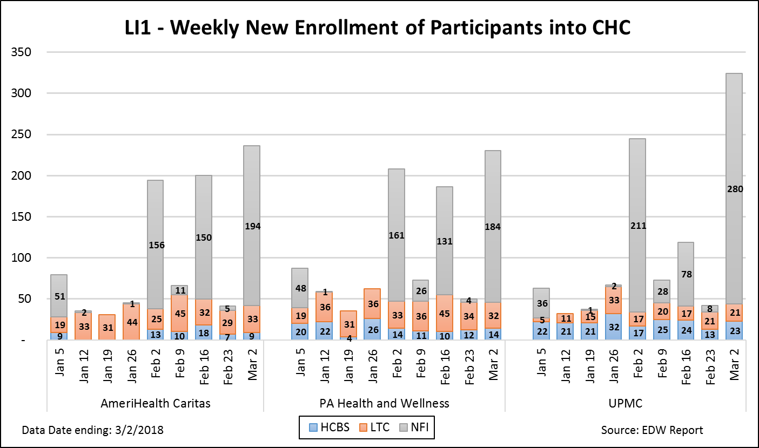
CHC SOUTHWEST (BY POPULATION GROUP)

Slide 10
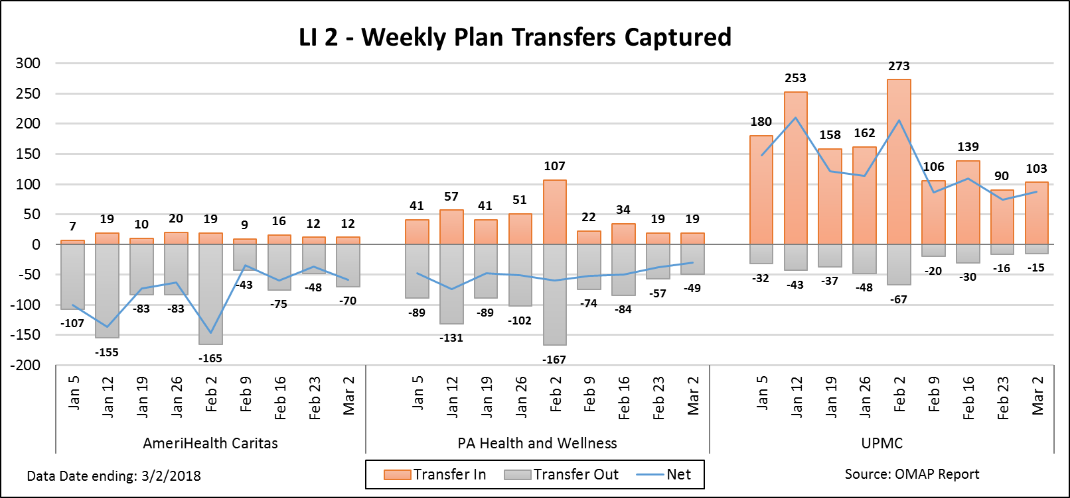
CHC SOUTHWEST Weekly Plan Transfers

Slide 11
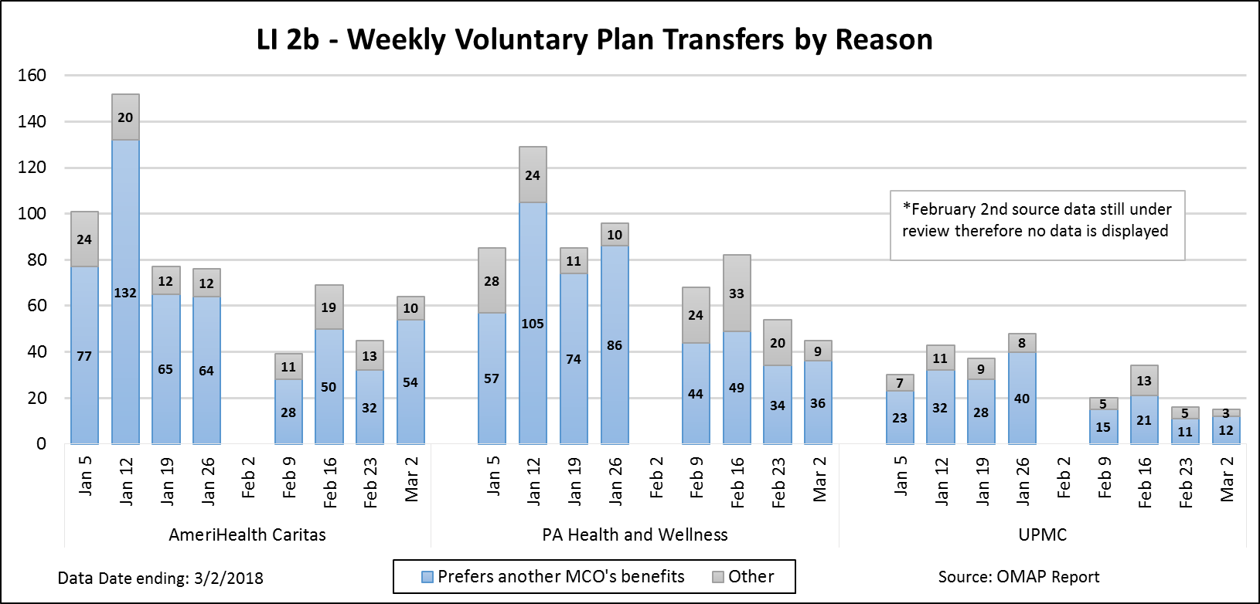
CHC SOUTHWEST Weekly Plan Transfers

Slide 12
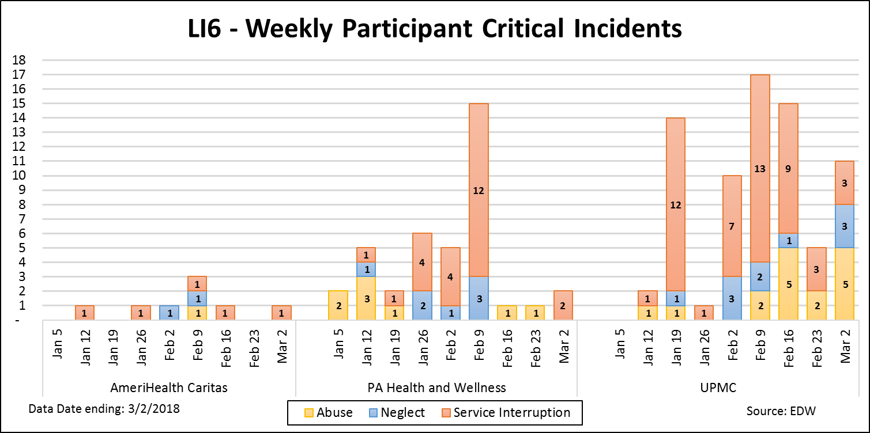
CHC SOUTHWEST Critical Incidents

Slide 13
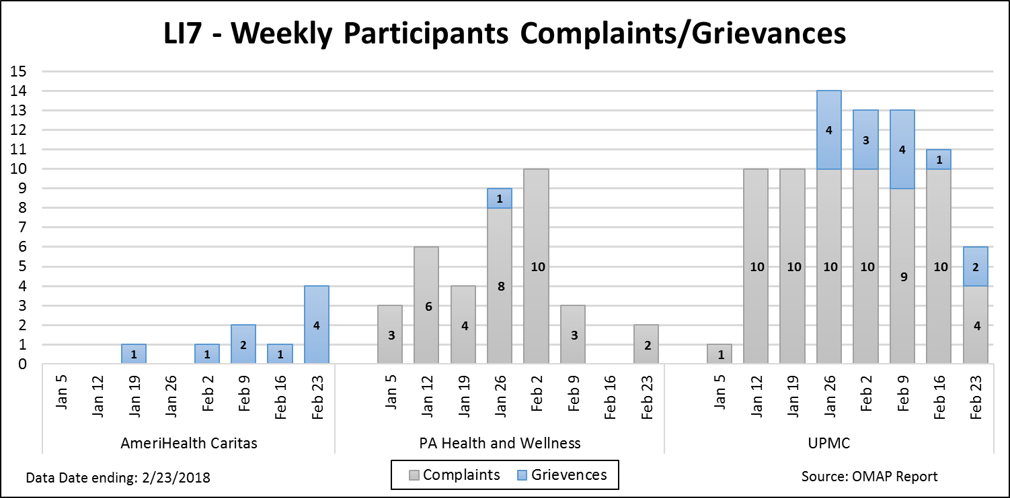
CHC SOUTHWEST Complaints/Grievances

Slide 14
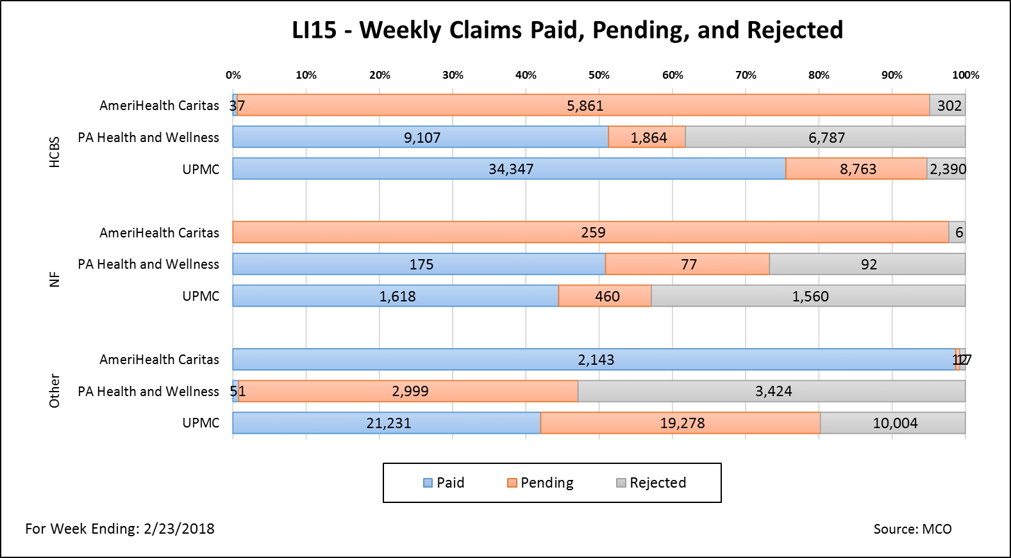
CHC SOUTHWEST Provider Claims Submissions

Slide 15
AREAS OF CURRENT FOCUS

Slide 16
LAUNCH COMMUNICATIONS
Daily Calls with individual MCOs, including weekly joint calls with all 3 MCOs.
Daily Calls with DHS and PDA.
Weekly Participant and Participant Advocate Calls.
Weekly Provider Association Calls, including:
Nursing Facilities
HCBS Providers
Weekly Calls with the Aging Network.

Slide 17
AREAS OF CURRENT FOCUS:
HHAeXchange/Data Integrity
Direct care Worker Authorizations
Nursing Facility and HCBS Claims Submission
Medicare/Medicaid Participant and Provider Education
Enrollment Issues
Person-centered Service Planning Process
Reviewing Changes in Person-Centered Service Plans
Transportation
Complaint and Grievance processes and notices for HCBS Services
Lessons Learned for the Southeast

Slide 18
SOUTHWEST LESSONS LEARNED (SO FAR):
Earlier stakeholder engagement opportunities with key population groups and group representatives
Earlier in-person provider communication sessions
Enhanced communication materials regarding Medicare vs. CHC
More education and communication on continuity-of-care
Addition report development on enrollment and plan transfer scenarios
Earlier OBRA reassessments
More communication on the LIFE program as an enrollment alternative
Earlier data clean-up in HCSIS and SAMS
Earlier pre-transition
More provider information on IEB website
More provider training on Medicare vs. CHC

Slide 19
Southeast Implementation

Slide 20
Southeast Population
Population Bucket | Count of Individuals
HCBS Dual | 28,887
HCBS Non-Dual | 12,136
LTC Dual | 12,456
LTC Non-Dual | 1,365
NFI Dual | 72,882
Grand Total | 127,726

Slide 21
Southeast Population
County | Count of Individuals
Bucks | 9,488
Chester | 5,216
Delaware | 12,435
Montgomery | 12,835
Philadelphia | 87,691
Under Review | 61
Grand Total | 127,726

Slide 22
Southeast Implementation Focuses
OBRA Assessments
Communications Planning
Provider Outreach and Education
Population Identification

Slide 23
RESOURCES

Slide 24
LAUNCH COMMUNICATIONS
Participant Help Line - 1-800-757-5042
OLTL will staff a participant help line to address questions or concerns regarding their CHC MCO, the IEB, their service coordinator, or anything associated with the program launch.
Independent Enrollment Broker - 1-844-824-3655 OR (TTY 1-833-254-0690)
If Participants have not received their post enrollment packets, they should contact the IEB at the above telephone number or visit their website at www.enrollchc.com (Open Monday through Friday, 8:00 a.m. to 6:00 p.m.).

Slide 25
RESOURCE INFORMATION
CHC LISTSERV // STAY INFORMED http://listserv.dpw.state.pa.us/oltl-community-healthchoices.html
COMMUNITY HEALTHCHOICES WEBSITE www.healthchoicespa.com
MLTSS SUBMAAC WEBSITE
www.dhs.pa.gov/communitypartners/informationforadvocatesandstakeholders/mltss/
EMAIL COMMENTS TO: RA-PWCHC@pa.gov
PROVIDER LINE: 1-800-932-0939
PARTICIPANT LINE: 1-800-757-5042
INDEPENDENT ENROLLMENT BROKER: 1-844-824-3655 OR (TTY 1-833-254-0690)
(Open Monday through Friday, 8:00 a.m. to 6:00 p.m.)
or visit www.enrollchc.com

Slide 26
CHC-MCO CONTACT INFORMATION
AmeriHealth Caritas | CHCProviders@amerihealthcaritas.com
www.amerihealthcaritaschc.com - 1-855-235-5115 (TTY 1-855-235-5112)
Pennsylvania Health and Wellness (Centene) | information@pahealthwellness.com
www.PAHealthWellness.com – 1-844-626-6813 (TTY 1-844-349-8916)
UPMC Community HealthChoices | CHCProviders@UPMC.edu
www.upmchealthplan.com/chc - 1-844-833-0523 (TTY 1-866-407-8762)
..

Slide 27
QUESTIONS

