Slide 1
CHC Third Thursday Webinar
October 17, 2019

Slide 2
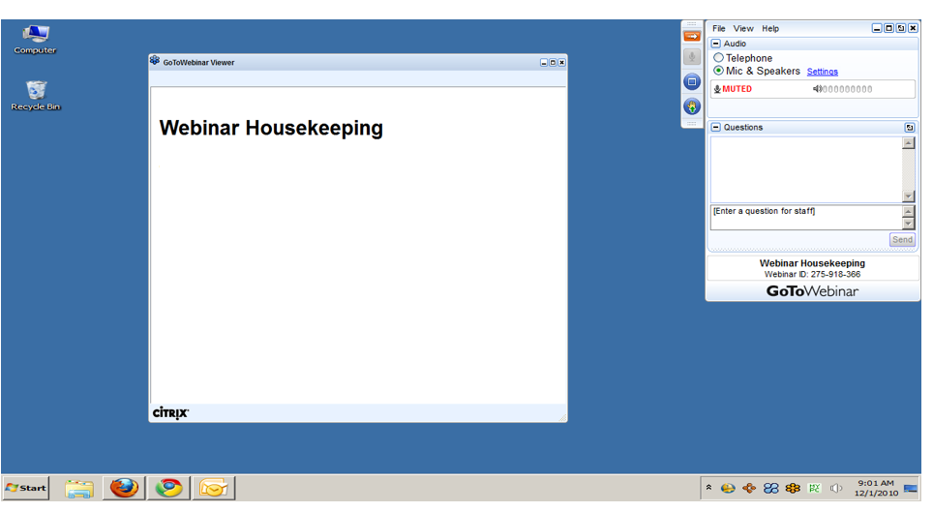
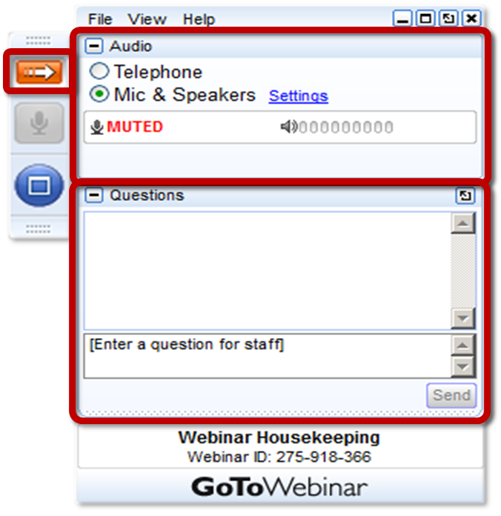
GoToWEBINAR HOUSEKEEPING: What Attendees See
Notes:
Before we get started, I’d like to go over a few items so you know how to participate in today’s event:
Here is a screen shot of the Attendee interface. This is what you should see on your desktop.
In the center of the screen is the GoToWebinar Viewer where you will see the presentation.
In the upper right hand corner is the GoToWebinar control panel where you can ask questions and select audio mode.
If the Control Panel is closed you will see a slim red rectangle. Click on the red arrow to expand the Control Panel.
5. You will be listening to the presentation via your computer's speaker system by default. If you prefer to join by phone, select the “Telephone” button in the audio pane and the dial-in information will be displayed. This will place you in the “listen only” mode to hear the presentation.
You may submit questions (via text) by typing your questions into the “Questions” pane of the control panel. You may send in your questions at any time during the presentation.
Note: The attendee control panel will collapse automatically when not in use. To keep it open, click the “View”, menu, and uncheck “Auto-hide Control Panel”.

Slide 3
AGENDA
CHC Phase 3 Implementation Updates
Electronic Visit Verification (EVV) Updates
Office of Long-Term Living (OLTL) Budget Updates

Slide 4
PHASE 3 IMPLEMENTATION

Slide 5
PHASE THREE IMPLEMENTATION
OBJECTIVES
Comprehensive participant communication
Robust readiness review
Provider communication and training
Pre-transition and plan selection for phase three participants
Incorporation of southwest, southeast implementation and launch lessons learned
CHALLENGES
Transportation
Geography
Participant Outreach
Electronic Visit Verification (EVV) Implementation

Slide 6
PHASE THREE PROVIDER NETWORKS
Nursing Facilities (318 Total)
Amerihealth Caritas – 235
PA Health & Wellness – 159
UPMC – 259
Hospitals (93 Total)
Amerihealth Caritas – 81
PA Health & Wellness – 59
UPMC – 61
All other Nursing Facility and Hospital contracts are in process.
All MCOs continue to submit weekly provider network reports for network adequacy monitoring.

Slide 7
CHC PROVIDER SUMMITS
Additional Provider Summits are being conducted in each Phase 3 Zone.
Northwest Zone: October 8th at Clarion University
Northeast Zone: October 21st at Marywood University
Lehigh/Capital Zone: October 28th at Kutztown University
Agenda:
An overview of CHC will be provided in the morning.
Breakout sessions will be offered in the afternoon and will cover the following topics:
Home and Community-Based Services
Service Coordination
Nursing Facilities
Behavioral Health
Physical Health
Transportation

Slide 8
PARTICIPANT INFORMATION SESSIONS
Aging Well has conducted 71 of 72 scheduled Participant Information Sessions
3,025 participants have attended the sessions.
11 additional Information Sessions are being offered by the PA Centers for Independent Living in partnership with the Office of Long-Term Living
The schedule can be found on the next slide.
Participants interested in attending may contact the location of the event to RSVP.

Slide 9
ADDITIONAL INFORMATION SESSIONS
DATE | LOCATION | CAPACITY | TIME
10/15/19 | Lehigh Valley CIL 713 N. 13th Street Allentown, PA 18102 | 45 | 1 p.m. – 3 p.m.
10/21/19 | Community Resources for Independence 3410 West 12th Street Erie, PA 16505 Phone: 1-800-530-5541 | 60 | 1 p.m. – 3 p.m.
10/22/19 | Voices for Independence 1432 Wilkins Road Erie, PA 16505 Phone: 1-866-407-0064 | 100 | 1 p.m. – 3 p.m.
10/22/19 | Anthracite Region Center for Independent Living 8 West Broad Street, Suite 228, Markle Building Hazelton, PA 18201 Phone: 717-364-1732 | 50 | 1 p.m. – 3 p.m.
10/28/19 | North Central 49 Ridgemont Drive Ridgway, PA 15853 (Life & Independence for Today) Phone: 570-327-9070 | 50 | 1 p.m. – 3 p.m.
DATE | LOCATION | CAPACITY | TIME
10/30/19 | Roads to Freedom 24 East 3rd Street Williamsport, PA 17701 Phone: 570-327-9070 | 75 | 10 a.m. - noon
10/30/19 | Center for Independent Living of Central PA 207 House Street, Suite 107 Camp Hill, PA 17011 Phone: 717-731-1900 | 50 | 1 p.m. – 3 p.m.
10/30/19 | Center for Independent Living Opportunities 127 West Market Street, Suite 100 York, PA 17401 Phone: 717-849-0991 | 60 | 1 p.m. – 3 p.m.
11/1/19 | Lancaster Chamber of Commerce 115 East King Street, Room 2 E Lancaster, PA 17602 (Disability Empowerment Center) Phone: 717-394-1890 | 50 | 1 p.m. – 3 p.m.
11/4/19 | Abilities in Motion 210 North 5th Street Reading, PA 19601 Phone: 1-888-376-0120 | 50 | 1 p.m. – 3 p.m.
11/5/19 | Huntingdon County Career and Technology Center 1183 Technology Drive Mill Creek, PA 17060 (Center for Independent Living of South Central PA) Phone: 717-731-1900 | 50 | 1 p.m. – 3 p.m.

Slide 10
ELECTRONIC VISIT VERIFICATION (EVV)

Slide 11
EVV REQUIREMENTS
Section 12006 of the 21st Century Cures Act requires all states to implement the use of EVV for Medicaid-funded personal care and home health care services. EVV must be implemented for personal care services by January 1, 2020 and for home health care services by January 1, 2023.
OLTL waiver services included in the initial implementation of EVV include:
Personal Assistance Services (Agency and Participant-Directed Model)
Participant-Directed Community Supports
Respite (unlicensed settings only)

Slide 12
EVV IMPLEMENTATION UPDATES
October
The DHS Sandata system went live on October 7th as planned.
Providers who have completed the DHS Sandata system training should have received their welcome packets to begin using the system and training their staff.
Providers who are using an alternate EVV system should begin integration and certification activities with Sandata and/or HHAeXchange depending on which programs they serve.
November
The EVV Public Meeting planned for October 22nd has been postponed. Additional information will be posted on the DHS EVV website and sent to attendees who registered regarding the rescheduled date in November.
Tentative agenda items for November include:
Implementation Updates
DHS Sandata System Training Updates
A demo of the DHS EVV system Billing module offered in addition to the standard EVV system.

Slide 13
EVV NEXT STEPS FOR PROVIDERS
Current CHC Providers and Aging, Attendant Care, and Independence Waiver Providers
If providers are electing to use the HHAeXchange EVV system offered by the MCOs, providers must work with the MCOs to complete training and other onboarding requirements.
Providers using Alternate EVV systems in CHC will need to send their EVV data the CHC-MCOs.
Providers should contact HHAeXchange at EDIsupport@hhaexchange.com to complete third party system integration activities for CHC.
Fee-For-Service (OBRA Waiver and Act 150 Program)
The DHS Sandata system training registration is available for providers electing to use the DHS Sandata system for the OBRA waiver and Act 150 program. Providers using the DHS system must complete this training in order to begin setting up their agency accounts and security permissions. The DHS Sandata system is only available for Fee-For-Service providers.
The DHS Aggregator will receive information from Alternate EVV systems being used by providers in fee-for-service programs.
Providers should contact Sandata at 1-855-705-2407 to complete third party system integration activities for fee-for-service programs.

Slide 14
EVV RESOURCES
FAQs, technical specifications, and other resources are available at: http://www.dhs.pa.gov/provider/billinginformation/electronicvisitverification/
For specific questions regarding EVV and to subscribe to the EVV listserv, please contact: RA-PWEVVNotice@pa.gov

Slide 15
Office of Long-Term Living Budget Updates

Slide 16
2019-20 Budget Factors
Maintains FFS Programs in Non-CHC Zones
Maintains Existing Service Levels for Participants
Shifts Funding from Legacy Appropriations (LTC, HCBS, Services to Persons w/Disabilities, Attendant Care) to CHC
Funds Implementation of CHC in the Lehigh/Capital, Northwest, and Northeast Zones in Jan. 2020
Reflects Full Year Operation of CHC in SW and SE
Reflects Actuarially Sound Rates for CHC MCOs PH & LTSS

Slide 17
2019-20 Budget Factors
Continues the IGT Program for County NFs
Expands the Total Number of Individuals covered in the OLTL Waivers
Includes increase for Personal Assistance Services
Includes funds to establish a single responsible entity for Functional Eligibility Determinations
Assumes Expansion in LIFE Program

Slide 18
2019-20 Budget: State Funding
Dollar Amounts in Thousands
2018-2019 2019-2020 Change
Actual Enacted
Budget
State General Fund:
Long-Term Care………………………………….. $ 850,149 $ 491,395 $ (358,754)
Community HealthChoices……………………… $ 693,766 $ 2,343,340 $ 1,649,574
Home and Community – Based Services……... $ 506,450 $ 159,605 $ (346,845)
Long-Term Care Managed Care……………….. $ 149,039 $ 156,933 $ 7,894
Services to Persons w/ Disabilities…………….. $ 354,573 $ 123,500 $ (231,073)
Attendant Care…………………………………… $ 221,599 $ 50,647 $ (170,952)
Total General Fund……………........................... $ 2,775,576 $ 3,325,420 $ 549,844
Appropriations within this Program

Slide 19
2019-20 Budget: Total Funding
Office of Long-Term Living
Long-Term Care, Community HealthChoices, Home and Community-Based Services, Living Independence for the Elderly, Services to Persons w/Disabilities, Attendant Care
Total State, Federal, and Other funding:
FY18-19 Actual $ 8,967,727,000
FY19-20 Enacted Budget $ 9,766,227,000
Increase $ 798,500,000

Slide 20
Consumers Eligible for Services
OLTL Participants by Program
FFS Waiver/Act 150/LIFE Program | 18-Jul | 18-Aug | 18-Sep | 18-Oct | 18-Nov | 18-Dec | 19-Jan | 19-Feb | 19-Mar | 19-Apr | 19-May | 19-Jun | 19-Jul | 19-Aug
Act 150 | 1,457 | 1,449 | 1,444 | 1,436 | 1,437 | 1,429 | 1,408 | 1,402 | 1,394 | 1,389 | 1,379 | 1,377 | 1,366 | 1,362
Aging | 35,269 | 35,740 | 35,506 | 36,321 | 36,660 | 36,745 | 10,740 | 10,805 | 10,856 | 11,067 | 11,181 | 11,193 | 11,445 | 11,541
Attendant Care | 16,213 | 16,328 | 16,374 | 16,522 | 16,661 | 16,718 | 2,574 | 2,564 | 2,563 | 2,580 | 2,493 | 2,486 | 2,506 | 2,508
Independence | 14,378 | 14,494 | 14,398 | 14,705 | 14,807 | 14,844 | 6,229 | 6,265 | 6,287 | 6,355 | 6,366 | 6,384 | 6,494 | 6,549
LIFE | 6,489 | 6,520 | 6,222 | 6,665 | 6,727 | 6,775 | 6,821 | 6,825 | 6,838 | 6,871 | 6,890 | 6,636 | 7,023 | 7,067
OBRA | 1,127 | 1,138 | 1,127 | 1,195 | 1,215 | 1,222 | 819 | 821 | 822 | 844 | 843 | 849 | 880 | 912
LTC | 41,358 | 41,209 | 41,123 | 41,500 | 41,455 | 40,591 | 27,010 | 26,828 | 26,596 | 27,044 | 26,721 | 27,069 | 26,953 | 26,545
Total FFS Waiver/ACT 150/LIFE Consumers | 116,291 | 116,878 | 116,194 | 118,344 | 118,962 | 118,324 | 55,601 | 55,510 | 55,356 | 56,150 | 55,873 | 55,994 | 56,667 | 56,484
Managed Care (Community Health Choices) | 18-Jul | 18-Aug | 18-Sep | 18-Oct | 18-Nov | 18-Dec | 19-Jan | 19-Feb | 19-Mar | 19-Apr | 19-May | 19-Jun | 19-Jul | 19-Aug
CHC-HCBS Duals | 8,750 | 8,889 | 8,972 | 9,076 | 9,142 | 9,286 | 43,619 | 43,774 | 44,247 | 44,431 | 44,717 | 45,238 | 45,638 | 45,874
CHC-HCBS Non Duals | 2,960 | 3,019 | 3,049 | 3,109 | 3,152 | 3,201 | 18,849 | 19,093 | 19,401 | 19,602 | 19,847 | 20,131 | 20,399 | 20,637
CHC-LTC Duals | 10,265 | 10,335 | 10,325 | 10,334 | 10,353 | 10,479 | 22,087 | 21,958 | 21,977 | 21,801 | 21,869 | 21,862 | 21,870 | 21,850
CHC-LTC Non Duals | 883 | 904 | 901 | 909 | 894 | 917 | 2,326 | 2,342 | 2,349 | 2,354 | 2,331 | 2,335 | 2,324 | 2,349
CHC-NFI | 57,060 | 57,749 | 57,629 | 57,695 | 57,530 | 57,600 | 126,759 | 126,159 | 126,045 | 125,764 | 125,623 | 125,342 | 125,290 | 124,873
Total Managed Care Consumers | 79,918 | 80,896 | 80,876 | 81,123 | 81,071 | 81,483 | 213,640 | 213,326 | 214,019 | 213,952 | 214,387 | 214,908 | 215,521 | 215,583
NOTES:
• The data source for both Fee For Service and Managed Care data is CIS.
• Consumers eligible for services count if active at any time during the period.
• The most recent activity date determines what record to choose if more than one activity occurs within the month.
• Consumers counted only in CHC if they appear in both FFS and Managed Care during the month.
• Approximately 5% of the LIFE count includes those participants in both LIFE and a long-term care facility.

Slide 21
Waiver Consumer Enrollment
FFS Non-Aging includes: | Attendant Care, Independence, and OBRA waivers
Data Source: | eDW Monthly Standard Reports

Slide 22
Overview of FY 19-20 OLTL Budget
$9.77B OLTL Budget by appropriation
Total Funds including: State, Federal, Lottery, Tobacco, and revenue
(Amounts in Thousands)
Services to Persons w/ Disabilities, $261,507

Slide 23
Appropriations: Line by Line
Long-Term Care
Nursing Facilities
OLTL Grants and Operating Contracts
 | 2018-2019 Actual | 2019-2020 Enacted Budget | Change
State Funds | $ 850M | $ 491M | ($ 359M)
Federal Funds | $ 1.48B | $ 720M | ($ 760M)
Other Funds* | $ 460M | $ 139M | ($ 321M)
Total Funds | $ 2.8B | $ 1.4B | ($ 1.4B)
* Includes Lottery, Tobacco, and Other Revenue Funds

Slide 24
Appropriations: Line by Line
Community HealthChoices
Medical Assistance
 | 2018-2019 Actual | 2019-2020 Enacted Budget | Change
State Funds | $ 694M | $ 2.343B | $ 1.65B
Federal Funds | $ 1.769B | $ 3.931B | $ 2.16B
Other Funds* | $ 906M | $ 1.077B | $ 155M
Total Funds | $ 3.4B | $ 7.4B | $ 4.0B
* Includes Lottery, Tobacco, and Other Revenue Funds

Slide 25
Appropriations: Line by Line
Home and Community-Based Services
Aging Waiver
 | 2018-2019 Actual | 2019-2020 Enacted Budget | Change
State Funds | $ 506M | $ 160M | ($ 346M)
Federal Funds | $ 681M | $ 198M | ($ 483M)
Other Funds* | $ 121M | $ 0 | ($ 121M)
Total Funds | $ 1.308B | $ 358M | ($ 950M)
* Includes Lottery, Tobacco, and Other Revenue Funds

Slide 26
Appropriations: Line by Line
Long-Term Care Managed Care
LIFE Program
 | 2018-2019 Actual | 2019-2020 Enacted Budget | Change
State Funds | $ 149M | $ 157M | $ 8.0M
Federal Funds | $ 171M | $ 172M | $ 1.0M
Total Funds | $ 320M | $ 329M | $ 9.0M

Slide 27
Appropriations: Line by Line
Services to Persons with Disabilities
Independence and OBRA Waiver Programs
 | 2018-2019 Actual | 2019-2020 Enacted Budget | Change
State Funds | $ 355M | $ 124M | ($ 231M)
Federal Funds | $ 388M | $ 138M | ($ 250M)
Total Funds | $ 743M | $ 262M | ($ 481M)

Slide 28
Appropriations: Line by Line
Attendant Care
Attendant Care Waiver, Act 150 Program
 | 2018-2019 Actual | 2019-2020 Enacted Budget | Change
State Funds | $ 222M | $ 51M | ($ 171M)
Federal Funds | $ 215M | $ 68M | ($ 147M)
Other Funds* | $ 1.0M | $ 1.0M | --
Total Funds | $ 438M | $ 120M | ($ 318M)
*Does not include A/C and Act 150 over 60 funds

Slide 29
QUESTIONS

Slide 30
CHC RESOURCE INFORMATION
CHC LISTSERV // STAY INFORMED: http://listserv.dpw.state.pa.us/oltl-community-healthchoices.html
COMMUNITY HEALTHCHOICES WEBSITE: www.healthchoices.pa.gov
MLTSS SUBMAAC WEBSITE: www.dhs.pa.gov/communitypartners/informationforadvocatesandstakeholders/mltss
EMAIL COMMENTS TO: RA-PWCHC@pa.gov
OLTL PROVIDER LINE: 1-800-932-0939
OLTL PARTICIPANT LINE: 1-800-757-5042
INDEPENDENT ENROLLMENT BROKER: 1-844-824-3655 or (TTY 1-833-254-0690)
or visit www.enrollchc.com

Slide 31
CHC MCO CONTACT INFORMATION
AmeriHealth Caritas/Keystone First | CHCProviders@amerihealthcaritas.com
www.amerihealthcaritaschc.com - 1-800-521-6007 (TTY 1-855-235-5112)
Pennsylvania Health and Wellness (Centene) | information@pahealthwellness.com
www.PAHealthWellness.com – 1-844-626-6813 (TTY 1-844-349-8916)
UPMC Community HealthChoices | CHCProviders@UPMC.edu
www.upmchealthplan.com/chc - 1-844-860-9303 (TTY 1-866-407-8762)

