Slide 1
NORRISTOWN STATE HOSPITAL
THE PATH FORWARD
ACTING SECRETARY TERESA MILLER
NOVEMBER 2017

Slide 2
AGENDA
Introductions
Current status and background
ACLU settlements
Original plan to address forensic components of ACLU settlements
Why Norristown was originally selected for forensic beds
The path forward
DGS land planning study
Public comment

Slide 3
CURRENT STATUS & BACKGROUND

Slide 4
CURRENT STATUS
The Department of Human Services (DHS) has:
Stopped construction at Norristown State Hospital.
Engaged a consultant to assess systems and processes and produce a report by the end of year with recommendations on how to reduce forensic wait times in the long term.
DHS will:
Explore other options for reducing the waitlist for forensic beds.
Make a commitment to solicit public feedback moving forward.

Slide 5
KEY TERMS
Civil beds
Beds to serve individuals who were committed by a court for psychiatric treatment.
Forensic beds
Beds to serve individuals who have been committed by a criminal court for psychiatric treatment. Individuals have been charged with a crime and were either:
Found incompetent to proceed to trial and need treatment in order to be able to proceed to trial;
Detained in a county prison and in need of inpatient care; or
Found not guilty by reason of insanity.
Step-down beds
Beds to serve individuals who still have criminal justice oversight but are determined by the supervising criminal court as not needing the level of security of a forensic unit.

Slide 6
HISTORY
Norristown State Hospital opened in 1880.
By 1947, the facility grew to support approximately 5,000 individuals needing mental health services.
Forensic services began in 1937 with the development of Building 51.
The facility’s census decline can be attributed to two factors:
Advances in treatment
Increased community opportunities

Slide 7
CURRENT CAPACITY
122
BEDS IN THE GENERAL PSYCHIATRY (CIVIL SECTION) UNIT
The civil section serves the five counties of the southeast region of Pennsylvania: Bucks, Chester, Delaware, Montgomery, and Philadelphia.
The program is in Building 1 and 10.
137
BEDS IN THE REGIONAL PSYCHIATRIC FORENSIC CENTER (RFPC)
The RFPC serves 19 counties.
These services are provided in Building 51.

Slide 8
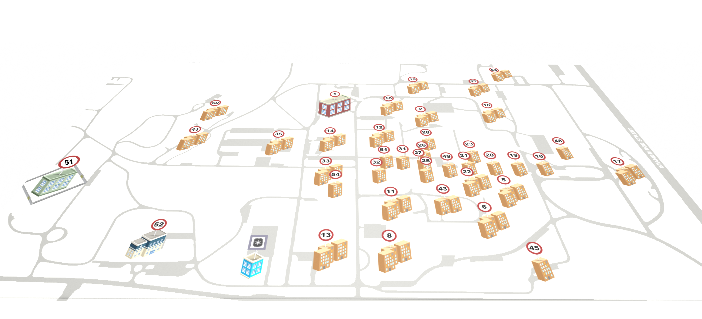
CURRENT CAPACITY
GENERAL PSYCHIATRY (CIVIL SECTION) UNIT HOUSING 122 CIVIL AND STEP-DOWN BEDS
REGIONAL PSYCHIATRIC FORENSIC CENTER (RFPC) HOUSING
137 BEDS

Slide 9
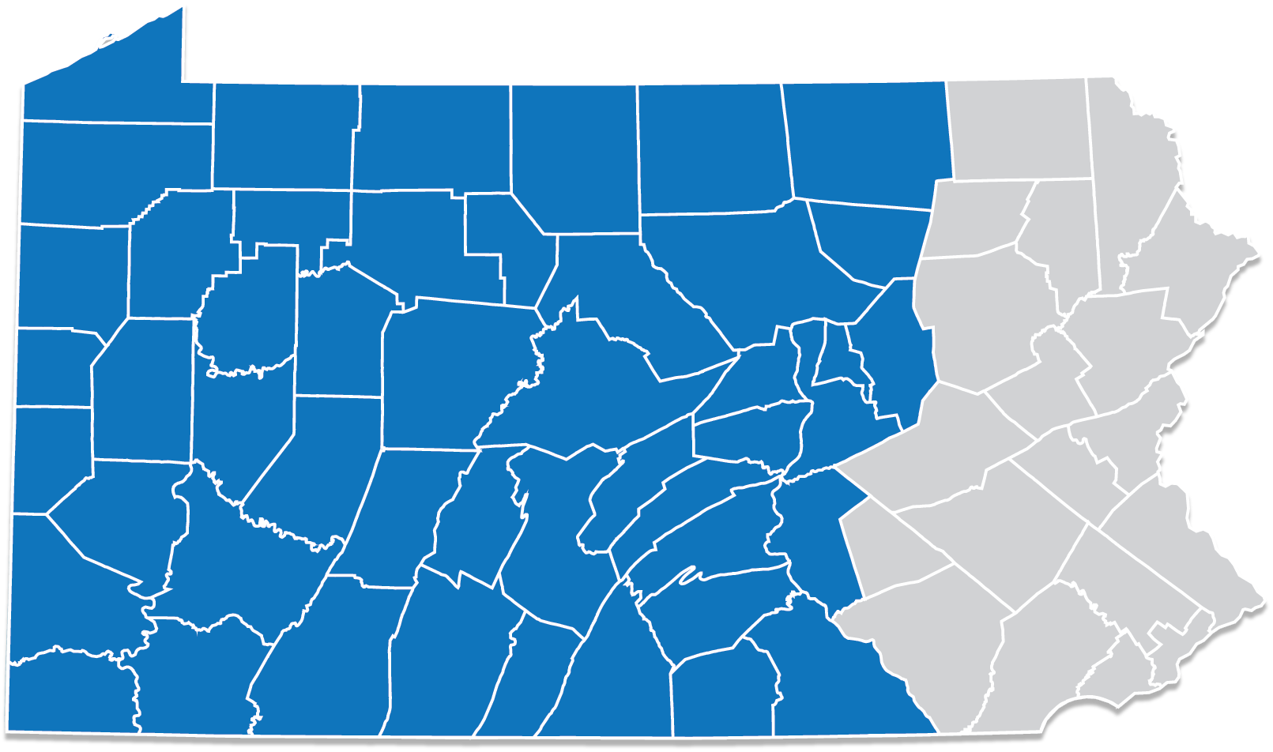
RFPC SERVICE AREAS
DESIGNATION OF SERVICE AREAS FOR RFPCs
TORRANCE STATE HOSPITAL RFPC
NORRISTOWN STATE HOSPITAL RFPC

Slide 10
NORRISTOWN CIVIL CLOSURE
Closure announced: Jan. 11, 2017
Closure will take 18-24 months.
What’s affected?
Funding directed to Wernersville State Hospital for community treatment slots, to free up beds at Wernersville for civil patients who would have been committed to Norristown State Hospital
60 step-down beds retained.
Unspecified number of beds temporarily converted from civil to forensic use to improve access to RFPC.
137 RFPC beds remain open.

Slide 11
HISTORY OF THE WAITING LIST
211
184
174
111
194
101
71
42
Norristown’s RFPC has historically had longer waitlists/wait times than Torrance’s RFPC.
In 2012, the wait time was four months.
Presently, the average wait time is over a year.
The majority of individuals on the waitlist (64%) have been charged with minor crimes.

Slide 12
ACLU SETTLEMENTS

Slide 13
ACLU SETTLEMENTS
In October 2015, the ACLU filed a class action lawsuit regarding length of wait times for admission to the forensic units at Norristown and Torrance state hospitals.
First settlement: January 16, 2017
60 new community slots within 120 days.
60 additional community slots within 180 days.
$1M reinvestment to Philadelphia for 100 supported housing slots
Psychiatric assessments of individuals on the wait lists.
Psychiatric assessments of individuals already in RFPCs.

Slide 14
ACLU SETTLEMENTS
Despite expansion of community treatment slots, the waitlist for Norristown State Hospital continued to grow from 184 individuals in 2016 to 204 in May 2017. The ACLU returned to court, demanding additional forensic beds to decrease these numbers.
Second settlement: June 15, 2017
50 additional forensic beds by Dec. 15, 2017.
30 civil beds temporarily converted to forensic use
Develop 29 additional community slots
10 slots in Philadelphia; 19 slots in Allegheny County
DHS to engage a consultant to assess systems and processes and produce a report by end of year with recommendations on how to reduce wait times in the long term.

Slide 15
ORIGINAL PLAN TO ADDRESS ACLU SETTLEMENTS

Slide 16
ADDRESSING ACLU SETTLEMENTS
Norristown State Hospital now:
Building 1 – civil and step-down beds
Building 10 – civil and step-down beds
Building 51 – forensic beds
Plan for Norristown given closure/settlements:
Building 1 – House individuals in civil beds as they transition out; some beds retained as step-down beds
Building 10 – House some step-down beds, as well as meet settlement agreement to add 50 forensic beds by:
Opening 28 beds in an unused unit
Repurpose 22 current beds
Adding security measures that replicate those used in Building 51
Building 51 – House individuals in forensic beds.

Slide 17
FORENSIC BEDS: WHY NORRISTOWN?

Slide 18
WHY NORRISTOWN?
Waitlist – The waitlist was four times that at Torrance.
Suitability – Building 10 was selected because:
Already in use and houses both civil and step-down units.
Only patient care building up to code, other than Building 1; also not in use via lease by other parties.
Required fewest renovations.
Unsuitability of alternatives
Other locations lacked usable buildings and/or staffing.
Staff
Forensic Security Employees (FSE) are required; only Norristown and Torrance have them.
Other locations would not be able to stand up staffing/beds within six months, per what the court would find acceptable and per the settlement agreement.

Slide 19
WHY NORRISTOWN?
Location & transit costs
Norristown offered the most centralized location for the 19-county service area. County sheriff departments must travel to forensic locations to transport individuals for court hearings.
A centralized location allows families to see their loved ones
A centralized location also affords defense counsel the ability to meet and interview their clients.

Slide 20
DGS LAND
PLANNING STUDY

Slide 21
THE PATH
FORWARD

Slide 22
THE PATH FORWARD
What are DHS’ next steps?
We are committed to finding a solution that addresses the needs of the community as well as DHS’s obligation to ensure that all individuals in the criminal justice system who need mental health treatment have access to necessary treatment in the most appropriate setting.

Slide 23
THE PATH FORWARD
What are DHS’ next steps?
The PA Department of General Services will be overseeing a land planning study for the state hospital.
We are committed to reducing the waitlist by working with stakeholders, gaining feedback, and finding a viable path forward.
We are looking forward to the consultant’s report at the end of year with recommendations on how to reduce forensic wait times.
We are evaluating long-term alternatives to Building 10 to provide forensic beds. In the meantime, construction has been stopped.
In return for our commitment to a solution that gets us out of buildings 1 and 10 in the Norristown municipality by sometime in 2022 at the latest, we hope that the community will accept us resuming construction on building 10 and using it as a temporary solution with a definite end point.
.

Slide 24
PUBLIC COMMENT

