Slide 1
CBO Training Module 4: Examples of CBO-MCO-Provider Partnerships n June 17, 2021
Notes:
Nora

Slide 2
PA DHS Presenters
Douglas Jacobs, MD, MPH, Chief Medical Officer & Chief Innovation Officer, DHS

Slide 3
Training Session #4
Two concurrent options today:
Plenary Session will feature CBO, MCO, and provider organization representatives talking about their own experiences developing these partnerships, featuring examples in the area of food security and housing. Register at: https://attendee.gotowebinar.com/register/2793971610639341836
CBO Financial Planning Model Breakout Session where interested representatives of CBOs’ budget and finance departments can spend time reviewing the CBO Financial Planning Model and participating in a discussion about the financial implications of a CBO contract with an MCO or provider organizations. Register at: https://attendee.gotowebinar.com/register/3714480547338020111
You are in plenary session
Use this link for financial planning session

Slide 4
Agenda
Welcome and Introductions
Housing Smart
Food Delivery for Vulnerable Families
Q&A

Slide 5
Virtual Training Etiquette
Due to the large number of attendees:
We will mute all lines during the presentation
Please use the question feature to ask questions
Be sure to ask for clarification when needed
Image Source. Ellicom

Slide 6
BUILDING PARTNERSHIPS
Training Resources
All training sessions are being recorded. These recordings, the slides, and tools will be posted on the DHS website at https://www.dhs.pa.gov/HealthInnovation/Pages/Health-Innovations-Resources.aspx

Slide 7
Meeting Participants – CEbP
Center for Evidence-based Policy (CEbP)
Susan Stuard, MBA, Lead for Pennsylvania Technical Assistance (TA)
Mike Bonetto, PhD, Member of Pennsylvania TA team, healthcare strategic planning and policy
Brittany Lazur, MPH, Policy Analyst
Allyson Evans, JD, MED Director
Nicole Thompson, Project Coordinator
Daniel Vizzini, Policy Analyst
Notes:
- Doug will hand off to Susan to lead introductions of Center staff

Slide 8
Training Schedule
Training | Date | Focus
Training Session 1: The Rationale for CBO and MCO/Provider Partnerships | April 28 | An overview of Value-based Purchasing (VBP), customized for a CBO audience, focusing on the rationale and goals of transitioning from fee-for-service to MCO/provider contracts that are part of a VBP arrangement.
Training Session 2: Aligning CBO Governance and Operations with MCO and/or Provider Partnerships | May 17 | An overview of how CBOs can best align and adapt their governance and operations to support participation in an MCO and/or provider contract.
Training Session 3: Evaluating CBO Opportunities and Negotiating an Agreement | May 28 | This session will focus on evaluation of readiness for partnerships, as well as considerations for picking an MCO or provider organization partner and negotiating an agreement.
Training Session 4: CBO Workshop Session | Today | A plenary session will provide examples of CBO-MCO-provider partnerships. A concurrent session will be a workshop review and discussion of the financial model.

Slide 9
Housing Smart
Presenters and Participants:
Patrick Vulgamore, MPH, Project Manager, Population Health, Temple University Health System
Bill Maroon, MSW, Director of Business Development and Innovation, Resources for Human Development
Kathleen Mullin, MUP, Director of Housing Initiatives, AmeriHealth Caritas Pennsylvania l Keystone First
Karin Annerhed-Harris, VP Business Development, Resources For Human Development
Steven R. Carson, MHA, BSN, RN, Senior Vice President, Population Health, Temple University Health System
Kristin Beck, Director of Community Health Programs, Health Partners Plans
Y. Lily Higgins, MD MBA MS, Market Chief Medical Officer, AmeriHealth Caritas Pennsylvania l Keystone First
Howard Lu, MD, MBA, MPH, Vice President & Chief Clinical Officer, Health Partners Plans

Slide 10
Presentation: Housing Smart

Slide 11
Q&A:
Housing Smart

Slide 12
Food Delivery for Vulnerable Families
Presenters and Participants:
Elizabeth (Liz) Scime, LCSW, Manager, Community Health Programs, Health Partners Plans
Jamiliyah (Jay) Foster, Director, Ending Hunger for Good, Philabundance
Melanie Cataldi, MPH, Chief Impact Officer, Philabundance
Aurica Donovan, MBA, Community Relations and Program Director, Food Connect
Megha Kulshreshtha, MA, Founder & Executive Director, Food Connect
Kristin Beck, Director of Community Health Programs, Health Partners Plans

Slide 13
Presentation: Food Delivery for Vulnerable Families

Slide 14
Q&A:
Food Delivery for Vulnerable Families

Slide 15
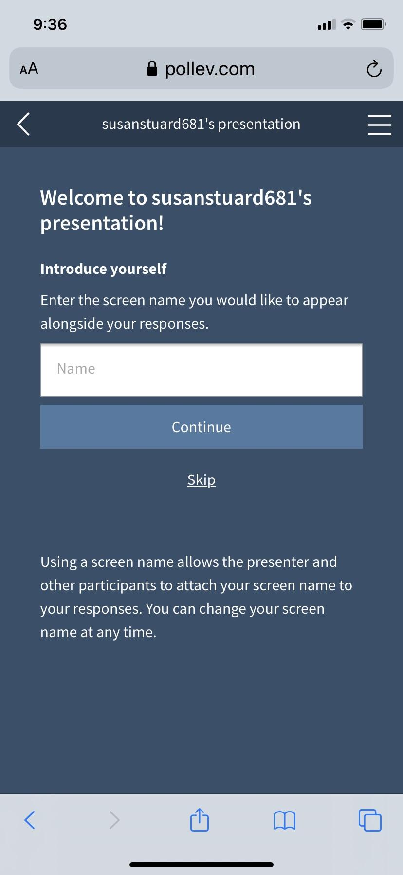
Electronic Voting Instructions
Poll Everywhere
Navigate to the link PollEv.com/cebpohsu300 and wait for the question prompts on your screen
You should be able to click on link inserted into the chat feature
If you wish to be anonymous, select the skip option when prompted to enter your name
Your device will automatically advance you to the active poll
Results will appear on the screen upon entry submission; you are allowed to change your responses if you wish

Slide 16
Notes:
Poll Title: Do not modify the notes in this section to avoid tampering with the Poll Everywhere activity. More info at polleverywhere.com/support Picture charades! Guess the movie. https://www.polleverywhere.com/free_text_polls/NyTXzCMzeyaQGD2MVfkh5

Slide 17
Notes:
Poll Title: Do not modify the notes in this section to avoid tampering with the Poll Everywhere activity. More info at polleverywhere.com/support How would you rate this training session overall? https://www.polleverywhere.com/multiple_choice_polls/6lK0jK4DVtEoGFNunHtxR?flow=Default&onscreen=persist

Slide 18
Notes:
Poll Title: Do not modify the notes in this section to avoid tampering with the Poll Everywhere activity. More info at polleverywhere.com/support As this session completes the training series, do you have any comments or suggestions to share with DHS? https://www.polleverywhere.com/free_text_polls/nCPfDB2jnlJwcYZWmJcfs

Slide 19
Thank you for your participation!

